Slide 1
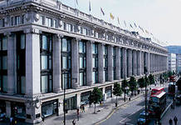
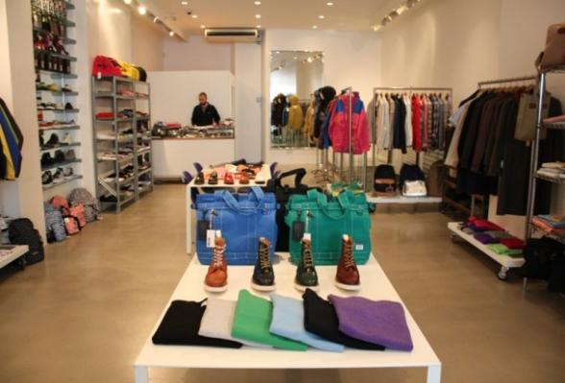
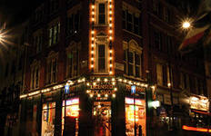
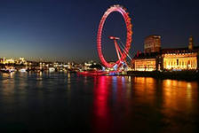

Slide 2
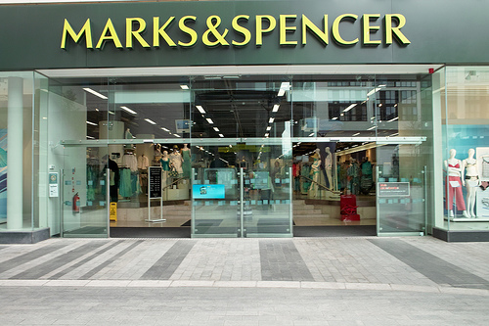
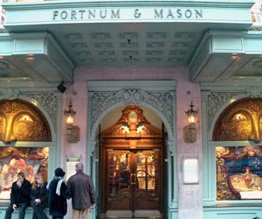
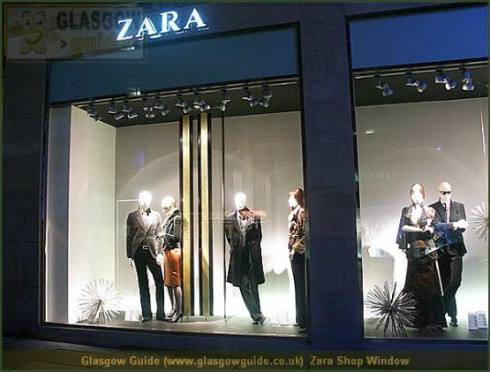
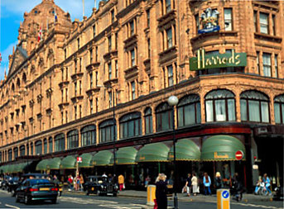

Slide 3
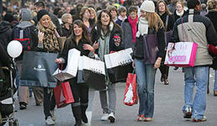
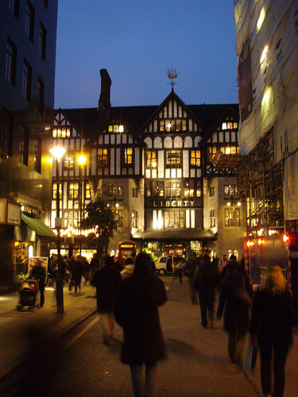

Slide 4
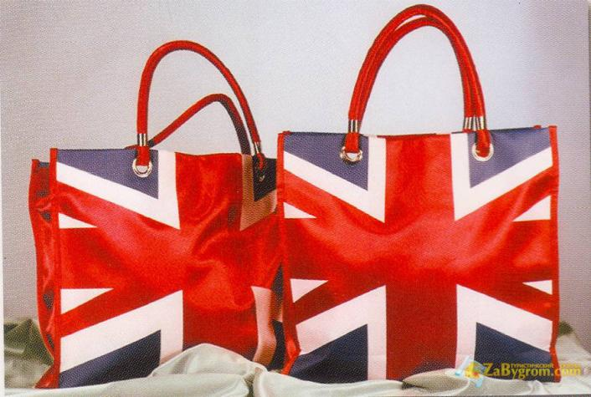
London shops

Slide 5
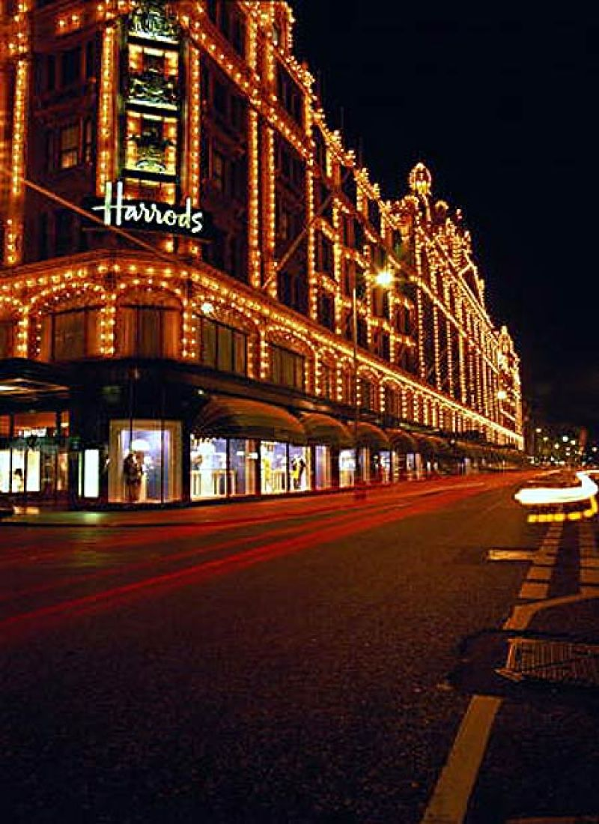
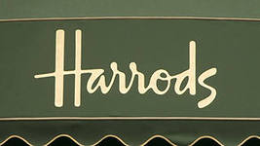

Slide 6
What do you know about harrods?
1. According to the speaker many people go to Harrods…
A-mainly to look and not to buy.
B- to buy expensive clothing.
C-to look for exclusive clothes.

Slide 7
2. Harrods is impressive because…..
A- it is a luxury shopping center.
B- it is huge.
C- it is situated in the center of London.

Slide 8
3. The speaker says it is easy……
A- to do shopping there.
B- to get lost there.
C- to choose what you like.

Slide 9
4. If you get hungry while shopping in Harrods you can go to…..
A- the food Hall.
B- one of the cafes.
C- one of the restaurants.

Slide 10
5. Here you can ………..
A- taste British cuisine.
B- taste European cuisine.
C- taste all kinds of cuisine.

Slide 11
Harrods has a big sale….
A- on Christmas Eve
B- all the year round
C- twice a year

Slide 12
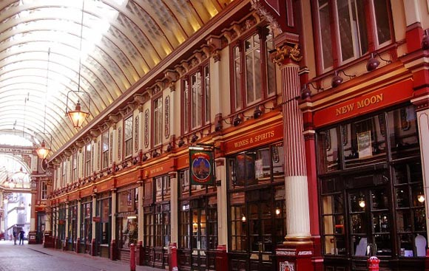
Some more facts about shopping in London

Slide 13
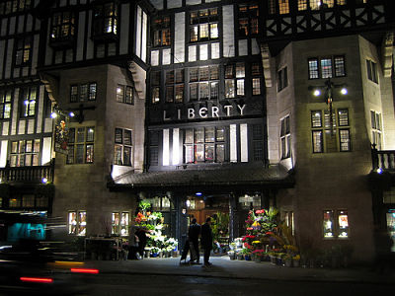
Liberty’s

Slide 14
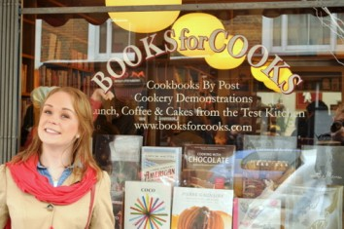
Books for cooks

Slide 15
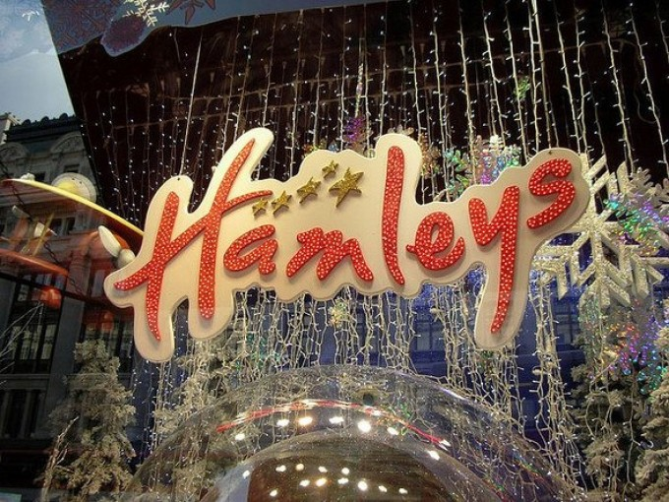

Slide 16
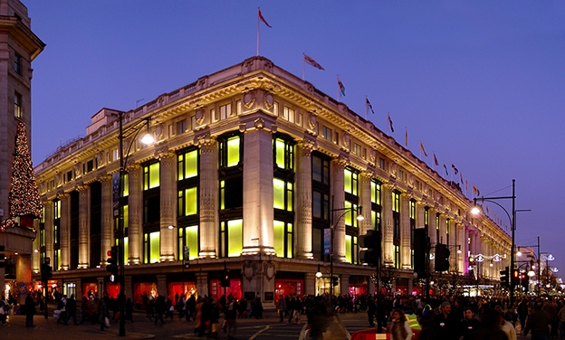
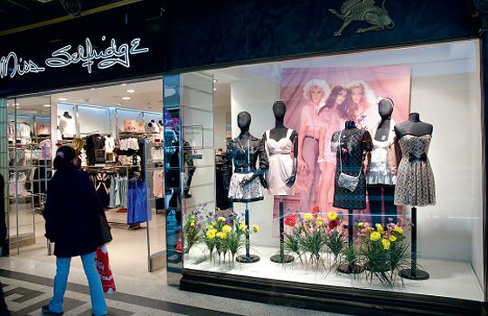

Slide 17
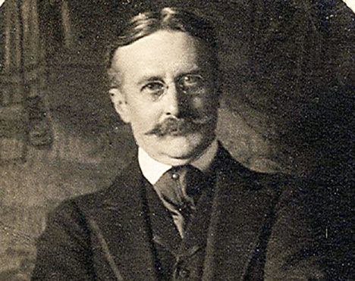
Harry Gordon Selfridge

Slide 18
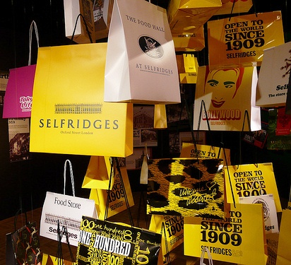
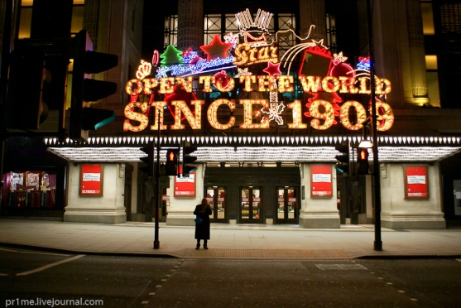
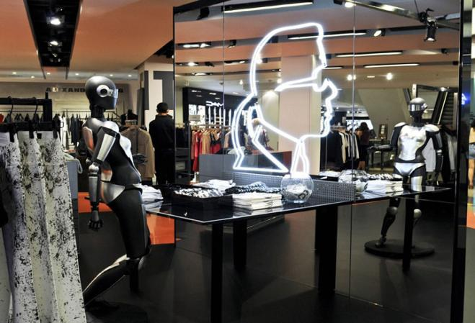
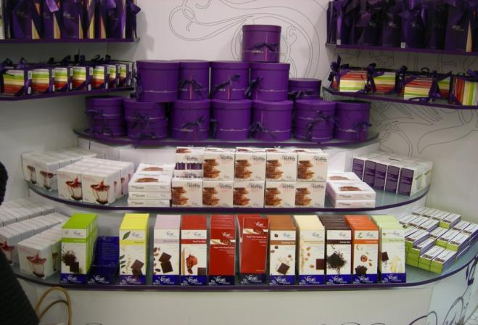

Slide 19
Hometask for the next lesson:
Tell about your favourite store
(you may use the words from the Topical vocabulary p. 130)

