Slide 1
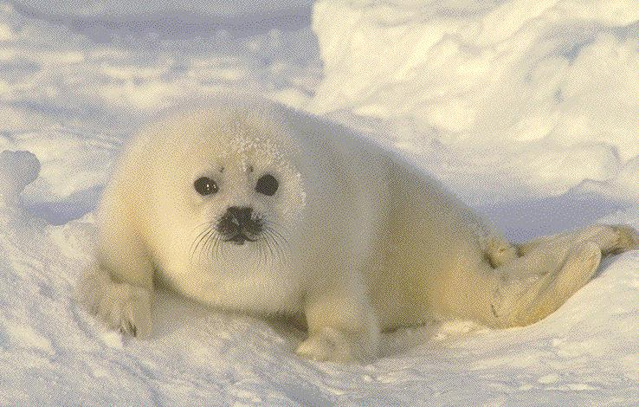
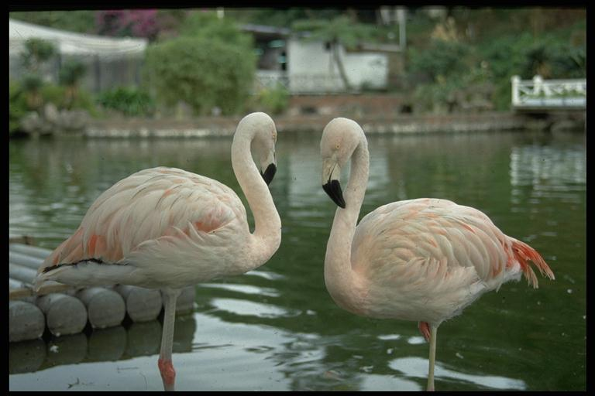

Animals
in our life
Animals
in our life

Slide 2
Polly has two puppies,
Peter has one,
Pam has a parrot
And I have none.

Slide 3
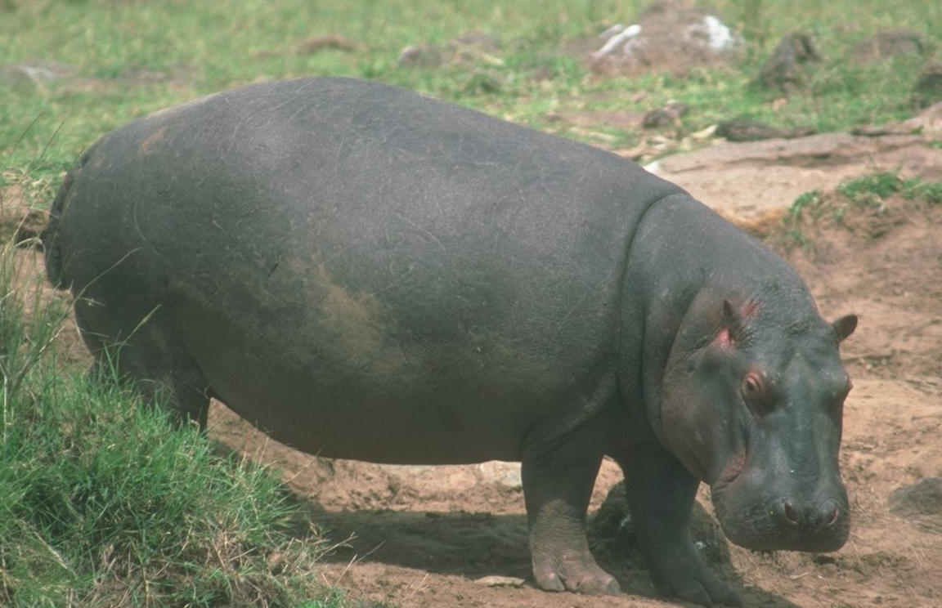
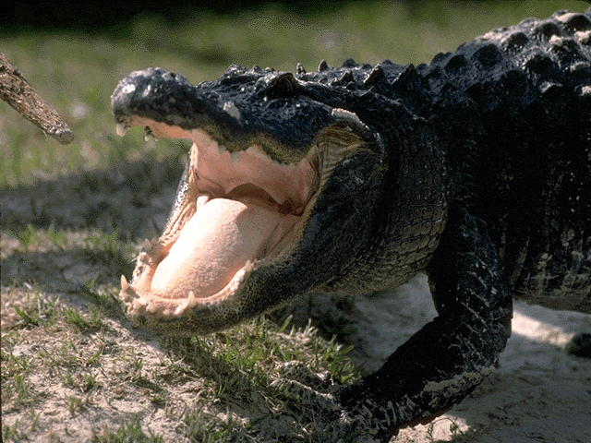
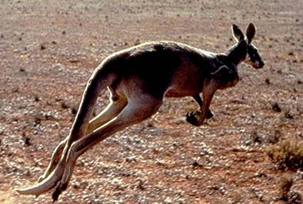
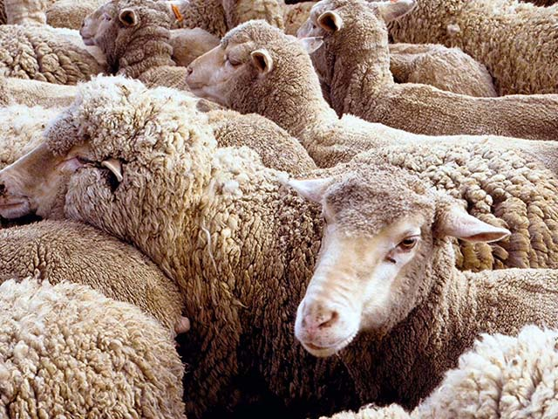

Slide 4
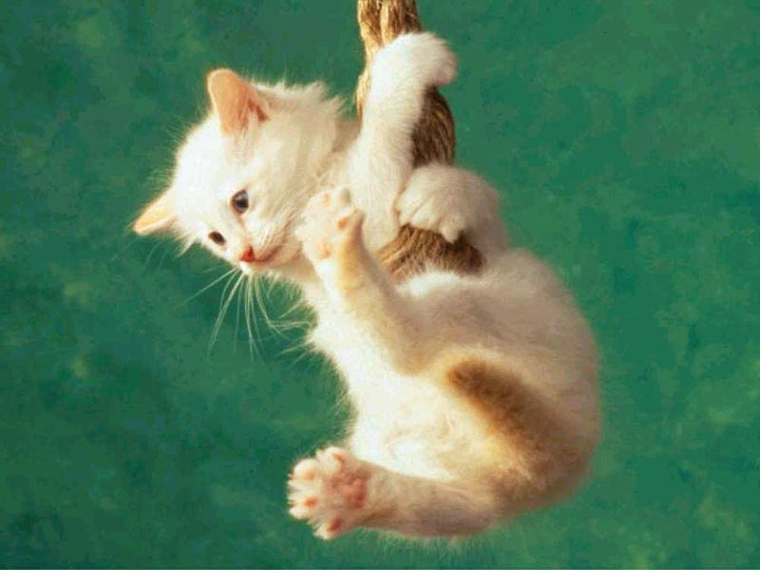
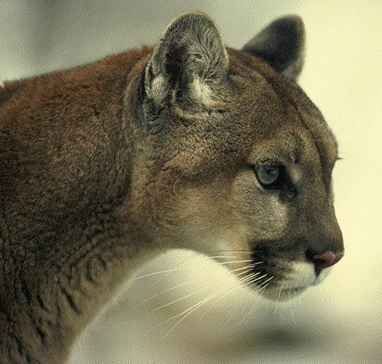
or
animals
Domestic
wild
animals

Slide 5
h | u | n | c | a | m | e | l | j | s | c
a | m | k | o | b | e | a | r | h | c | r
r | s | c | w | d | o | g | h | e | w | o
h | a | r | e | y | t | r | s | n | o | k
r | e | d | o | l | p | h | i | n | l | o
r | a | b | b | i | t | i | f | o | f | d
b | p | v | f | o | g | f | o | x | g | a
b | f | d | e | k | h | o | x | h | e | n
i | y | g | g | w | h | a | l | e | e | e
s | h | e | e | p | r | t | y | u | p | e
c | n | l | e | o | p | a | r | d | j | p

Slide 6
It is the biggest animal in the seas and oceans.
It has got a big mouth and a big tail.
It can swim and dive well.
It is a smart and strong animal.

Slide 7
It lives in Africa.
It has got four legs and a long neck.
It can run well. It likes to eat green leaves (листья).
It is a funny beautiful animal.
You can see it in the zoo.

Slide 8
It lives in the mountains.
It has got strong wings (крылья) .
It can fly high in the sky.
It eats mice, small birds and animals. It is strong and brave.

Slide 9
It lives in Australia.
It has got a long tail and strong legs. It can jump well.
It likes to eat grass and leaves.
It is a nice funny animal.

