Slide 2
Rain. Rain on the green grass, Rain on the tree. Rain on the house-top But not on me! Rain, rain, go away! Come again another day!

Slide 3
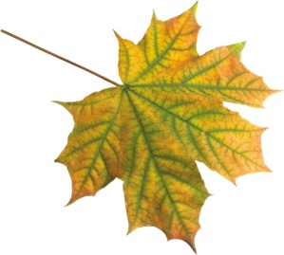
Rain
Rain on the green grass,
Rain on the tree.
Rain on the house-top
But not on me! Rain, rain, go away!
Come again another day!

Slide 4
I’m a little snowflake, Small and white. When the moon is shining I’m sparkling and bright. When you see me falling Come out and play. You can make a snowman With me today.

Slide 5
I’m a little snowflake, Small and white. When the moon is shining I’m sparkling and bright. When you see me falling Come out and play. You can make a snowman With me today.

Slide 6
My dear, dear Mummy, I love you so much, I want you to be happy On the 8th of March.

Slide 7
My dear, dear Mummy, I love you so much, I want you to be happy On the 8th of March.

Slide 8
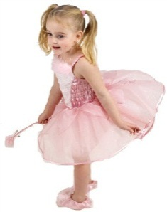

Slide 9
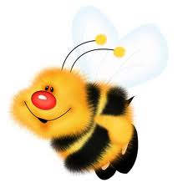
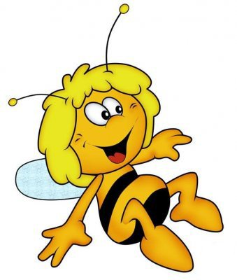
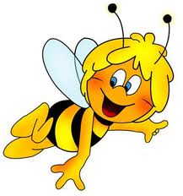
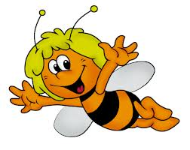
I
we
they
he
Have
Has
she
you
it

Slide 10
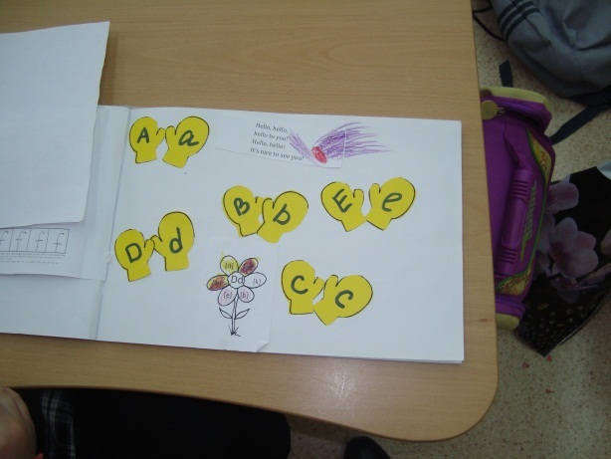
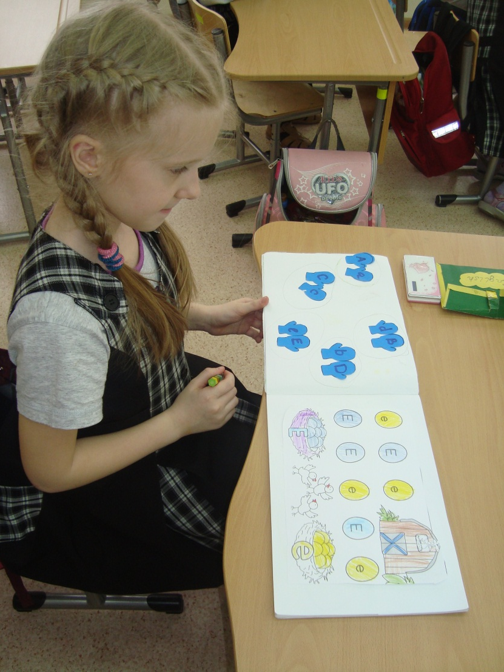
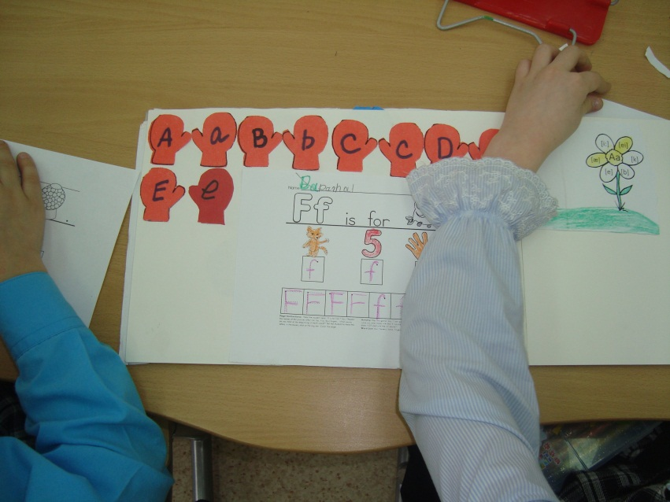

Slide 11
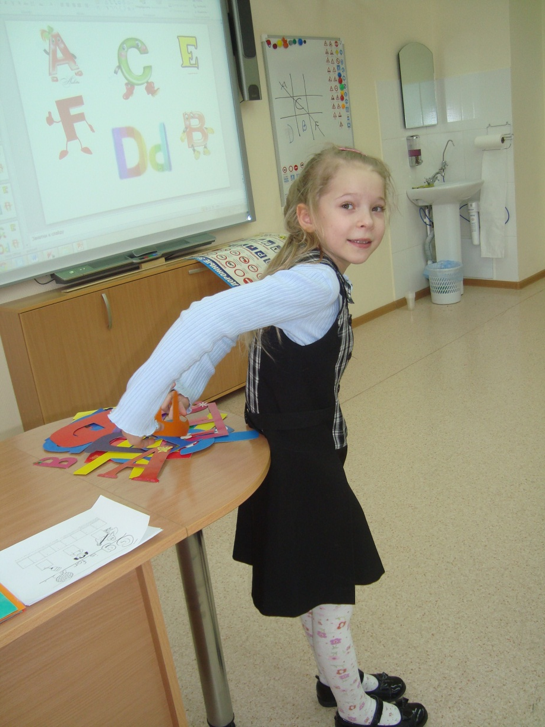

Slide 12
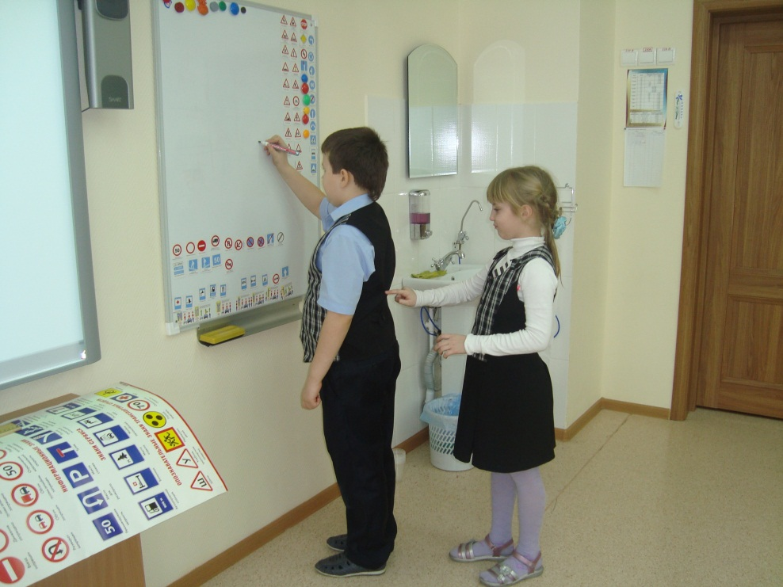
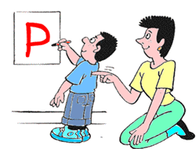
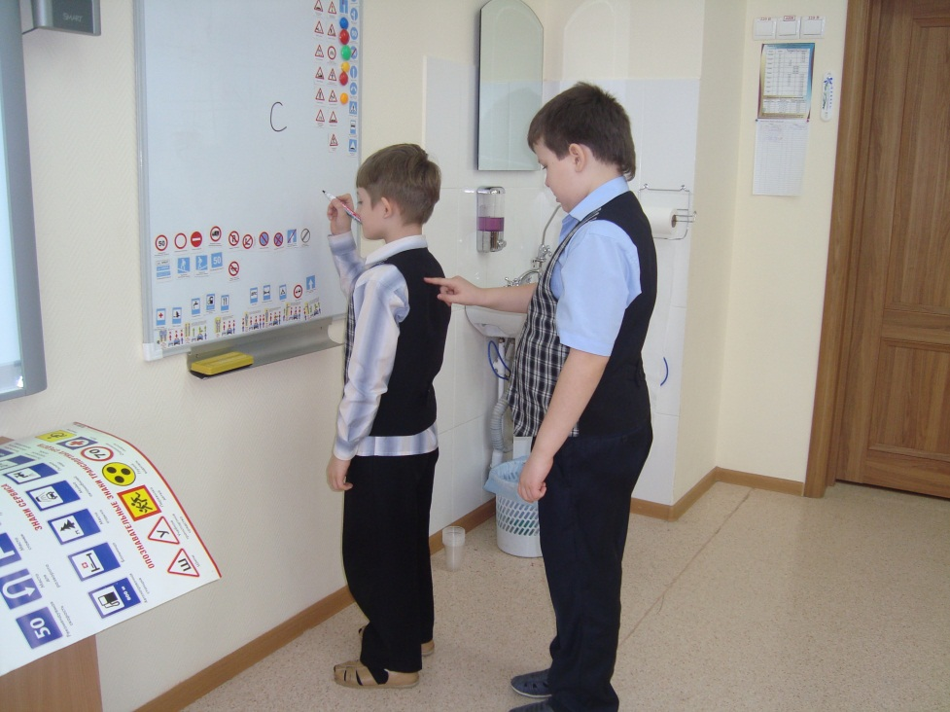

Slide 13
