Slide 1
WORK FOR A LIVING.
PLACES TO WORK
SKILLS
PROFESSIONS
INTERVIEW

Slide 2
WORK FOR A LIVING.

Slide 3
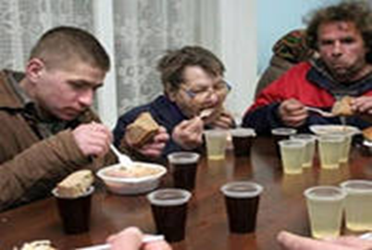
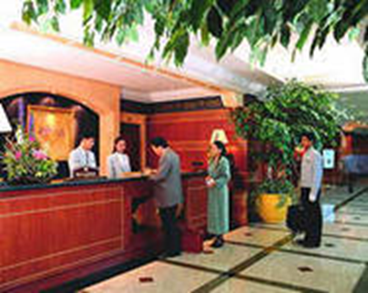
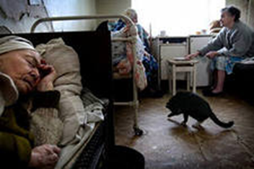
PLACES TO WORK
porter
lift attendant
civil engineer
bell-boy
ground crew
cook
doctor
nurse
social worker
surgeon
waiter
cashier
miner
cleaner
engineer
flight attendant
ambulance driver
air traffic controller
confectionary selector
conference organizer

Slide 4
QUALITIES SKILLS ABILITIES
be good with figures
be a people person
be a good listener
have a “can do” attitude
work well in a team
have an eye for detail
get the best out of other people
be good at using your own initiative
be able to meet tight deadlines
keep calm under pressure
honest
well-organized
ambitious
financial skills
managerial skills
artistic skills
language skills
patient
physically strong
emotionally strong
caring
calm
clean and tidy
punctual
interpersonal skills
flexibility

Slide 5
ACE JOB AGENCY
Student /Temporary job application
Name: …………………(1)
Address: ……………………(2) Conway Street, Cambridge
Subjects Studied: …………………(3)
Skills and experience/ Please tick.
 | YES | NO
Foreign Languages |  |  | 4
Waiting at table |  |  | 5
Cookery |  |  | 6
Sports |  |  | 7
Driving |  |  | 8
Typing/WP skills |  |  | 9
Shop assistant |  |  | 10
Cashier |  |  | 11
Music |  |  | 12
Work with children |  |  | 13
Office work |  |  | 14

Slide 6
Children’s Nanny required for 2 months. Full time help for 4 lovely kids, includes a month with the family in a villa near Rome. Must be able to drive. No pay, but a great experience! Tel: 342022
Research Assistant
required by university professor writing book on Mozart. Some musical knowledge desirable. Must be able to type. Driver preferred. 4 month vacancy. Would suit student. Office hours. Tel: 349822
WAITER/ KITCHEN ASSISTANT
REQUIRED
Seasonal Vacancy. No previous experience
necessary. Suitable for student.
Must be able to work under pressure
and for long hours. Language useful.
Full time plus some weekend work.
Good pay and tips. Telephone: 322450
Helper for friendly village hotel required
Early mornings and lunchtime only. Reception work, answering the phone, dealing with enquiries, handling money. Some typing. Summer vacancy. Suitable for flexible students. Pay plus breakfast & lunch. TEL: 344211

