Slide 1
IT & electronic learning resources
1. IWBs
2. Video
3. Computers
4. Distance learning
5. Internet contests

Slide 2
Neil Postman : “What is the problem for which this technology is the solution?”
Interactive White Boards
PROs
1 provide a change of focus,
2 deliver interesting content,
3 offer multiple functions that can keep learners engaged and entertained.
4 have the power to transform any classroom into a dynamic learning environment (suggested answers, word definitions, the audio, great illustrations, games and modern songs)
5 eliminate the time-consuming preparation
CONs
IWBs allow the learners to interact only with the content, not with other learners or language users.

Slide 3
IWB software: Access course

Slide 4
Access Online Games
School Objects
Places to go
Countries &
Nationalities
Weather Rooms
The animal kingdom
Signs Jobs
Food & drinks
Daily routines

Slide 5
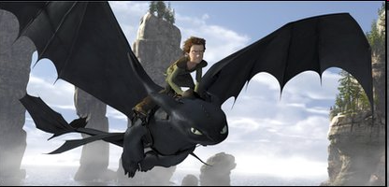
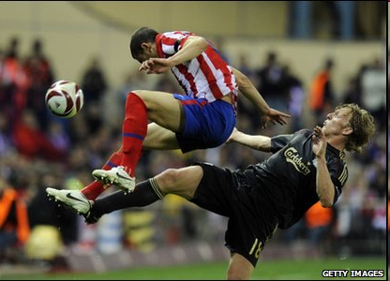
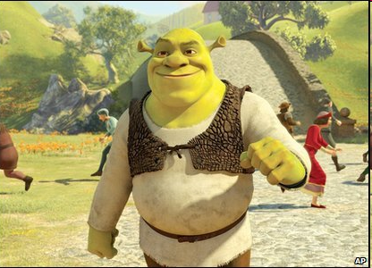
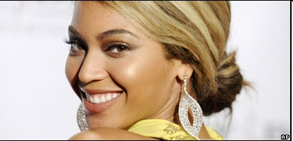
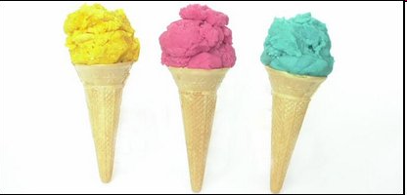
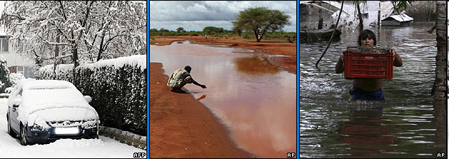
VIDEO CLIPS

Slide 6
Some tips
Using a clip
Advantages of using video clips
Possible problems
Choosing a clip:
Who will select the video
The topic of the video
Class objectives
Exploiting a clip:
Pre-teaching
While watching
After viewing
Conclusion

Slide 7
A Computer in Class to improve English teaching techniques
1. select target structure or function by deciding what students need to focus on considering past lessons and future goals.
2. select computer materials to be used: either are you going to use a program or the Internet.
3. plan the lesson in the typical four areas: warm-up, introduction of materials, class work, summary.
Use the computer as a springboard for useful discussion

Slide 8
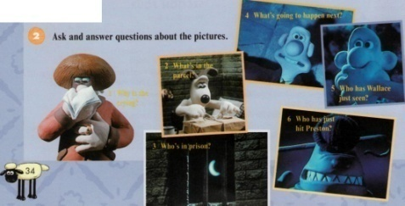
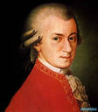
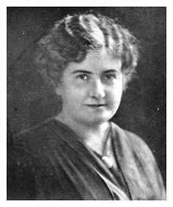
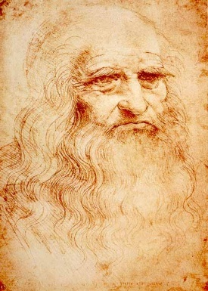
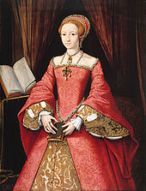
Distance learning:
Doing the tasks in home reading,
watching video ,reading articles ,
writing informal letters,
creating e- projects

Slide 9
Internet competitions
аn annual poetry competition
the best translation of some famous and not very well- known poems from English, French and German into Russian
Improve skills in English learning
Develop students` creative abilities

Slide 10
All information technologies and electronic resources are great learning tools should be regularly used in class . Any technology has its strengths and weaknesses the teacher should decide why and how often to turn to it

