Slide 1
Презентация к учебнику М.А. Гацкевич
The Mikhailovsky
Palace
Учитель английского языка
ГОУ СОШ № 180 г.Санкт-Петербург
Белоброва Е.Д.

Slide 2
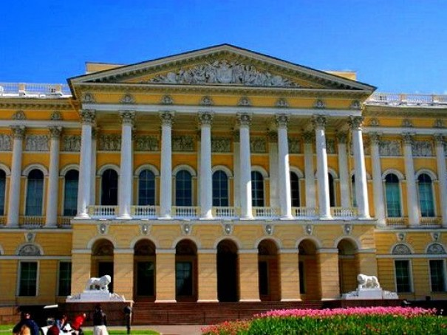

Slide 3
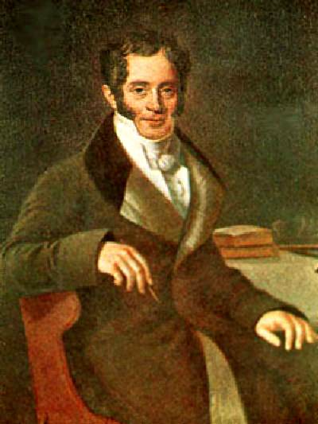
Carlo Rossi
(1775 – 1849)
was an Italian architect
worked the major portion
of his life in Russia.
He was the author of many classical buildings and architectural ensembles
in Saint -Petersburg
and its environments.

Slide 4
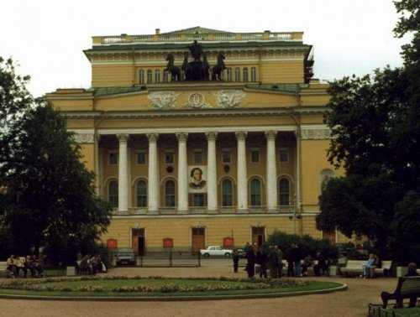

Slide 5
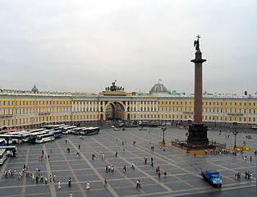

Slide 6
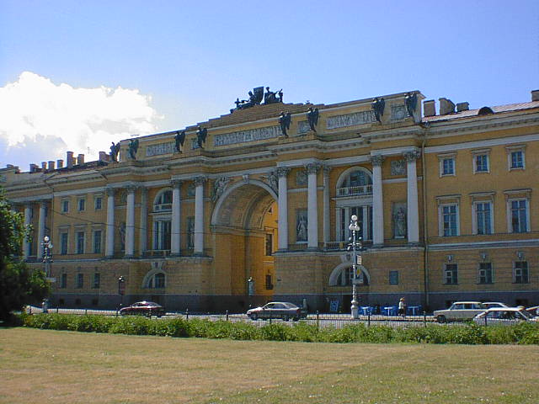

Slide 7
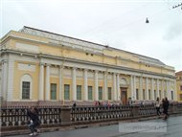

Slide 8
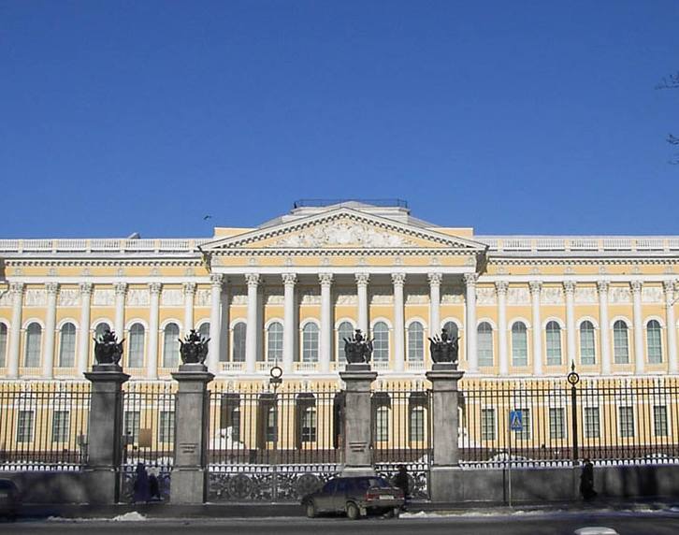

Slide 9
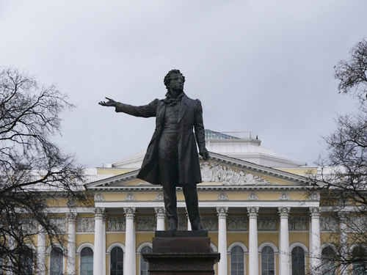

Slide 10
http://visitpetersburg.invest.gov.spb.ru/img/v3/qHfQvcOoTE96OoqaVoNLq688cg00S9.jpg
http://www.nearyou.ru/0rumuz/mihdv/rossi.jpg
http://www.luxury2.ru/files/images/-театро.preview.jpg
http://upload.wikimedia.org/wikipedia/commons/thumb/5/59/Hermitage_from_inside.jpg/313px-Hermitage_from_inside.jpg?uselang=ru
http://commons.wikimedia.org/wiki/File:Senatesynod.jpg?usela
http://www.nearyou.ru/0rumuz/virt1.php
http://22-91.ru/upload/images/photo/_rev1/15_1293218115.jpg

