Slide 1
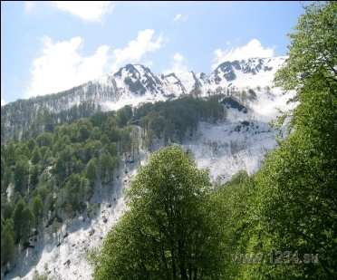
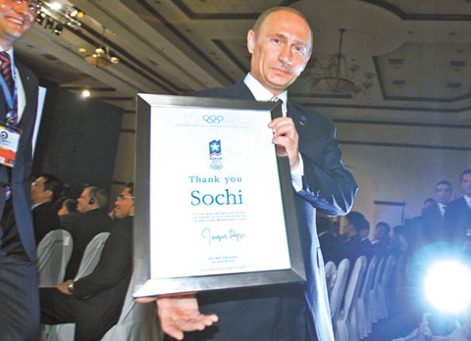
Презентация к уроку английского языка в 11 классе «How beautiful the world is!»

Slide 2
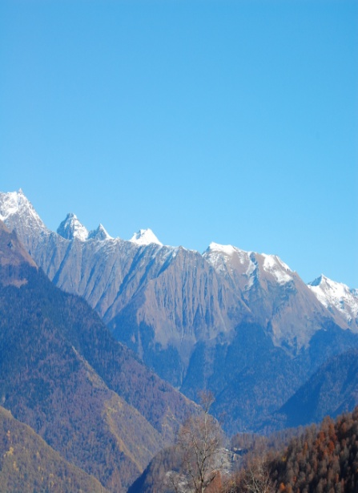
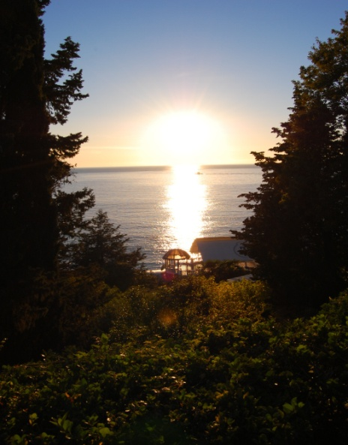
Beautiful nature of the Northern Caucasus

Slide 3
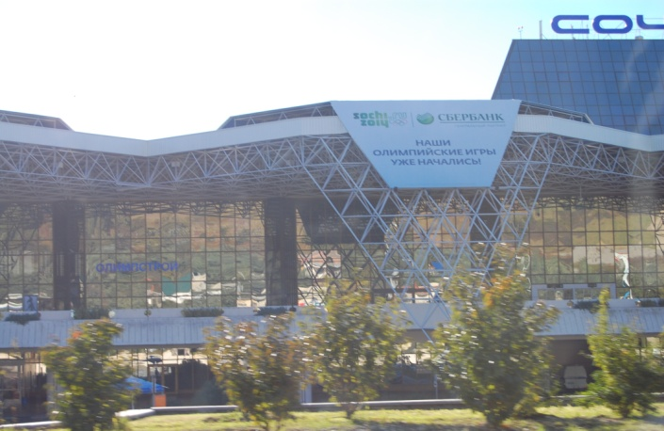
International airport in Sochi

Slide 4
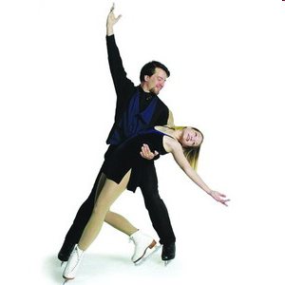
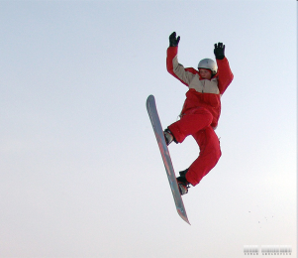
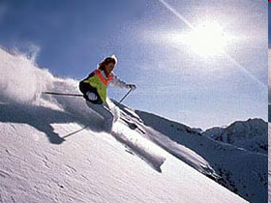
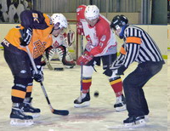
The winter season attracts sportsmen to the Krasnaya Polyana resort

Slide 5
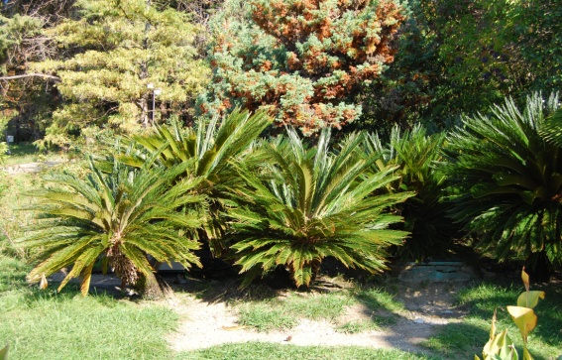
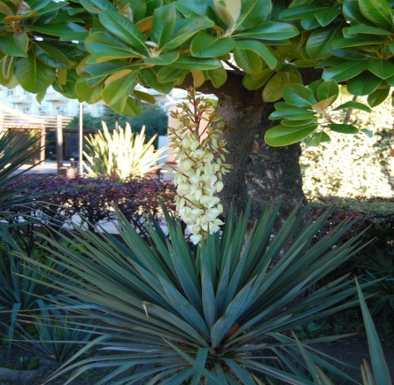
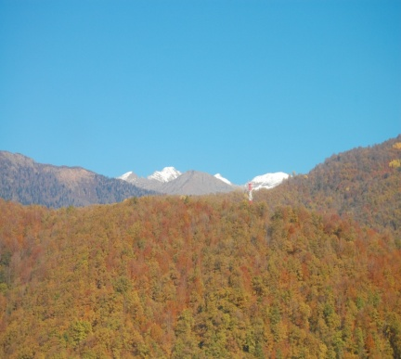
There is sunshine and greenery all year round in Sochi

Slide 6
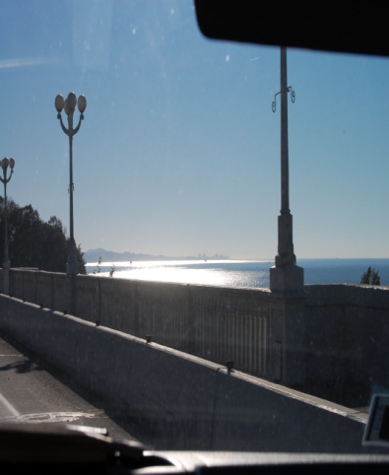
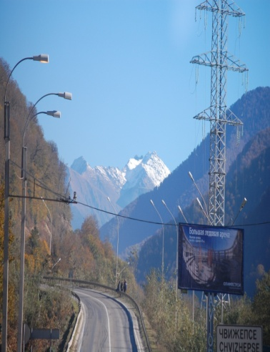
From warm sea to snow-capped mountains

Slide 7
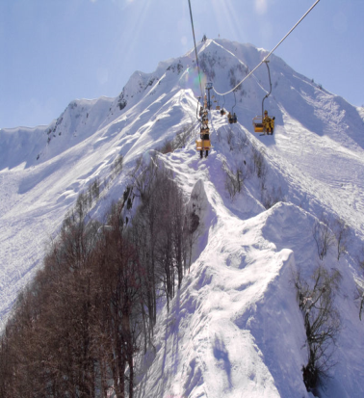
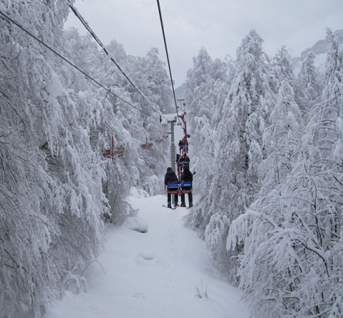
Sochi a host-city of the Winter Olympics - 2014

Slide 8
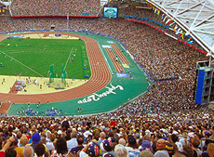
Sochi will host guests from all over the world

Slide 9
Ecological appeal to the guests of the 2014th Winter Olympics
Respect the life and the work of the countryside.
Help to keep all water clean.
Protect wildlife, plants and trees.
Don’t spoil the parks and gardens-don’t leave litter.
Don’t damage the Black Sea coasts.
Don’t take flowers and plants.
Put your litter in the bin.

