Slide 1
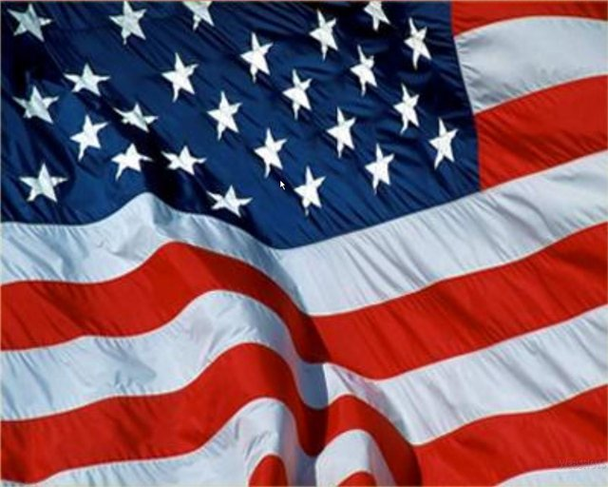
Political system of the USA
Подготовила учитель английского языка
МБОУ СОШ №1
г. Мичуринска
Тамбовской обл.
Желтикова Светлана Витальевна

Slide 2
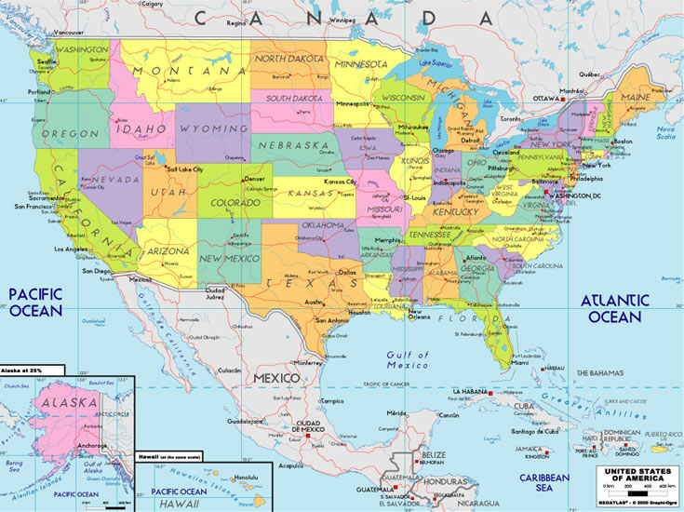
- The United States of America is a federal republic consis­ting of 50 states. - Each state has its own government .

Slide 3
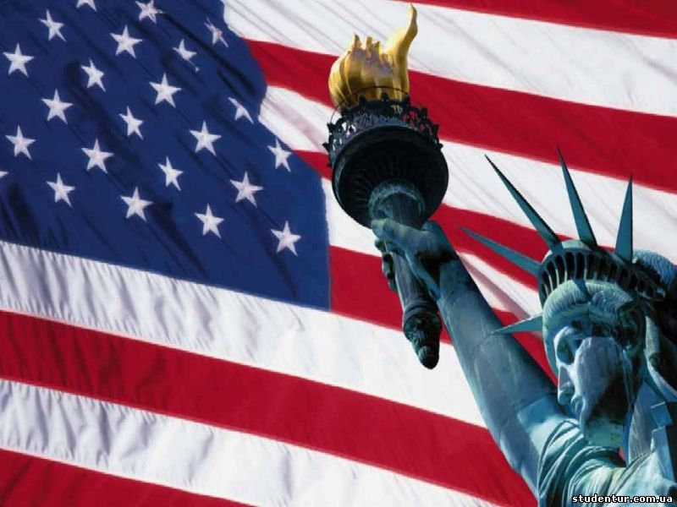
The government of the USA act according to the Constitu­tion which was signed by the first thirteen representatives of thirteen original American states in 1787.
- Every citizen has rights which can not be violated.

Slide 4
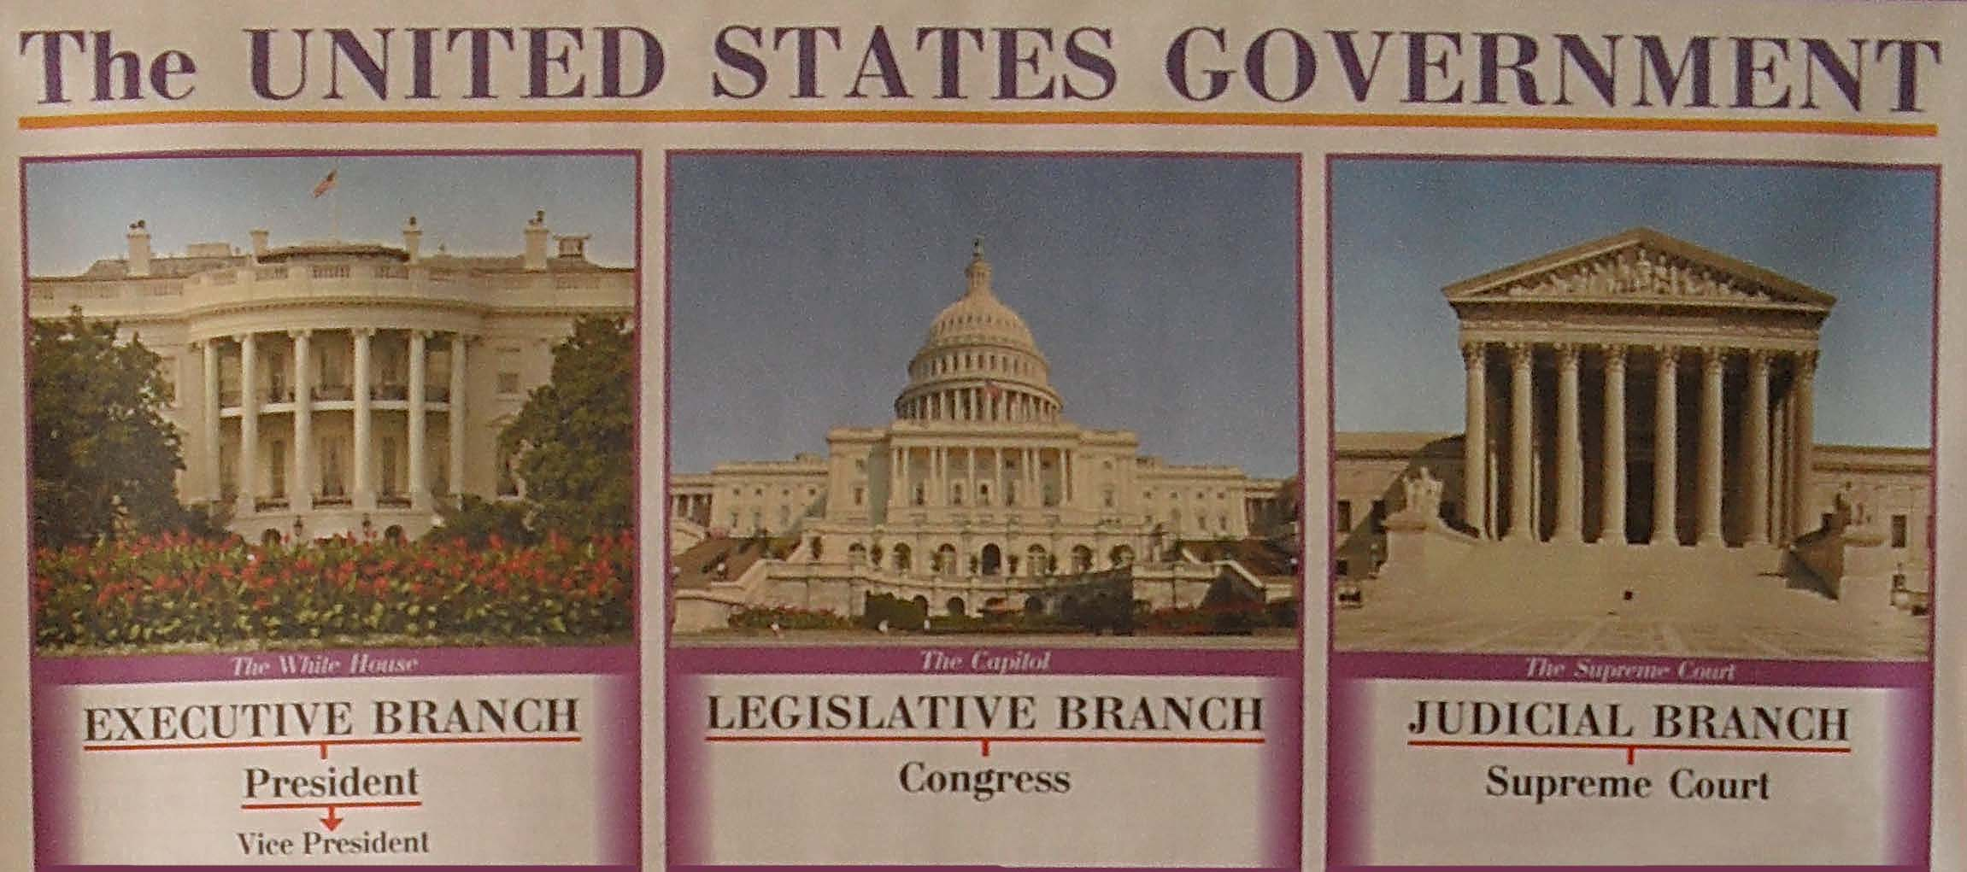
The federal power is located in Washington, D.C. It is based on legislative, executive and juridical branches of power.

Slide 5
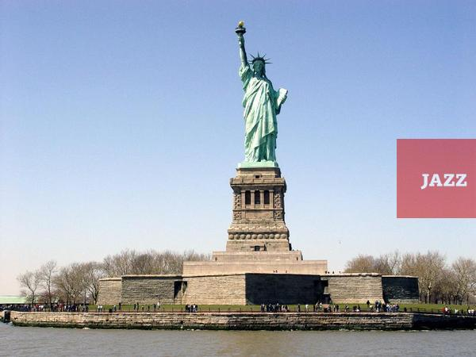
- The legislative branch of the Government is represented by the Congress. - The main function of it is law making.
The House of Representatives
- 435 members
- Every state is represented
- The members are elected every two years
The Senate
- 100 members
- The period of Senator’s serving is 6 years
-A Senator has to be
at least 30 years

Slide 6
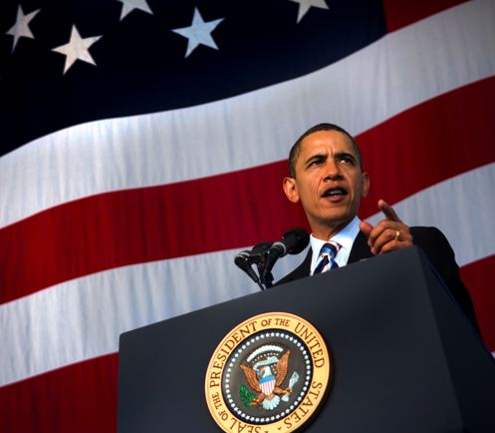
The executive branch of the Government
The President
The Cabinet of the President
Vice - President
- The executive branch is headed by the President who is as­sisted by the Vice President.
- The Vice President acts as chairman of the Se­nate, and in the event of the death of the President, assumes the Presidency.
- The Cabinet is made up of Department Secretaries. The most im­portant of them is the Secretary of State, who deals with fo­reign affairs.

Slide 7
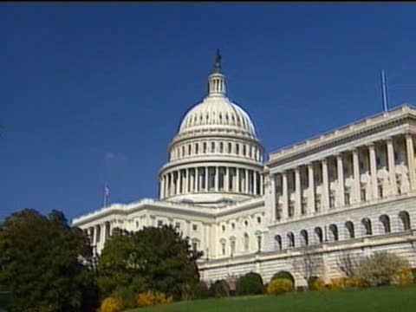
The judicial branch of the Government
The judicial branch is made up of Federal District Courts, 11 Federal Courts and the Supreme Court.
Federal judges are appointed by the President for life.
Federal courts decide ca­ses involving federal law, conflicts between citizens of diffe­rent states.

Slide 8
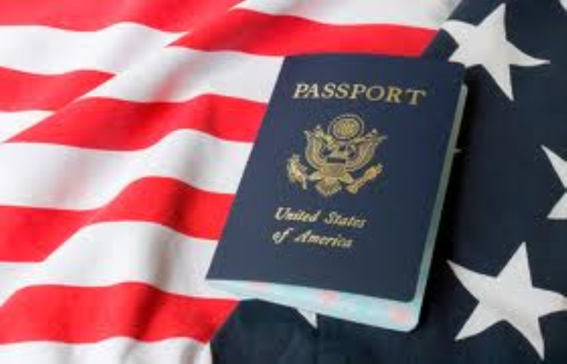
- Constitution has been amended twenty six times.
- The Bill of Rights guarantees individual liberties: freedom of word, religion and so on.
- Later amendments abolished slavery, gran­ted the vote to women and colour people and allowed citizens to vote at the age of 18.

Slide 9
Ресурсы:
http://www.amerikos.com/usa/political-system-s/
http://engmaster.ru/topic/2181
http://xn--e1aogju.xn--p1ai/shemy/politologija/isaev-b-a-politologija-v-shemah-i-komentarijah-2009-g/51.html
http://www.alleng.ru/engl-top/071.htm
http://www.bestreferat.ru/referat-39515.html
http://images.yandex.ru/yandsearch?text=политическая%20система%20америки%20фото&img_url
http://video.yandex.ru/#search?id=38484789-04-12&where=all&text=

