Slide 1
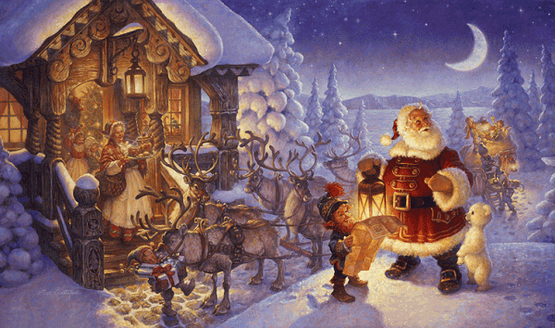
Christmas Traditions
Prezentacii.com

Slide 2
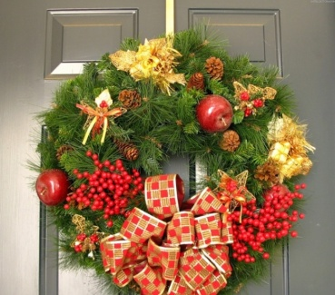
Content:
Santa Claus
Winter Festivals & Traditions
Fruitcake
Poinsettias
Christmas lights
Christmas Stockings
History of the Christmas Tree
Mistletoe
Christmas Gifting
The Three Wise Men or Kings
The Candy Canes of Christmas
Christmas Carols and Caroling

Slide 3
Santa Claus
Santa Claus, also known as Saint Nicholas, Father Christmas, Kris Kringle, or simply "Santa", is an old man who, in many brings gifts to the homes of the good children during the late evening and overnight hours of Christmas Eve, December 24.

Slide 4
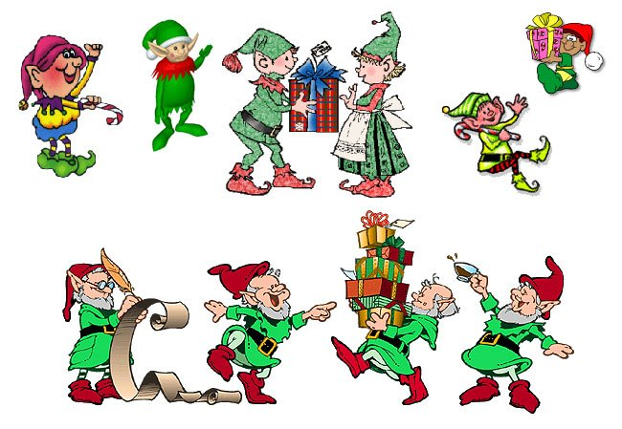
Santa Claus is generally depicted as a plump, jolly, white-bearded man wearing a red coat with white collar and cuffs, white-cuffed red trousers, and black leather belt and boots .
Santa Claus lives at the NORTH POLE, with a large number of magical elves, and nine (originally eight) flying reindeer.

Slide 5
Winter Festivals & Traditions
November 1....................................... All Saints Day November 11..................................... St. Martin's Day (Germany) Last Thursday in November................ Thanksgiving Day (USA) Fourth Sunday before Christmas........ Advent begins December 6 ...................................... St. Nicholas Day December 8....................................... Bodhi Day in the Buddhists' faith December 10..................................... Hannukah begins (date varies) December 13..................................... Santa Lucia's Day (Italy, Sweden) December 15 - 16 ............................ Posados or Novena begins December 17 .................................... Hannukah ends (date varies) December 19..................................... St. Nicholas Day (Julian Calendar) December 20 .................................... St. Ignatious' Day in Romania December 20/21................................ Winter Solstice December 21..................................... St. Thomas' Day December 23..................................... Little Christmas in Denmark December 24..................................... Christmas Eve

Slide 6
December 25.......................... Christmas Day
December 26..................................... St. Stephen's Day, December 26..................................... Boxing Day in England December 26..................................... Kwanzaa Begins December 27..................................... St. John's Day, Mother Night December 28 .................................... Holy Innocents Day December 30 .................................... Bringing in the Boar December 31 .................................... New Year's Eve, St. Sylvester's Eve, December 31 .................................... Hogmanay in Scotland January 1........................................... New Year's Day, St. Basil's Day January 2 .......................................... Snow Day, Holde's Day January 3........................................... Evergreen Day January 4 .......................................... St. Distaff's Day January 5 .......................................... Epiphany Eve January 6 .......................................... Epiphany, Three Kings Day, Twelfth Night January 7 .......................................... Russian Christmas First Monday after Epiphany............... Plough Monday in England's traditions January 13 ........................................ Twentieth Day, January 13 ........................................ St. Knut's Day in Scandanavia

Slide 7
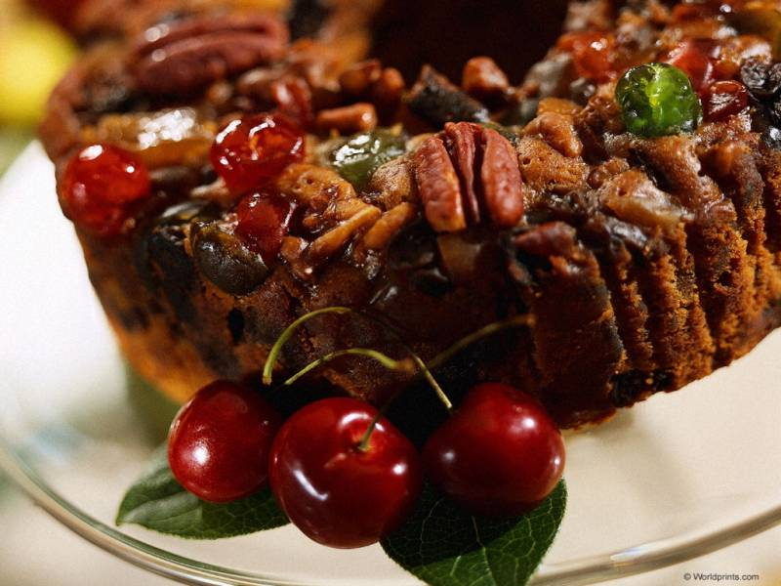
Fruitcake
Fruitcake is for many families the giving and receiving of a favorite, though often ridiculed, traditional food. Fruitcake is considered to be a part of many families' Christmas traditions just as important as having a Christmas tree.

Slide 8
Poinsettias
Poinsettias are believed to have originated in central and south America and were recorded, described, and revered by the ancient Aztec peoples. This flowering plant eventually became a symbol of Christmas to the Mexican culture and it became a tradition to use poinsettia plants to decorate during Christmas time.

Slide 9
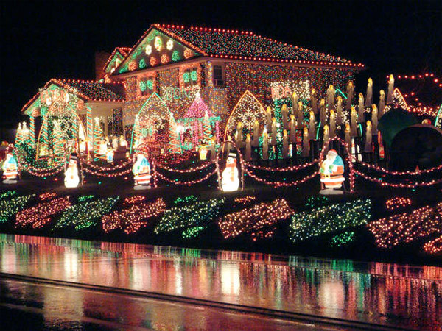
Christmas lights
Christmas lights at one time were candles, chosen because their twinkling appearance reminded families of the twinkling of moon light through the branches of fir trees in the forest. Despite the safety precautions taken by these early Christmas light users, mixing live flame with highly flammable Christmas trees resulted in a very dangerous situation and many fires resulted.

Slide 10
Christmas Stockings
Christmas Stockings Many families will hang large brightly colored Christmas stockings over the fireplace or on the walls of their homes during Christmastime in the hopes that Santa Claus will fill them with toys, treats, and goodies. In fact, families have been hanging stockings for as long as there have been stockings!

Slide 11
History of the Christmas Tree
The tradition of having an evergreen tree become a symbol of Christmas goes back past recorded written history.
The Druids in ancient England & Gual and the Romans in Europe both used evergreen branches to decorate their homes and public buildings to celebrate the Winter Solstice. Over the years, these traditions were adopted by Christians, who incorporated them as part of their Christmas holiday celebration.

Slide 12
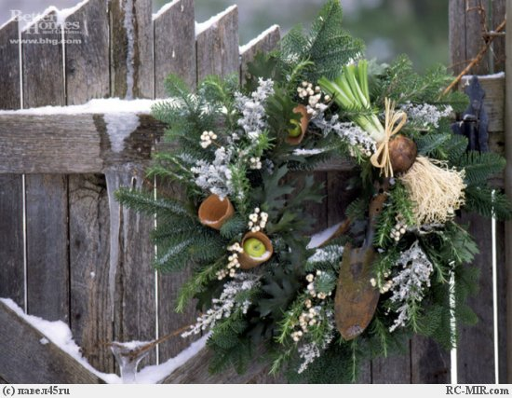
Mistletoe
Mistletoe was often hung over the entrances to homes of the pagans in Scandinavian countries to keep out evil spirits. An old Scandinavian myth tells of the seemingly invulnerable god, Balder, who was struck down by a dart made from mistletoe. The tears of this mother, Frigga, became the white berries of the mistletoe, and it was decreed that the plant must never again be used as a weapon.

Slide 13
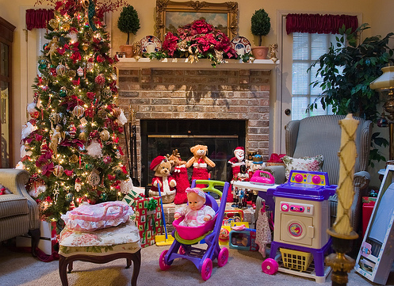
Christmas Gifting
The idea of presenting people you love with gifts is as old as the human race. The idea of exchanging gifts at Christmas time originated with the birth of Jesus, when three wise men traveled to deliver gifts of gold, frankincense, and myrrh to the newborn baby. Shepherds in the fields also came to give gifts to the newborn baby Jesus.

Slide 14
The Three Wise Men or Kings
The Three Wise were always a part of the Nativity scene. The story of a visit of wise men to the Christ Child is told in the bible in St.Mathhew 2:1 tells us: "...Now when Jesus was born in Bethlehem of Judaea in the days of Herod the king, behold, there came wise men from the east to Jerusalem . . ." This Bible passage doesn't state how many wise men actually came from the east nor does it mention their names or their method of travel. It is only assumed they traveled by camel and they could have easily traveled by foot. The Bible doesn't claim these men to be kings, however it is speculated they were at least learned men and perhaps even astrologers.

Slide 15
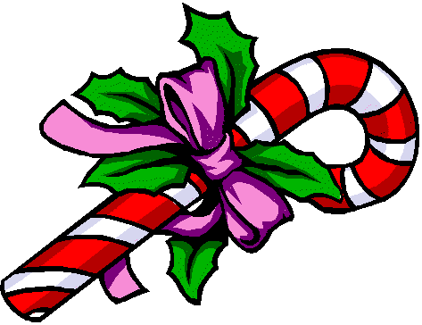
The Candy Canes of Christmas
Candy cane sweet treats made primarily from boiled sugar seem to have first appeared in Europe in the late 1600’s to early 1700’s. They were made in many different colors (most often white) and shapes (most often straight sticks), evolving to the familiar cane or upside down J shape with the red and white stripes in the early 1900’s.

Slide 16
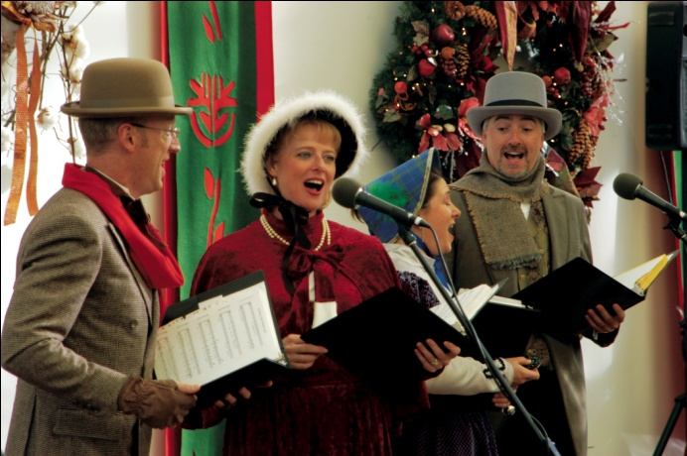
Christmas Carols and Caroling
Christmas carols and caroling in the old world was a mix of singing and dancing and was practiced for all festivals throughout the year. When Christmas was firmly established to be celebrated on December 25th, many of the existing carols (or songs) were sung on that day and new ones written to celebrate Christmas.

Slide 17
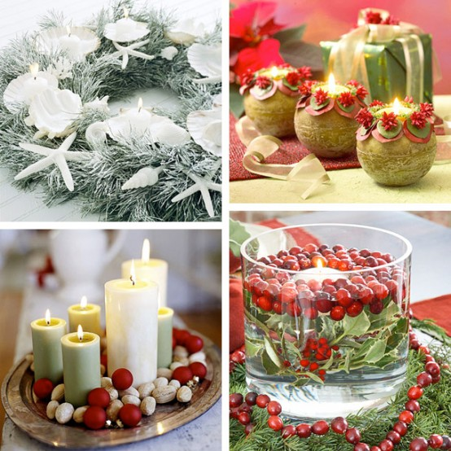
THANK YOU VERY MUCH

