Slide 1
Презентация к учебнику М.А. Гацкевич
The Admiralty
Учитель английского языка
ГОУ СОШ № 180 г.Санкт-Петербург
Белоброва Е.Д.

Slide 2
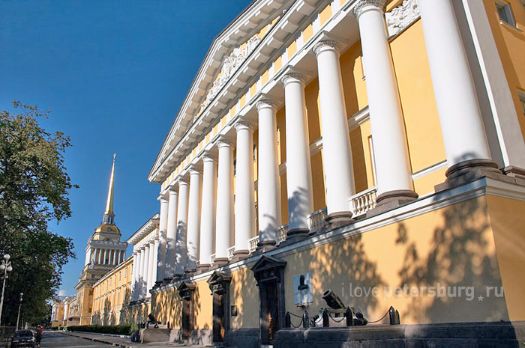
The present building was constructed after the design of the architect Andreyan Zakharov
The main façade is 407 meters wide.

Slide 3
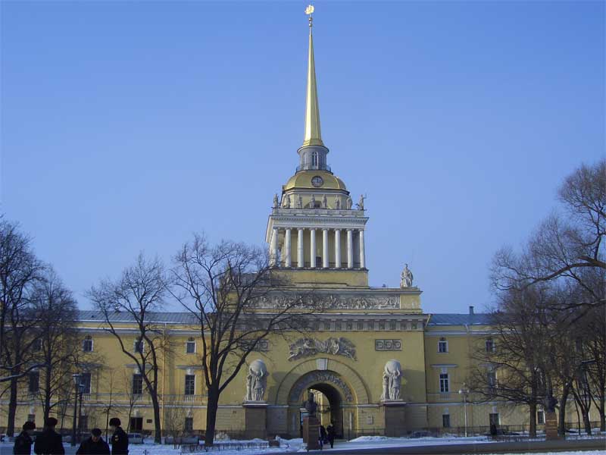
In the centre of the façade there is a tower with an entrance arch.

Slide 4
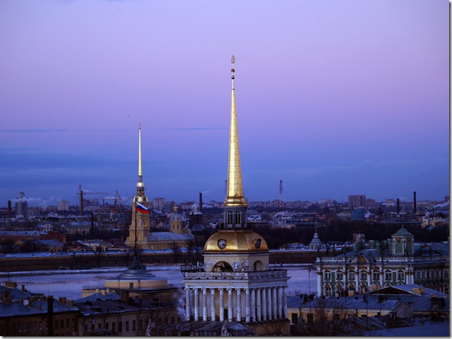
The tower is adorned with a colonnade and crowned with a cupola and a gilded spire.

Slide 5
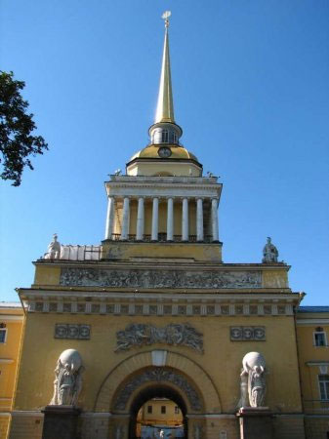
On both sides of the arch
there are nymphs carrying
the terrestrial and celestial spheres.

Slide 6
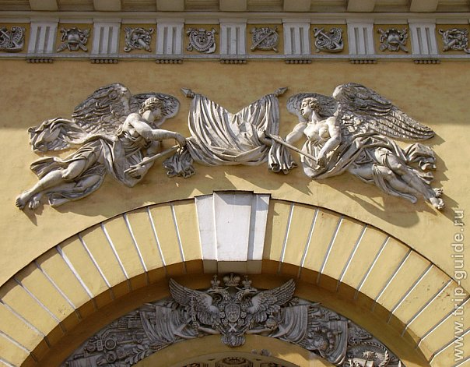
Two Geniuses of Glory are above the arch.

Slide 7
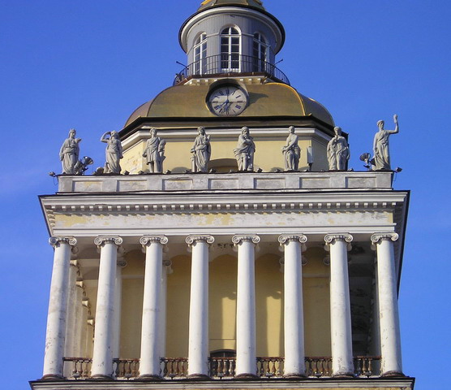
The colonnade circling the base of the spire is decorated with 28 statues.

Slide 8
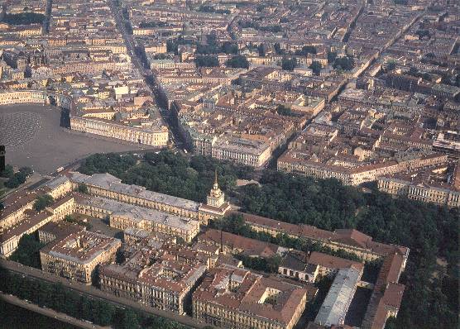
Thу grandiose building consists of two U-shaped wings.

Slide 9
Использованные интернет-ресурсы
http://forum.vgd.ru/file.php?fid=9604&IB2XPforum_=6adfad981cbf71f244df81ad91ea6319
http://www.spb-guide.ru/img/7915/325.jpg
http://lifeglobe.net/media/entry/456/1310645_3.jpg
http://findmapplaces.com/bphoto/33/vostochnaya-arka-admiralteystva_335646.jpg
http://files.germany.ru/wwwthreads/files/1880-5504945-10.jpg
http://domensever.net/images/photos/medium/4863d21e5506cd37d8cd6a595bf90c5e.jpg
http://www.zayavka.org/files/images/00005.jpg
http://www.echo.msk.ru/att/element-633163-misc-ad1.jpg
http://www.ilovepetersburg.ru/sites/default/files/arhitector_pamytnik/admiralteystvo/admiralteystvo_2.jpg
http://deva-sova.spb.ru/img-afina/afina_admiralteistvo_5.jpg
http://russel.narod.ru/SPB/BIG/admiral_2b.jpg

