Slide 1
“a QUICKLY-MINDED EXPLORER”
УЧЕБНИК АФАНАСЬЕВОЙ 5 КЛ
Задания к аудированию

Slide 2
PUT THE MISSING WORDS INTO THE SENTENCES:
A hotel was in the …. of the city.
Corner b) center c) left
2. Two … were talking near the hotel.
Men b) man c) mans
3. The first person looked for … and found it.
Rooms b) silver coins c) money
4. He … all the money and ran out from the hotel.
Take b) taked c) took
5. He wanted to visit … countries.
Hot b) cold c) foreign
6. The second person was a … .
a) Fireman b) policeman c) policewoman
7. The first person said that he never tell … about the things that never took place.
a) Stories b) fairy tales c) story ‘s

Slide 3
The right answers:
B
A
C
C
C
B
A

Slide 4
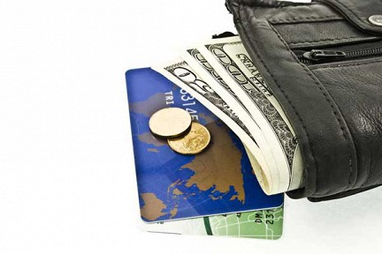
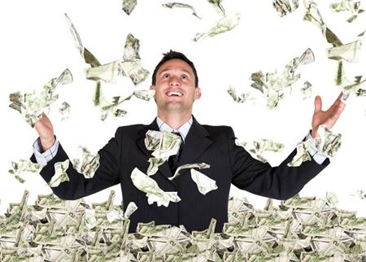
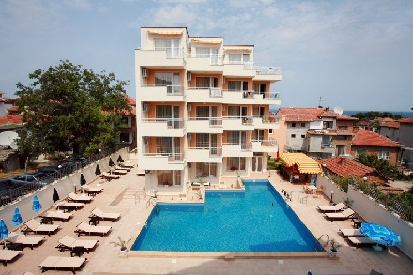
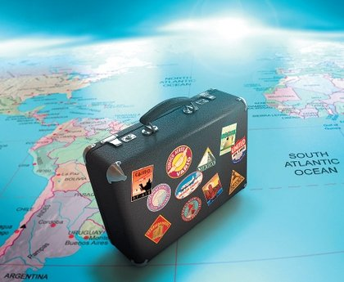
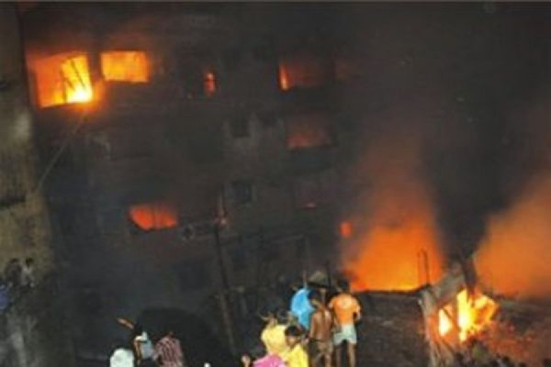
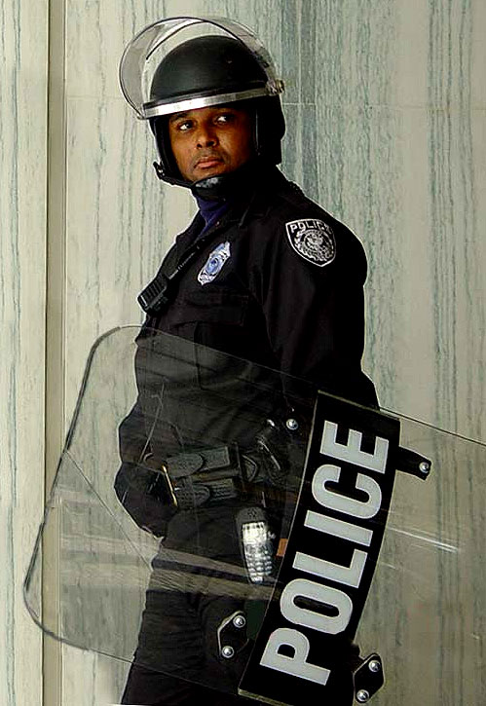
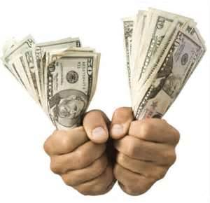
A
B
C
F
D
E
G

