Slide 1
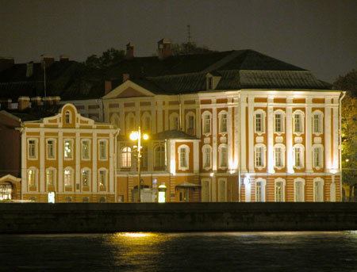
School180@inbox.ru
The Twelve Collegiums Building
Презентация к учебнику М.А. Гацкевич «Санкт-Петербург»
Учитель английского языка
ГБОУ СОШ № 180
Санкт-Петербург
Дмитрук Л.Е.

Slide 2
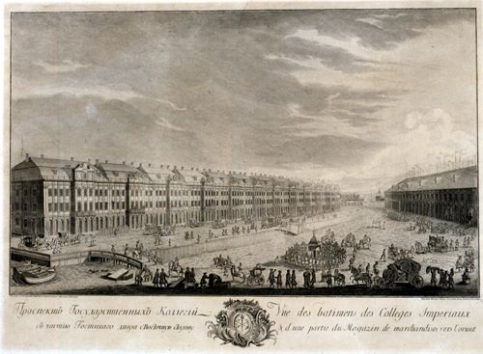
This building is one of the oldest in the city

Slide 3
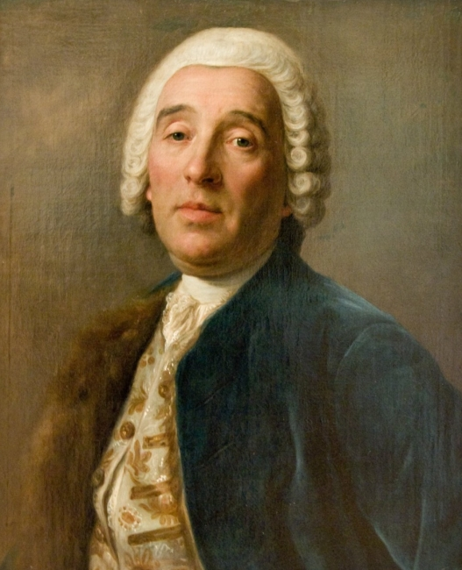
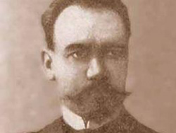
The construction of the Twelve Collegiums building was started after Domenico Trezzini’s project in 1722
The construction was finished only in 1742 by Mikhail Zemtsov
Domenico Trezzini

Slide 4
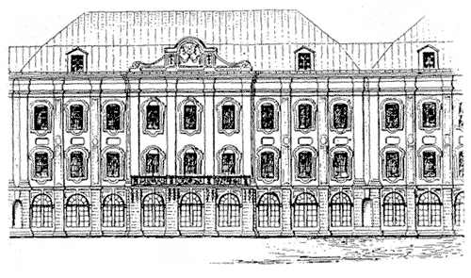
The building is divided into twelve identical but independent sections. Each of the twelve parts of the building has its separate roof.

Slide 5
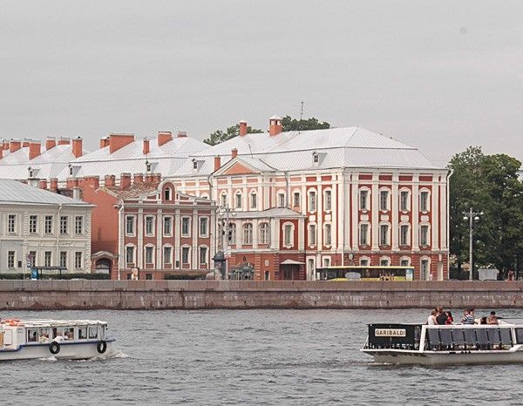
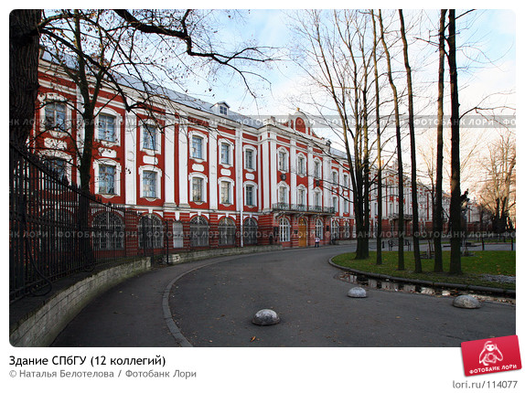
One end of the building faces the Neva, the main facade stretches for nearly half a kilometre into the island.

Slide 6
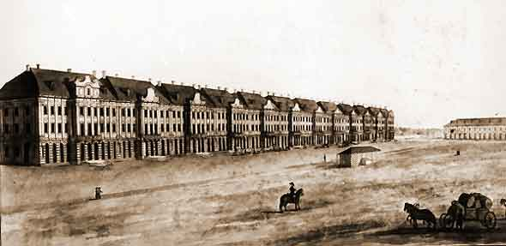
Important administrative reforms by Peter I were put into effect at that time. The numerous state establishments (prikazy) were replaced in 1718 by “collegiums” set up by Peter the Great.

Slide 7
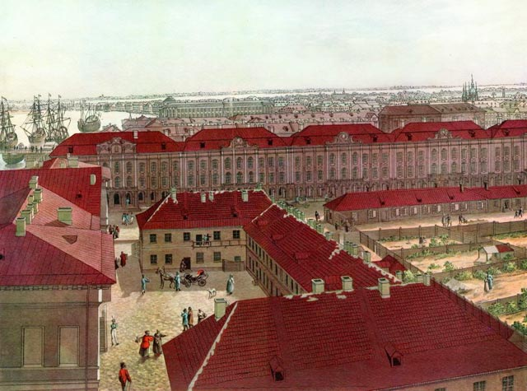
The colleges were committed in the direction of certain branches of economy and state services. At the beginning of the 19th century they were reorganized into ministries.

Slide 8
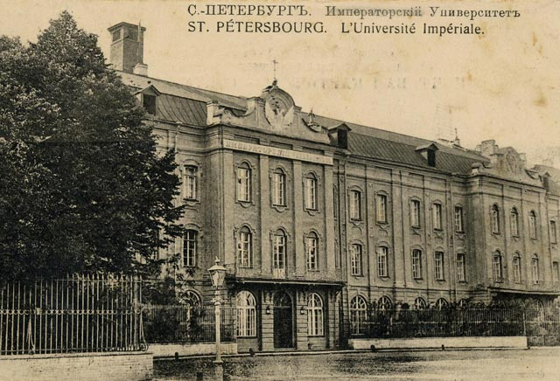
In 1819 the building was taken over by St Petersburg University. Many Russian scholars have made this educational institute famous.

Slide 9
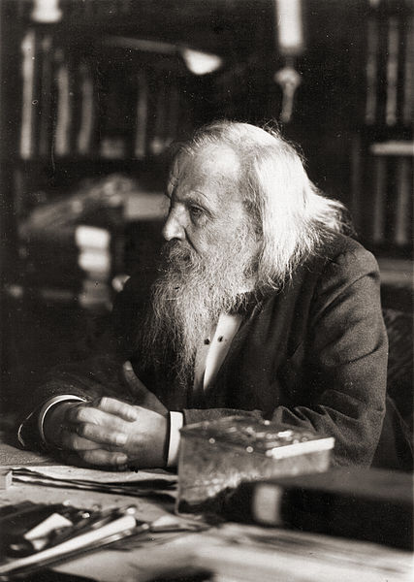
From 1866 to 1890 the outstanding Russian chemist, Dmitry Mendeleyev (1834-1907), lived and worked at the university. Mendeleyev is famous for having formulated the Periodic Law and invented the periodic table of elements.

Slide 10
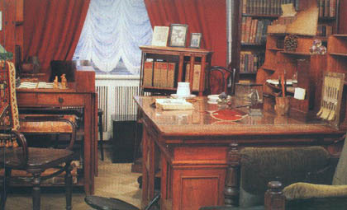
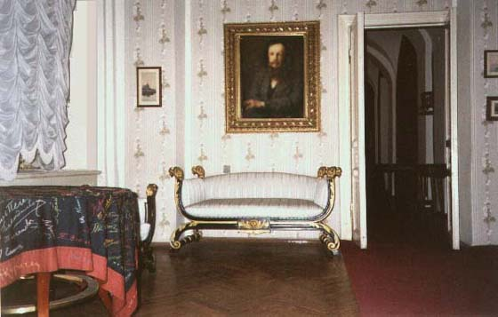
Nowadays, the apartment in the university where he lived for nearly twenty-five years is a museum. It’s open to the public.

Slide 11
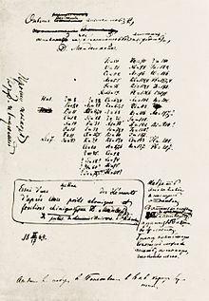
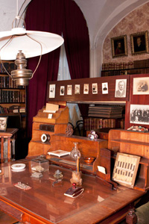
The history of the discovery of the Periodic Law of elements figures in the exposition. Instruments from Mendeleyev’s laboratory are on display here.

Slide 12
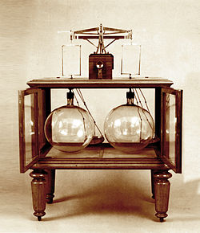
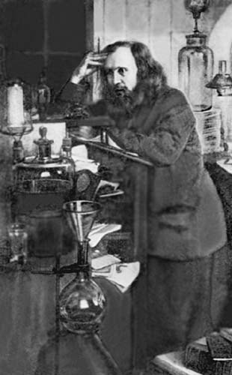
They are a barometer and a two-tiered balance for weighing solid and gaseous substances actually designed by Mendeleyev.

Slide 13
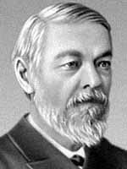
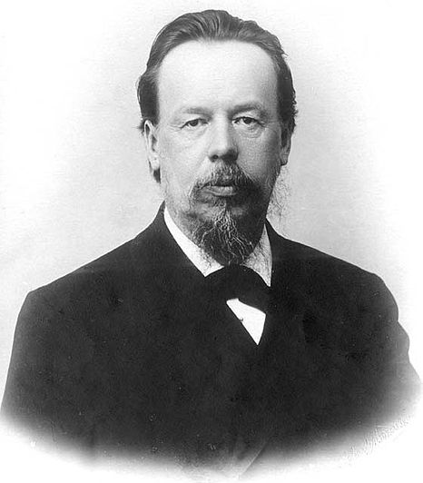
Many prominent scientists and writers worked here, among them:
the naturalist
Ivan Sechenov
Alexander Popov,
inventor of the radio

Slide 14
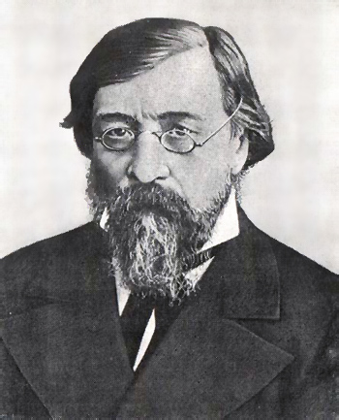
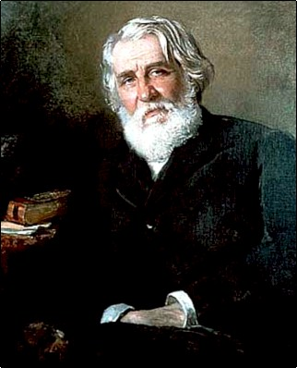
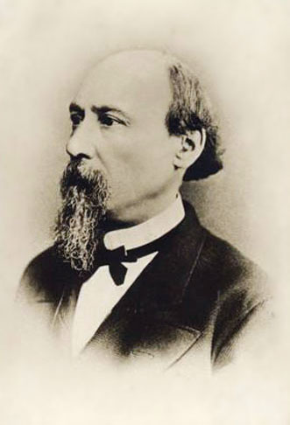
Many prominent scientists and writers worked here, among them:
the writers
Nikolay
Chernyshevsky
Nikolay
Nekrasov
Ivan Turgenev

Slide 15
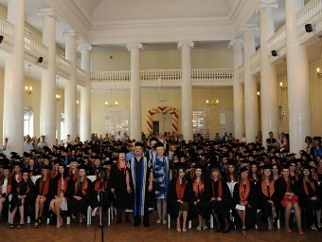
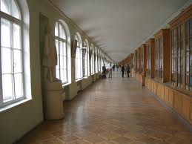
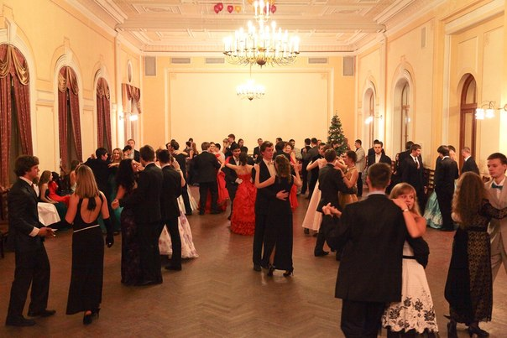
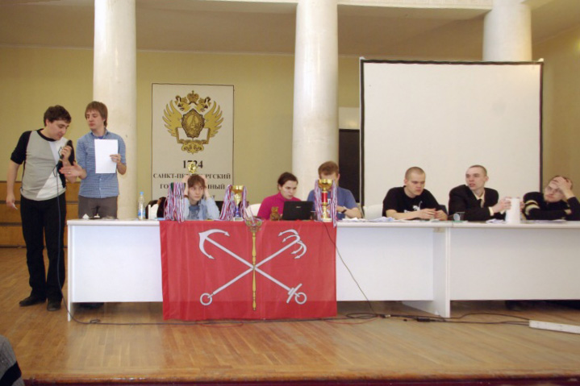
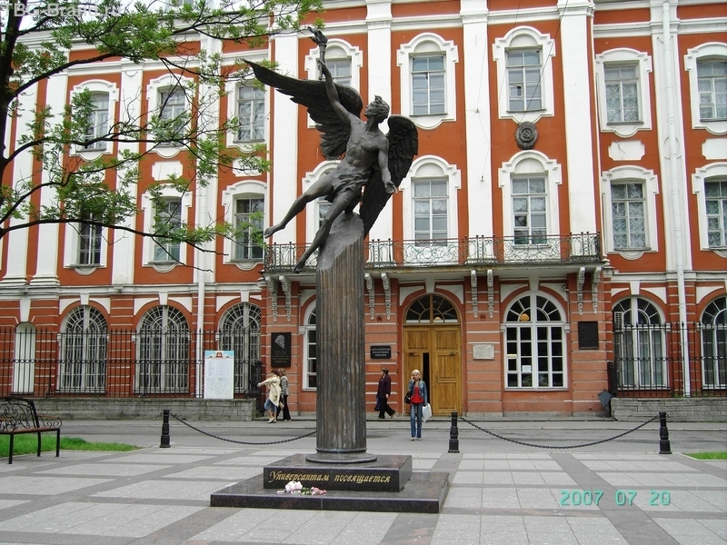
Nowadays, over 17,000 students are enrolled in its departments

Slide 16
Интернет-ресурсы
http://commons.wikimedia.org/wiki/File:Twelvecollegia.jpg?uselang=ru
http://www.enlight.ru/camera/272/index.html
http://www.ipetersburg.ru/guide/sights/monuments/ruka-tvortsa/
http://www.peterburg.biz/zemtsov-mihail-grigorevich.html
http://festival.1september.ru/articles/210520/
http://drugoypiter.ru/place/12ti_kollegiy.htm
http://lori.ru/114077
http://www.spbumag.nw.ru/2003/15/19.shtml
http://www.hellopiter.ru/Building_of_twelve_boards.html
http://commons.wikimedia.org/wiki/File:DIMendeleevCab.jpg?uselang=ru
http://spbu.ru/structure/uprav/sit/150-structure/structure/uprav/372-mendeleev-museum
http://s-pb.in/museums/museum-of-mendeleev
http://ru.wikipedia.org/wiki/%D0%9D%D0%B0%D1%83%D0%BA%D0%B0_%D0%B2_%D0%A0%D0%BE%D1%81%D1%81%D0%B8%D0%B8
http://journal.spbu.ru/?p=676
http://vk.com/zamyjnaya
http://upload.wikimedia.org/wikipedia/commons/a/a7/Sechenov.jpg?uselang=ru
http://commons.wikimedia.org/wiki/File:Popov.jpg?uselang=ru
http://commons.wikimedia.org/wiki/File:Nikolay_Chernyshevsky.jpg?uselang=ru
http://hidden-facts.info/archives/temnaya-storona-turgeneva/
http://ru.wikipedia.org/wiki/%D0%9D%D0%B5%D0%BA%D1%80%D0%B0%D1%81%D0%BE%D0%B2,_%D0%9D%D0%B8%D0%BA%D0%BE%D0%BB%D0%B0%D0%B9_%D0%90%D0%BB%D0%B5%D0%BA%D1%81%D0%B5%D0%B5%D0%B2%D0%B8%D1%87
http://lenta.ru/news/2012/11/10/filfak/
http://dic.academic.ru/dic.nsf/ruwiki/16455

