Slide 1
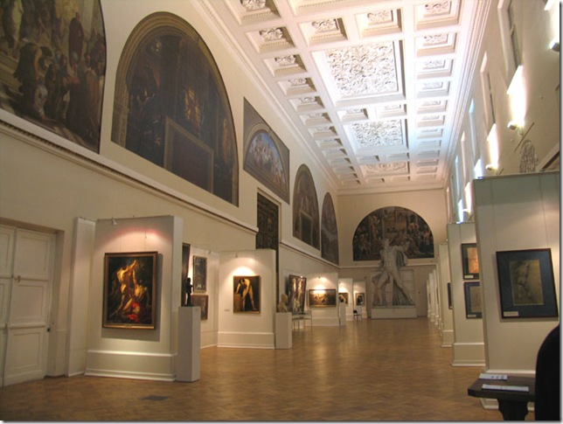
Учебное пособие М.А. Гацкевич «Санкт-Петербург»
Презентация
по теме: «Академия художеств» для уч-ся 9 класса
Учитель английского языка
высшей категории
ГБОУ СОШ № 180
Красногвардейского района СПБ
Дмитрук Л.Е.

Slide 2
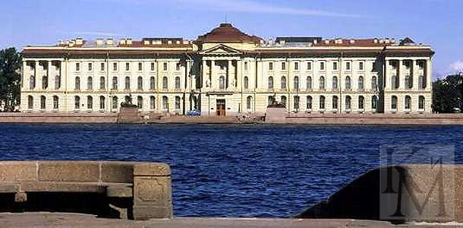
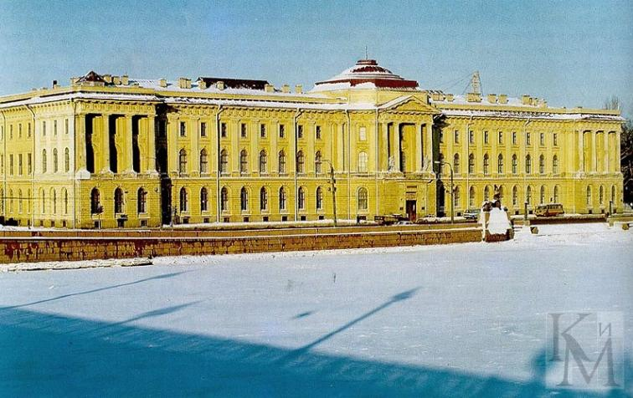
The Academy of Arts
The main facade of the Academy of Arts overlooks the Neva.

Slide 3
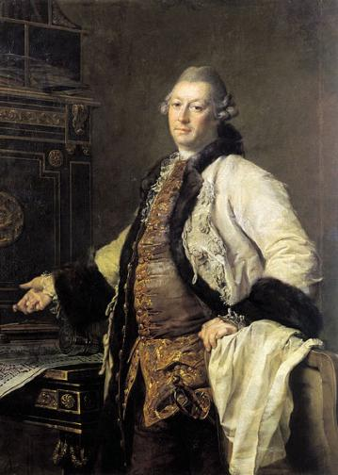
The building was designed by the architects Alexander Kokorinov and Jean Batist Vallin de la Mothe in 1764.
The construction of the building was finished in 1788. It is one of the vivid examples of early Classicism in Russian architecture.
Alexander Kokorinov

Slide 4
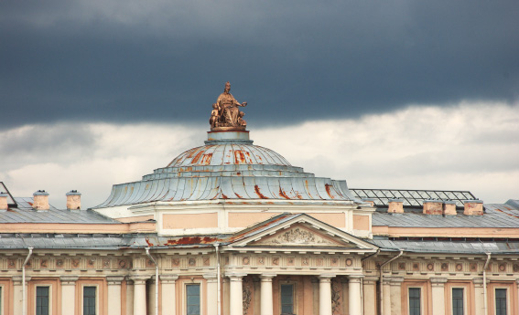
Over the entrance there is an inscription in bronze letters “To Free Arts. The year of 1765”.

Slide 5
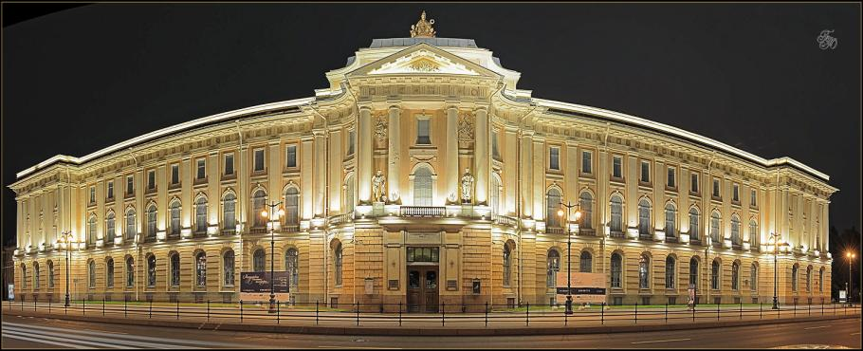
It was the first building in classic style in St Petersburg. The well-balanced proportions of the main facade are particularly impressive.

Slide 6
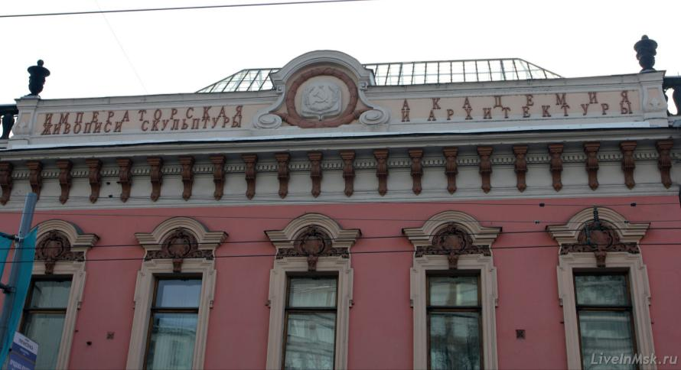
The Academy of the Three Most Noble Arts (painting, sculpture and architecture) was founded in 1757. The first students graduated from the Academy in 1762.

Slide 7
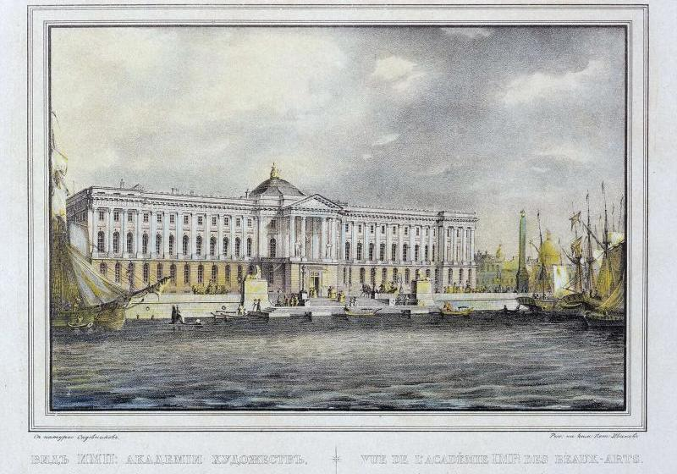
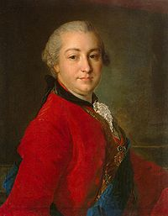
The idea of creation of a Russian artistic school belonged to Peter I but it was realized only partially at that time.
In 1757, Count Ivan Shuvalov came forward with a project to create the Academy of Fine Arts.
Ivan Shuvalov

Slide 8
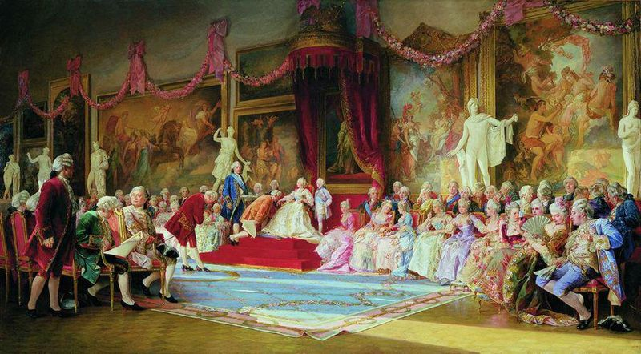
The Inauguration of the Academy of Arts, a painting by Valery Jacobi.

Slide 9

The Academy of Arts has played an important role in the development of Russian art. A lot of famous Russian painters and sculptors studied and worked there.
At the beginning of the 19th century the graduates of the Academy of Arts deserved the European recognition.

Slide 10
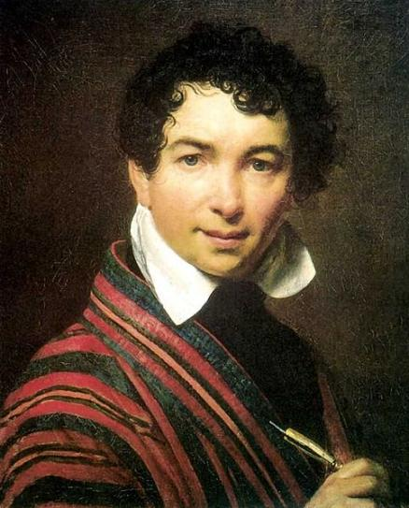
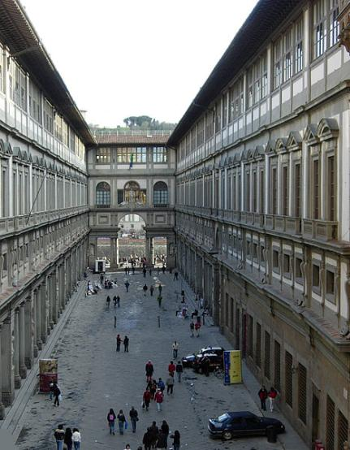
The Uffizzi Gallery ordered the self-portrait of the portrait master Orest Kiprensky.
The Uffizi Gallery
is a museum in Florence, Italy. It is one of the oldest and most famous art museums of the Western world.
Orest Kiprensky

Slide 11
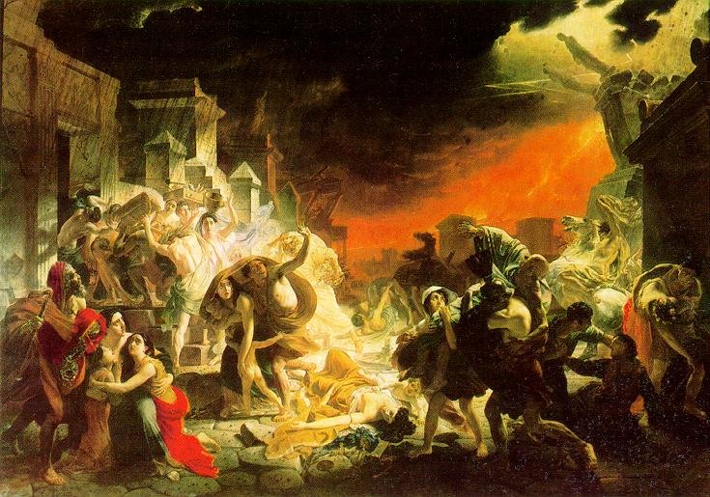
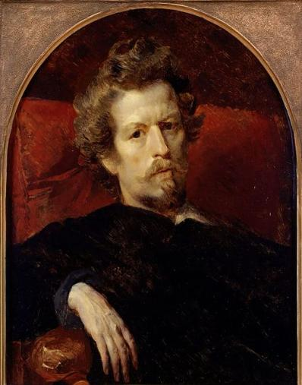
The history artist Karl Bryullov painted the picture “The Last day of Pompei”, which was recognized in Europe.
Now this masterpiece is in the collection of the Russian Museum of St Petersburg.
Karl Bryullov

Slide 12
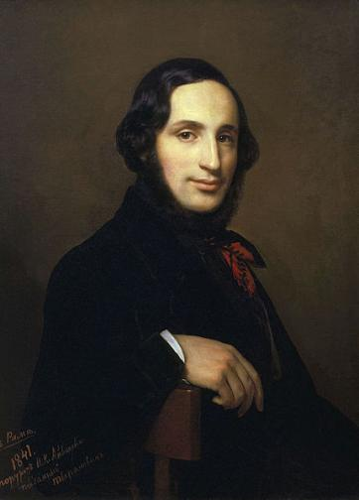
The marinist Ivan Ayvazovsky at the age of 30 became a member of the Academy. Now a lot of his best pictures we can see in the halls of the Russian Museum as well.
Ivan Ayvazovsky

Slide 13
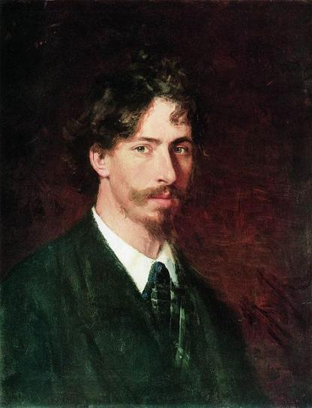
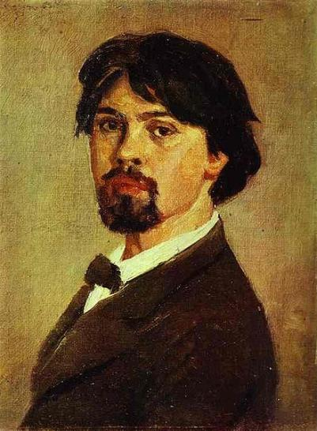
A lot of outstanding masters studied and worked there. Such as:
Ilya Repin
Vasily Surikov

Slide 14
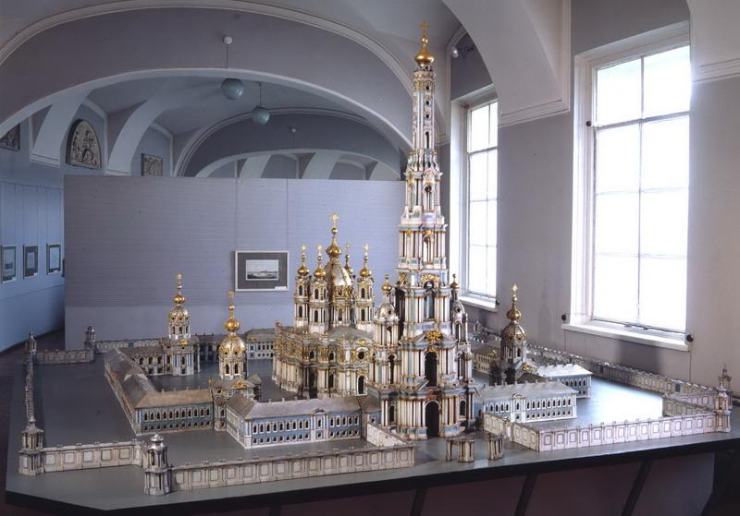
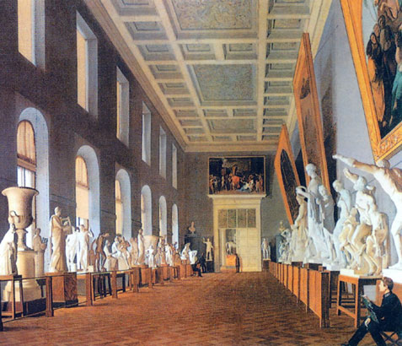
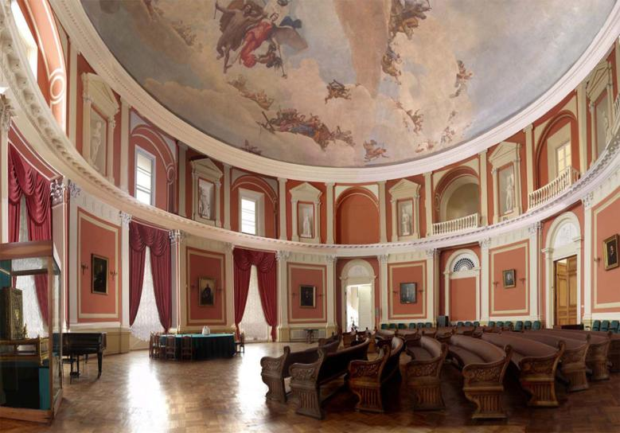
Along the classes and studios the building contains a research museum of the Academy and a reference library.

Slide 15
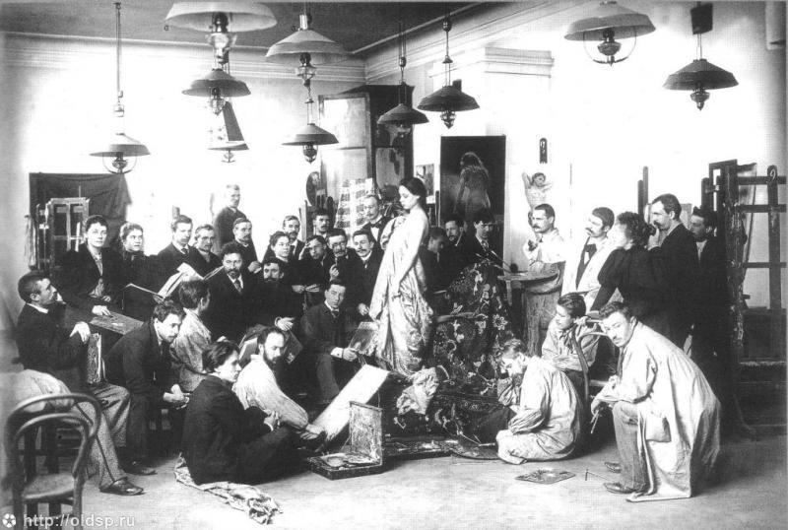
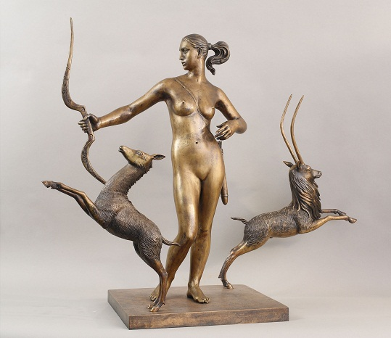
In the museum, works by the greatest painters are displayed.

Slide 16
Интернет - ресурсы
http://spbfotos.ru/postcard.img500.htm
http://tochek.net/lofiversion/index.php/t26023.html
http://travel-live.ru/dvorec-menshikova-v-sankt-peterburge.html
http://www.megabook.ru/MediaViewer.asp?AID=608870
http://commons.wikimedia.org/wiki/File:Levitsky_kokrinov.jpg?uselang=ru
http://900igr.net/kartinki/mkhk/Klassitsizm/023-Imperatorskoj-akademii-khudozhestv.html
http://karpovka.net/2012/09/10/61224/akadem-hudojestv/
http://www.skyscrapercity.com/showthread.php?t=574628&page=3&langid=5
http://liveinmsk.ru/index.php?dn=places&re=tags&to=tag&id=11
http://en.wikipedia.org/wiki/File:Galleria_degli_Uffizi_court_crop.JPG
http://commons.wikimedia.org/wiki/File:Kiprensky_self.jpg?uselang=ru
http://www.virtualrm.spb.ru/node/4405
http://muzei-mira.com/kartini_russkih_hudojnikov/520-kartina-posledniy-den-pompei.html
http://www.wm-painting.ru/StyleInPaintingAG/p2_articleid/271
http://wmuseum.ru/rossiya/373-muzey-akademii-hudozhestv-v-sankt-peterburge.html
http://oldsp.ru/photo/view/5330
http://www.nimrah.ru/exhibitions/old/289/

