Slide 1
МОУ «Красненская средняя общеобразовательная школа имени М.И.Светличной»
HOLY PLACES OF KRASNENSKIY DISTRICT
Выполнил: учитель
английского
языка
Бутрий Я.Н.

Slide 2
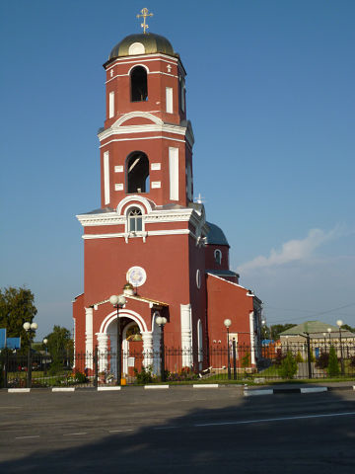
I would like to present sightseeing tour which can show people the beauty and spiritual value of Krasnenskiy district. There are a lot of wonderful churches with their own history. Let`s start with our main temple. It is situated in the center of the village Krasnoe.It is St. Elias Church. Firstly it was built in 1774, people came here to pray, but during the Great Patriotic War it was converted into a hospital, then become a recreation centre. In 1991 it became the church again. In 2001 the bell tower was built. Two years later, in 2003 the dome was settled. In 2006 the restoration work on the interior decoration of the temple was began. By the end of July 2007 the outer decoration of the temple was finished. The long - awaited opening of the St. Elias temple took place in 2007.

Slide 3
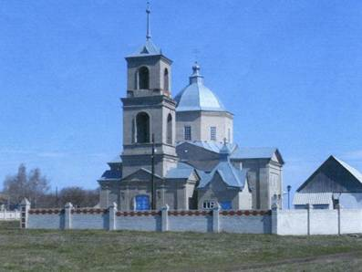
The next sightseeing I’d like to present is Church of the Vladimir Icon of the Mother of God. It is situated in the village Old Ukolovo.
The base of the village Old Ukolovo historians refer to 1610. Its first settlers – boyars` children - were sent from StaryOskol to protect the southern borders of the Russian State from the raids of the Tatars. The wooden church was built in 1650, it was the first temple in Krasnenskiy district. In 1809 the church was rebuild from stone with a bell tower, burial place and guardhouse. The temple had a chapel in honor of the holy martyr Paraskeva.

Slide 4
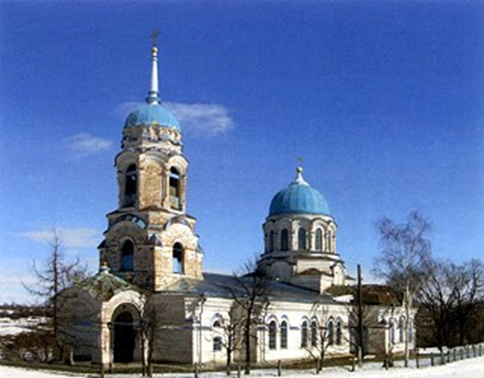
Our tour continues. In the village LesnoeUkolovo we can observe Nativity Church. It was founded in 1730. After 100 years a stone church was built on the
place of wooden one. There was a bell tower too. Also we can see there Crucifix and few icons made and written on Mount Athos. Tomb, candlesticks, chandeliers and many others things saved from the first days of the temple. In the temple there are lists about the miraculous icon of the Mother of God, which was carried around the village Korotoyak and town Ostrogozhsk during cholera in 1847 and 1848. Inhabitants were saved. The church wasn`t closed even in the hard years of the Great Patriotic War

Slide 5
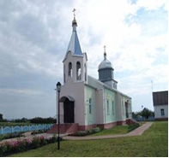
In the nice village Kamyzino we can see the Temple of the Holy Spirit. The first mention of the village dates back to the 18th century, when its territory was settled by 11 families headed by ZinoviyKamyzin. They were sent from town Userd by government to serve.
In Kamyzino was Trinity Church. At the beginning of the 20th century, the church was closed and the building was used as a warehouse. Later there was club. In the early 90s after the repair work the worship in the temple was resumed. Then the throne was recalled in honor of the Holy Spirit. Day of the Holy Spirit is celebrated after Trinity. Restoration works were completed in 2009.

Slide 6
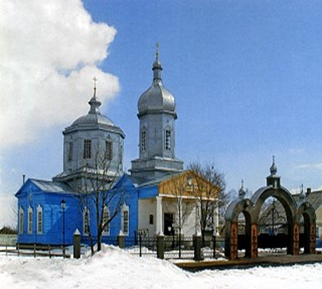
Krasnenskiy district is rich in holy places. The next of them is Nativity Church
in the village Gorki. It is situated on the bank of the river Potudan. The church was built in 1774. Its history is closely connected with the history of the village. It is made of wood with two domes. The central dome is in the form of an octahedron, the height is 5 meters, and diameter is 8 meters. The roof has the half – bulb formof octagonal bell tower. In 1995 – 1998 years Regional center of social care for the elderly people and persons with disabilities, children from poor families was settled there. It is called in the name of saint Xenia of St. Petersburg.I want to finish our tour with the new wonderful church in the Village Setishe.

Slide 7
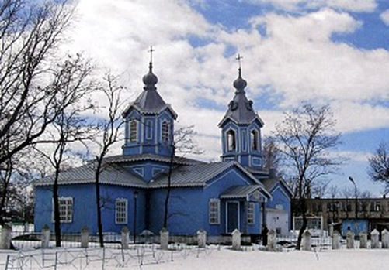
The wooden church with dome was built in 1879 in honor of the Blessed Virgin Mary. The temple belonged to the church of the village Zalomnoe. There were 640 parishioners. In 1926 it was closed, the bells wereremoved, all valuable things were taken away. In 1942 the temple was opened for parishioners. The original paintings of the dome and walls was saved.But in April 2010, when workers were repairing the church there was a fire. Temple burned completelyto the ground. Thanks to concerted actions of parishioners it became possible to save all the church furnishings and icons, some of which were written in the Holy Mount Athos. Immediately, after the tragic events, the district administration, with the blessing of Bishop John, decided to rebuild the temple on its place. In two years it was opened for its parishioners again.
To my regret, our trip is over. Come and see our wonderful churches and beautiful nature again!

Slide 8
Использованные материалы:
1. www.kraadm.ru
2. www.vidania.ru

