Slide 1
Грамматические таблицы для средней школы
The presentation is made
by teacher Julia Apt,
gymnasium 74, St. Petersburg, Russia
www.JuliaApt.blogspot.ru
Юлия Ефимовна Апт,
гимназия №74, г. С-Петербург
2015

Slide 2
Уважаемые коллеги!
Когда-то я сделала «раздатки» с грамматическими правилами для начальной школы. Теперь коллеги спрашивают про таблицы для старших учащихся. Текстов для печати у меня нет, но есть правила, которые создавались для упражнений-презентаций. Возможно, они вам пригодятся.

Slide 3
Conditionals: First Conditional
Conditionals: Second Conditional vs. First Conditional
Conditionals: Third Conditional
Conditionals: First – Second – Third –
Passive Voice (Present)
Passive Voice (Present, Past)
Passive Voice (Present Simple, Past Simple, Present Perfect)
Passive Voice (Present, Past, Future, Modals + Passive)
Past Continuous
Past Perfect vs. Past Continuous
Past Perfect – Past Continuous – Past Simple
Present Perfect 1
Present Perfect 2
Present Perfect (for, since)
Present Perfect vs. Past Simple
Present Perfect Continuous
Present Perfect Continuous vs. Present Perfect
Reported Speech: Orders
Reported Speech: Sequence of Tenses 1
Reported Speech: Sequence of Tenses 2
Used to + Verb

Slide 4
Present Perfect
I have drawn a picture.
We have drawn a picture.
You have drawn a picture.
They have drawn a picture.
He has drawn a picture.
She has drawn a picture.
It has drawn a picture.
have
has
+ V3
Exercise “Present Perfect” ppt

Slide 5
Present Perfect
I have drawn a picture.
He has drawn a picture.
+
have
has
+ V3
I haven’t drawn a picture.
He hasn’t drawn a picture.
Have you drawn a picture?
Yes, I have.
Has he drawn a picture?
Yes, he has.
?
Exercise “Present Perfect” ppt

Slide 6
Present Perfect vs. Past Simple
Present Perfect
Look! I have drawn a picture.
Past Simple
I drew a picture yesterday.
Exercise “Present Perfect vs Past Simple” ppt

Slide 7
Present Perfect (for, since)
+
Verbs to Use
to be
to have
to know
to live
to work
I have a bike.
I have had this bike
for 2 months.
I have known Tim
since 2012.
I haven’t seen Peter
for ages.
Exercise “Present Perfect (for, since)” ppt

Slide 8
Past Continuous
+
I was reading a book.
I wasn’t reading a book.
At 8 o’clock yesterday
Were you reading a book?
Yes, I was.
No, I wasn’t.
?
Exercise “Past Continuous vs Past Simple 1” ppt
Exercise “Past Contimuous vs Past Simple 2” ppt

Slide 9
Past Perfect vs. Past Continuous
Past
Continuous
was
were
+ V_{ing}
When father came home, Tim was doing his homework.
Past
Perfect
had
+ V₃
When father came home, Tim had done his homework.
Exercise “Past Perfect, Past Continuous, Past Simple” ppt

Slide 10
Past Perfect – Past Continuous – Past Simple
Два действия происходят друг за другом. Следующее действие – Past Simple.
Tim did his homework.
Then father came home.
Два действия одновременные:
длящееся – Past Continuous,
однократное – Past Simple.
When father came home,
Tim was doing his homework.
Одно действие завершилось до того, как произошло другое (предшествующее действие)
– Past Perfect.
When father came home,
Tim had done his homework.
Exercise “Past Perfect, Past Continuous, Past Simple” ppt

Slide 11
Present Perfect Continuous
I have been drawing a picture
for an hour.
Exercise “Present Perfect Continuous” ppt

Slide 12
Present Perfect Continuous
I have been drawing a picture
for an hour.
Present Perfect
Look! I have drawn a picture.
Exercise “Present Perfect Continuous vs Present Perfect” ppt

Slide 13
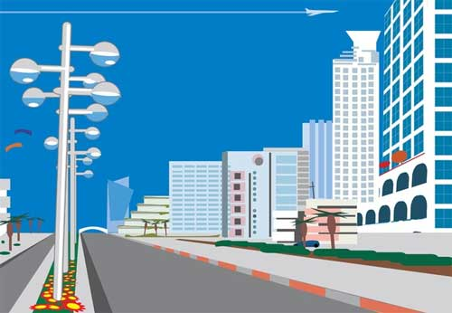
Passive Voice (Present)
am
is
are
Present Simple
Passive
+ V₃
+
New houses are built every year.
New houses aren’t built every year.
Are new houses built every year?
Yes, they are.
No, they aren’t.
?
Exercise “Present Simple Passive” ppt

Slide 14
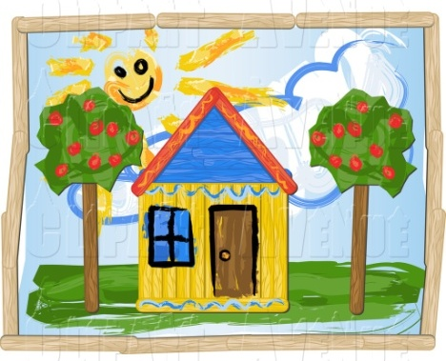
Passive Voice (Present, Past)
am
is
are
Present Simple
Passive
+ V₃
Many houses are built in our city every year.
Past Simple
Passive
was
were
+ V₃
This house was built last year.
Exercise “Passive Voice - Past Simple, Present Simple” ppt

Slide 15
Passive Voice
is
are
Present Simple:
+ V₃
was
were
Past Simple:
+ V₃
have been
has been
Present Perfect:
+ V₃
Exercise “Passive Voice - Present Simple, Past Simple, Present Perfect” ppt

Slide 16
Passive Voice
am
is
are
Present Simple Passive
+ V₃
was
were
Past Simple Passive
+ V₃
Future Simple Passive
will + be + V₃
must
can
should
have to
Modals + Passive
+ be + V₃
Exercise “Passive Voice - Present Simple, Past Simple, Future Simple, Modals + Passive” ppt

Slide 17
First Conditional
if clause | main clause
Present Simple | Future Simple
If Mary invites me to her birthday party, I will give her a nice present.
Using a Comma ( , ) in Conditional Sentences
If it doesn’t rain, we will go for a walk.
We will go for a walk if it doesn’t rain.
Exercise “First Conditional” ppt

Slide 18
First Conditional
Реальное условие. Изъявительное наклонение.
if clause | main clause
Present Simple | will + V
Mary is my friend.
If Mary invites me to her birthday party,
I will give her a nice present.
Second Conditional
Маловероятное условие. Сослагательное наклонение.
if clause | main clause
Past Simple | would + V
I don’t know Mary very well.
If Mary invited me to her birthday party,
I would give her a nice present.
В официальной речи используется were для всех лиц и чисел. В разговорной речи допускается использование was.
Exercise “Second Conditional” ppt

Slide 19
Third Conditional
Сослагательное наклонение – «вчера».
if clause | main clause
Past Perfect | would + have + V₃
I didn’t do my homework yesterday. The teacher asked me and I got a bad mark.
If I had done my homework,
I wouldn’t have got a bad mark.
Exercise “Third Conditional” ppt

Slide 20
FIRST CONDITIONAL (Реальное условие)
if clause | main clause
Present Simple | will + V
Mary is my friend.
If Mary invites me to the party, I will give her a present.
SECOND CONDITIONAL (Сослагательное наклонение: «СЕЙЧАС»)
if clause | main clause
Past Simple | would + V
I don’t know Mary very well.
If Mary invited me to the party, I would give her a present.
THIRD CONDITIONAL (Сослагательное наклонение: «ВЧЕРА»)
The party was yesterday, and Mary didn’t invite me.
if clause | main clause
Past Perfect | would + have + V3
If Mary had invite me to the party, I would have given her a present.
Exercise “1-2-3 Conditionals” ppt

Slide 21
Reported Speech: Orders
He asked + TO + V
“Open the door, please.”
Tim asked Liz to open the door.
+
He asked + NOT + TO + V
“Don’t open the door, please.”
Tim asked Liz not to open the door.
–
Exercise “Reported Speech: orders” ppt

Slide 22
Sequence of Tenses
Direct Speech
Reported Speech
is | was
are | were
V_{s} / V | V₂
will + V | would + V
has + V₃ | had + V₃
V₂ | had + V₃
Exercise “Reported Speech: Statements” ppt
Exercise “Reported Speech: all types of sentences” ppt

Slide 23
Sequence of Tenses
Direct Speech
Reported Speech
Present Simple | Past Simple
Present Continuous | Past Continuous
Present Perfect | Past Perfect
Future Simple | would + V
Past Simple | Past Perfect
Past Perfect | Past Perfect
Past Continuous | Past Perfect Continuous
Exercise “Reported Speech: Statements” ppt
Exercise “Reported Speech: all types of sentences” ppt

Slide 24
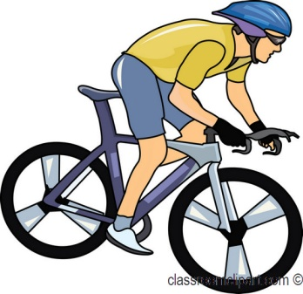
used to + V
+
I used to ride a tricycle.
I didn’t use to ride a tricycle.
Did you use to ride a tricycle? – Yes, I did.
No, I didn’t
When I was a small boy
?
Now
I ride a bike very well.
Exercise “Used to + V” ppt

