Slide 1
Методика подготовки обучающихся к выполнению заданий устной части ЕГЭ. Критерии оценивания заданий части С устной части ЕГЭ

Slide 2
Task 1. Imagine that you are preparing a project with your friend about celebrating Christmas in different parts of the world. You have found some interesting material for the presentation and you want to read this text to your friend. You have 1,5 minutes to read this text silently, then be ready to read it aloud. You will not have more than 1,5 minutes to read it.

Slide 3
Christmas and New Year are the happiest and the busiest time of the year for millions of people all over the world. On Christmas Eve children hang stockings for Father Christmas to fill with presents.
In France, children put their shoes near the fireplace so Father Christmas can fill them with presents. Most Scottish families have a Christmas tree and sing carols but they have their most important celebration on New Year’s Eve. It is called Hogmanay.
In Australia and New Zealand, December comes during the summer. Many people celebrate Christmas by going on a picnic or going to the beach.

Slide 4
Task 2. Study the advertisement. You are considering visiting Austria during Christmas time and now you are calling to find out more information.

Slide 5
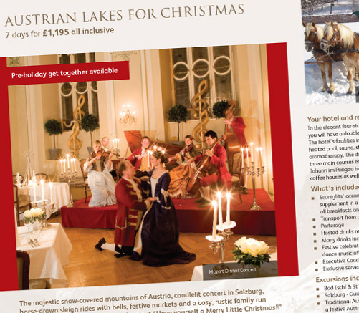
You are to ask five direct questions to find out the following: 1) dates for departure 2) hotel facilities 3) if breakfast is included 4) number of city tours 5) discounts You have 20 seconds to ask each question

Slide 6
Task 3. Imagine that you have that photo in your family album. Present it to your friend. You will have to speak for not more than 2 minutes.

Slide 7
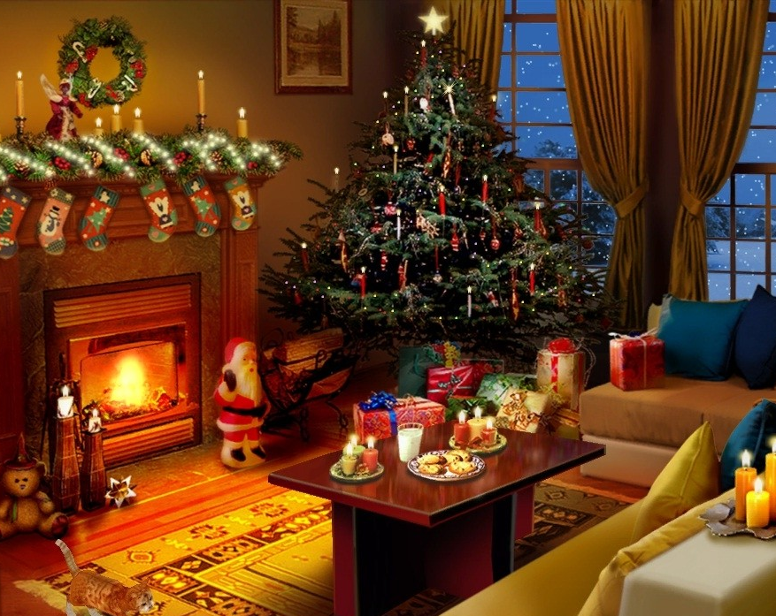
In your talk remember to speak about:
when you took the photo
what/who is in the photo
what is happening
why you took the photo
why you decided to show the picture to your friend

Slide 8
Task 4. Study the two photographs. Be ready to compare and contrast the photographs: - give a brief description of the photos (action, location) - say what the pictures have in common - say in what way the pictures are different - say which of the postcards presented you’d prefer - explain why You will have to speak for not more than 2 minutes.

Slide 9
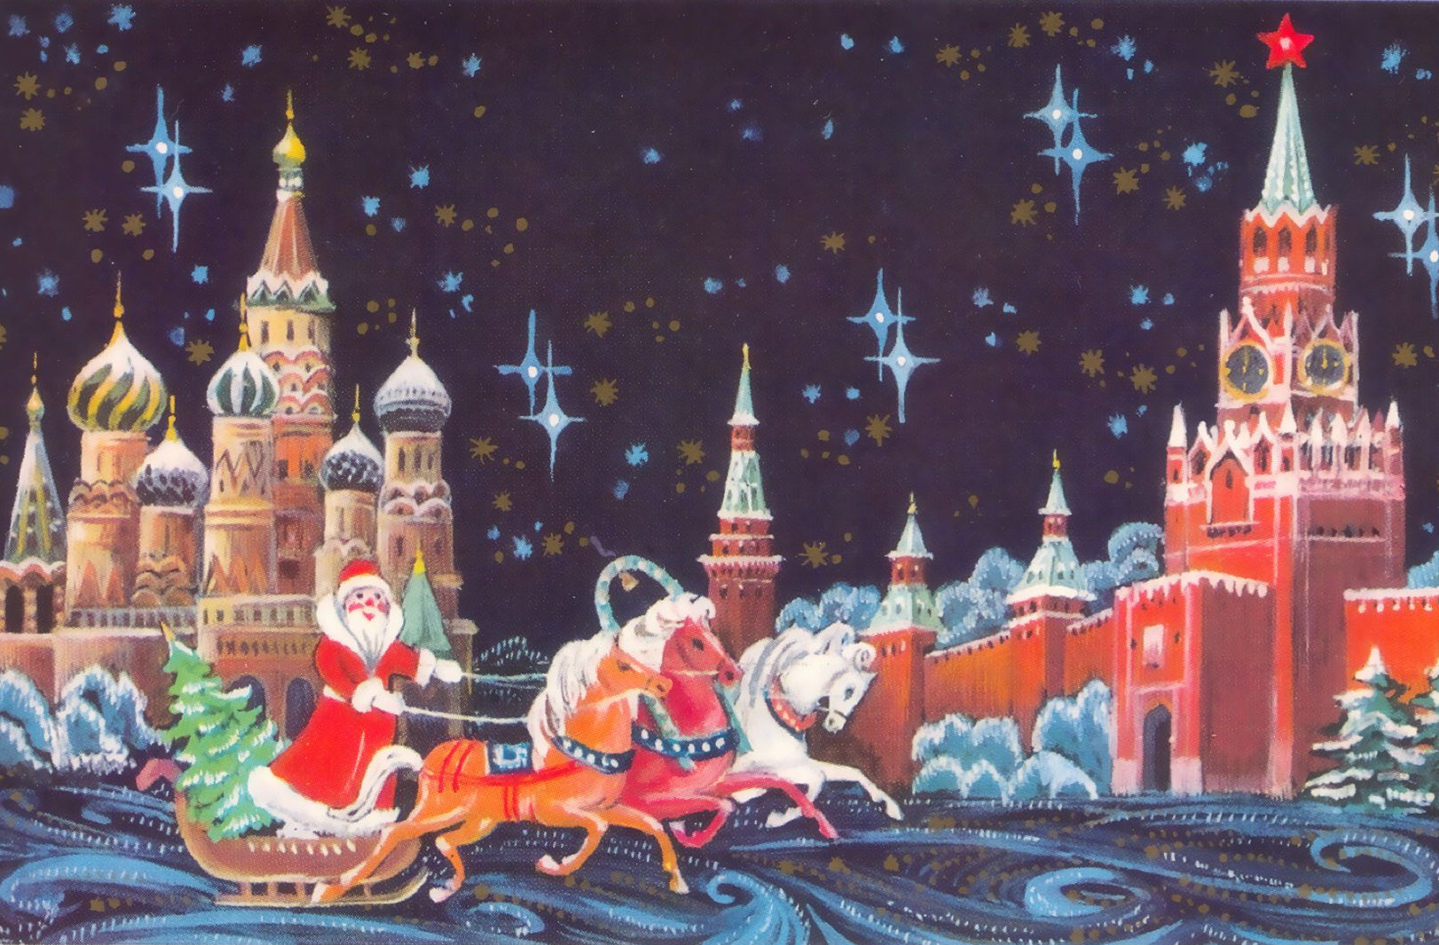
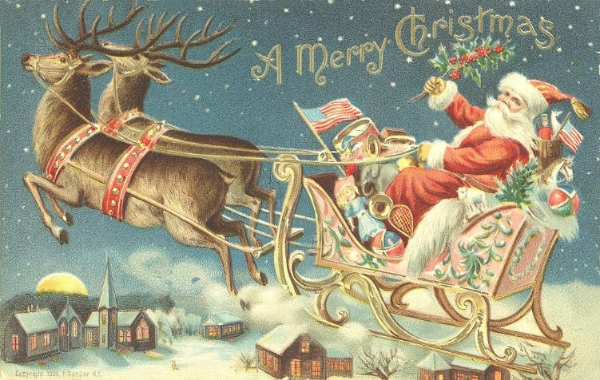
Be ready to compare and contrast the photographs: - give a brief description of the photos (action, location) - say what the pictures have in common
- say in what way the pictures are different - say which of the postcards presented you’d prefer - explain why

Slide 10
Thanks for your attention!

