Slide 1
THINGS I LIKE

Slide 2
Wednesday, the nineteenth of November.
Things I like
Today:
We learn names of food;
Ask and answer questions about food;
Learn to order food at cafe;
Play and have fun.

Slide 3
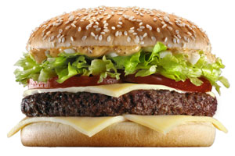
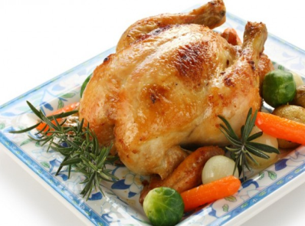
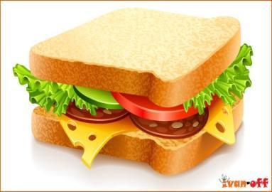
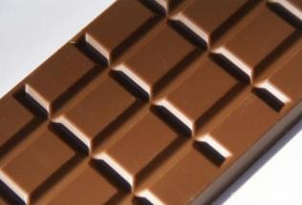
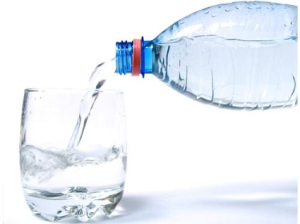
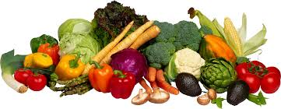
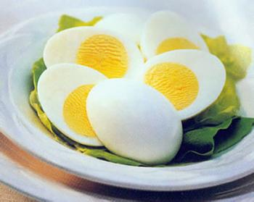
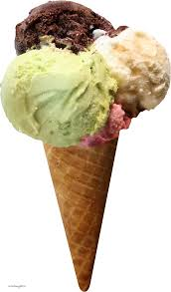
What’s this?

Slide 4
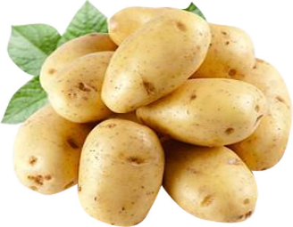
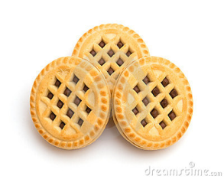
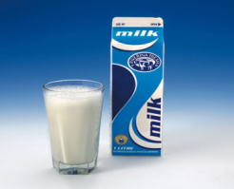
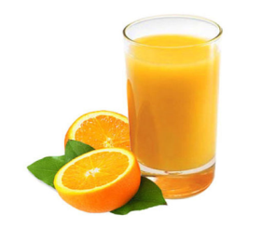
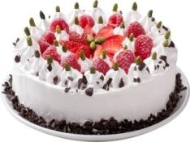
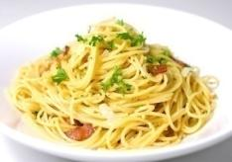
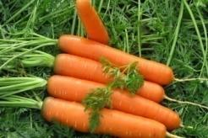
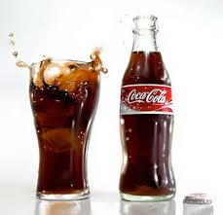
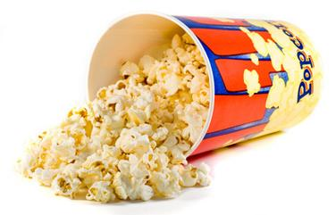
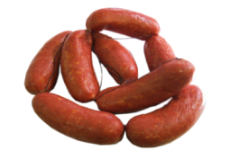
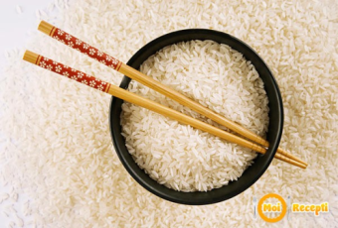
Let’s learn new words.

Slide 5
Let’s play!
Who likes meat?
Who likes cakes?
Who likes pasta?
Who likes milk?
Who likes potatoes?

Slide 6
Listen and learn
Do you like…?
Yes, I do. / No, I don’t.
I like… She / He likes…
I don’t like… She / He doesn’t like

Slide 7
Choose the correct variant
1.I like/likes milk.
2.She like / likes potatoes.
3.I don’t / doesn’t like rice.
4. He don’t / doesn’t like pasta/

Slide 8
Check yourselves
1.I like milk.
2.She likes potatoes.
3.I don’t like rice.
4. He doesn’t like pasta/

Slide 9
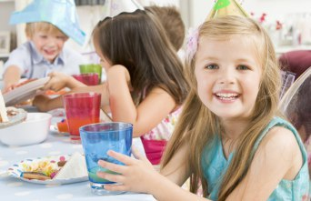
Welcome to our café
2.Here you are
1.Hello!
Can I have some coke, please?
3. Thank you!

Slide 10
Let’s sum up
I know the words- Я знаю слова
I can ask question about food-
Я могу задать вопрос о еде
I can order food- я могу заказать еду в кафе

