Slide 1
School

Slide 2
Fill in gaps and read the words
Sub…ect , sc…ool, Mat…s, les…on , st…dy , le…rn , favo…rite.

Slide 3
Check yourself
Subject , school, Maths, lesson , study , learn , favourite.

Slide 4
Listen to the teacher
Listen to music
Read poems
Learn words
Do sums
Retell texts
Sing songs
Draw pictures
Play games
Write exercises
Have lunch
Do homework

Slide 5
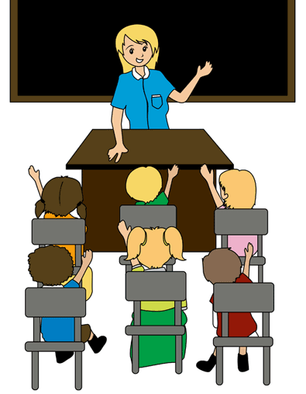
Do you like school?
What is your favourite subject?
Do you always do нщгк your homework?

Slide 6
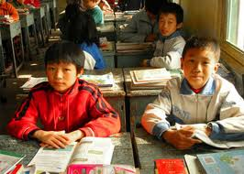
Let’s check:
-Where is Mao from?
-What is his school number?
-Does he like to do sums?
-What is his favourite
Subject?

Slide 7
New words
Raise [ˈreɪz] поднимать
bully [ˈbʊliː] обижать
quiet [ˈkwaɪət] тихий, спокойный
mean [ˈmiːn ] злой
mess [ˈmes] беспорядок
leave [ˈliːv ] оставлять
wait [ˈweɪt] ждать
skip [ˈskɪp] прыгать, скакать
trip [ˈtrɪp] споткнуться

Slide 9
Match the words
Raise to speak
Walk mess
Wait your hand
Clean in school
Leave up

Slide 10
Check yourself
Raise to speak
Walk mess
Wait your hand
Clean in school
Leave up

Slide 11
Find opposites
Stand up
Clean up
Walk in school
Leave mess
Bully
Run and skip
Sit down
Be nice and kind

Slide 12
Clean up
Leave mess
Walk in school
Run and skip
Be nice and kind
Bully
Stand up
Sit down

Slide 14
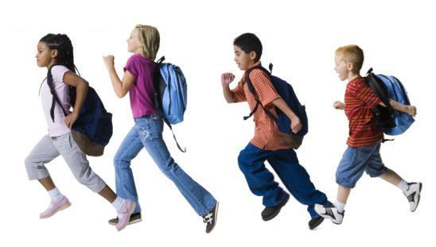
Agree or disagree
1)We should stand up to greet the teacher.
2)We should leave the mess in the classroom.
3) We should clean up after work.
4) We should not raise the hand to speak at the lesson.
5) You may run and skip at school.

Slide 15
Write the words into the right colomn:
We should … We should not
Wait to speak, skip and run in the classroom, walk in school, listen to the teacher , raise our hands to speak in the classroom , be mean , be nice and quiet , leave the mess , clean up

Slide 16
Today at the lesson we learned :
New words
Rules of the classroom
Use of should
Home assignment:
Write 5-7 rules of the classroom

Slide 17
Good bye

