Slide 1
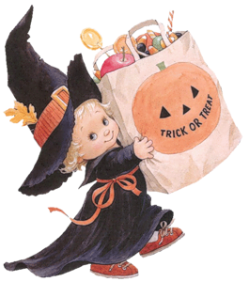
Halloween

Slide 2
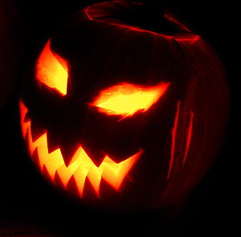
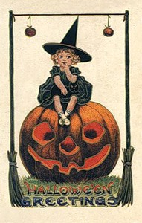
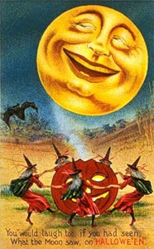
On the 31st of October British people celebrate Halloween.
It is the most colorful and exciting holiday of the year.

Slide 3
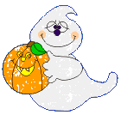
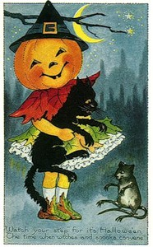
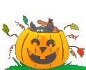
Halloween is time for fun. It is very dear to those who celebrate it, especially to children and teenagers.
Streets and houses are decorated with pumpkins.

Slide 4
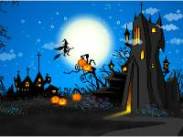
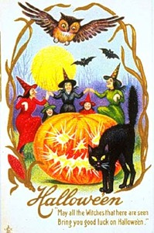
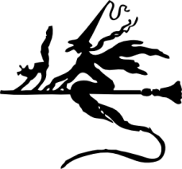
In ancient times people made fires and danced around them.
They hoped to frighten evil spirits and to bring warmth to their houses.

Slide 5
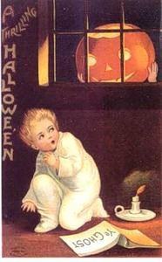
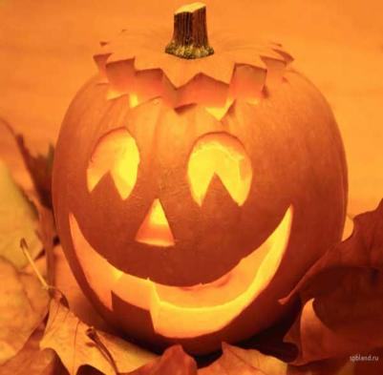
The traditional decoration is Jack-o-lantern. People cut holes in the pumpkin and put a candle inside it. It looks frightening at night!

Slide 6
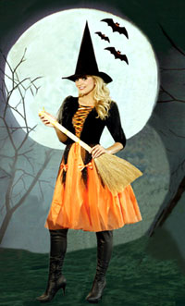
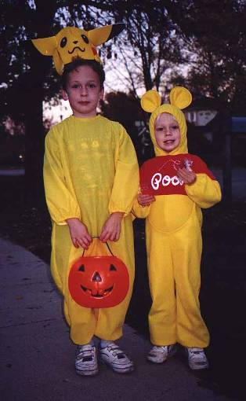
Children dress up, go from house to house and cry: “Trick or treat”? You are to give them some tasty things or they will play a trick on you.
Children enjoy Halloween. They wear masks and colorful costumes.

Slide 7
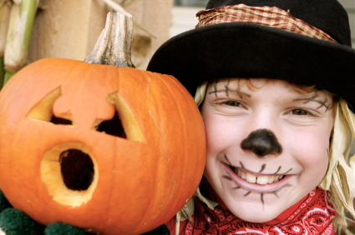
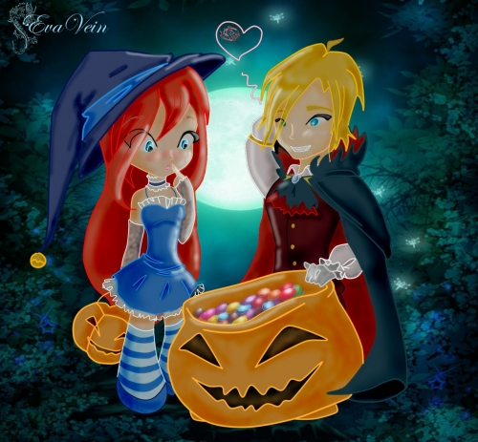
Trick or treat,
Smell our feet.
We want something
Good to eat.

Slide 8
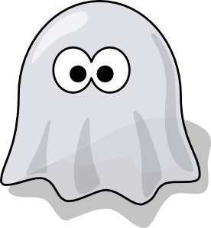
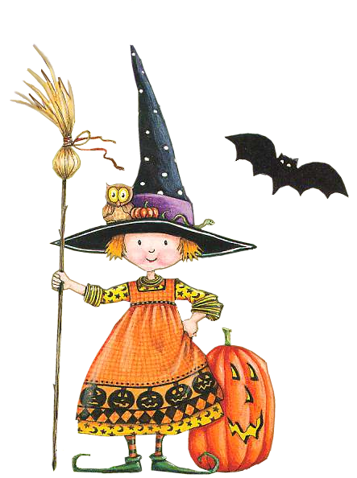
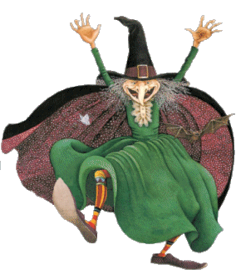
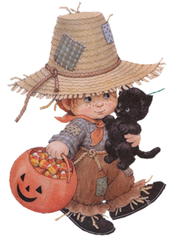
The most popular costumes are of witches, skeletons, black cats, ghosts and other.

Slide 9
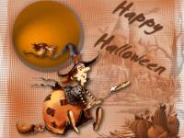
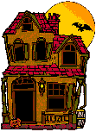
At Halloween parties children play traditional games. Many games date back to the harvest festivals of very ancient times.

Slide 10
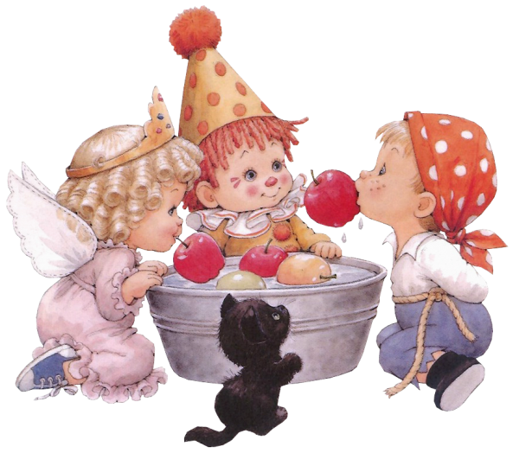
One of the most popular is called bobbing for apples. One child at a time has to get apples from a tub of water without using hands. But how to do this? By sinking his or her face into the water and biting the apple!

Slide 11
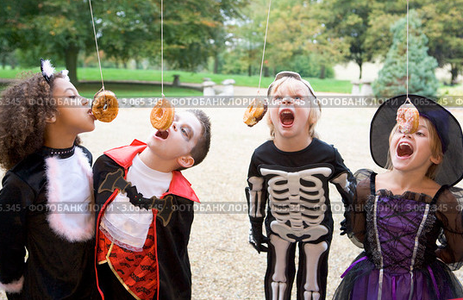
It’s another merry game. You must eat the dough-nut
without using your hands as quickly as you can.

Slide 12
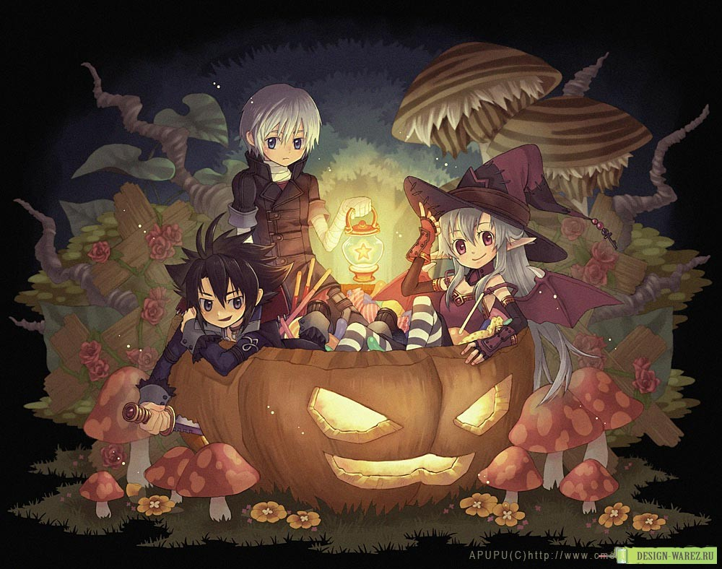

Slide 13
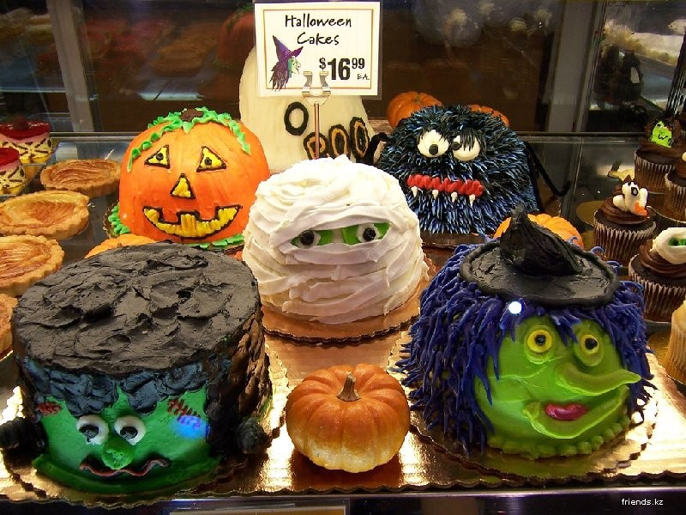

Slide 14
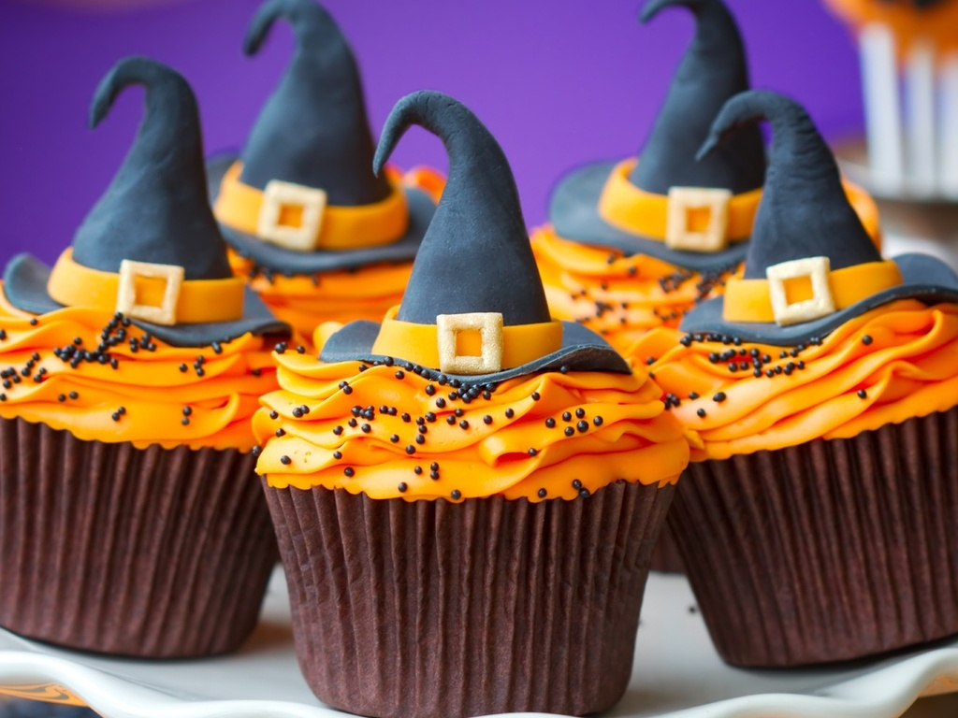
Halloween Blue Witch Hat Cupcakes

Slide 15
