Slide 1
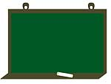
Презентация к уроку английского языка
Unit 9. Section 3.Shopping for food
УМК Биболетова М.З. « Enjoy English »
4 класс
Выполнила: учитель английского языка МБОУ Вешкаймская СОШ №2 им. Б.П. Зиновьева
Панкина Н.С.

Slide 2
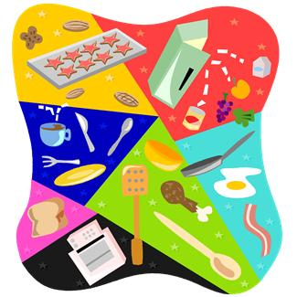


Slide 3
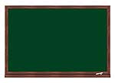
At the lesson we’ll
review the words “Clothes” and “Food”;
try to describe people;
review the rule of using SOME, ANY, NO;
try to make up the dialogues “Shopping for food”.

Slide 4
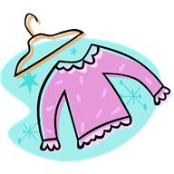
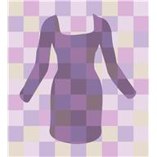


Let’s read!
“The Kitten’s Clothes”
Jeans and trousers,
Sweaters and shirts,
Socks and tights,
And jackets and skirts.
T-shirts and shoes,
High boots and mittens,
These are the clothes
Of the kittens.

Slide 5
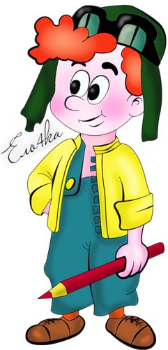
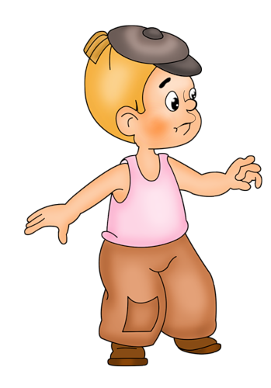
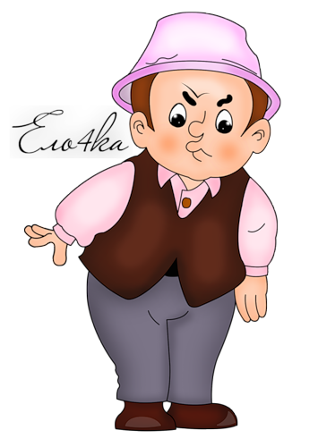
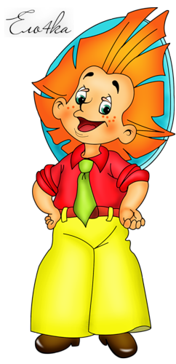
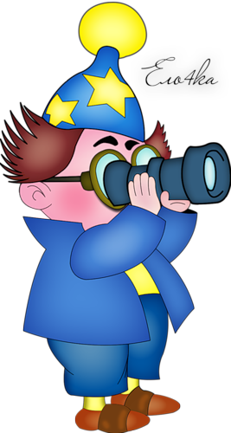
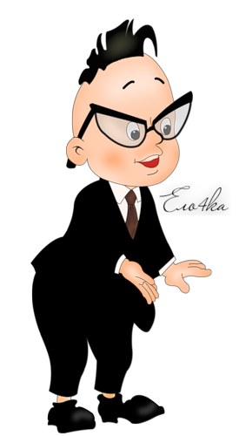
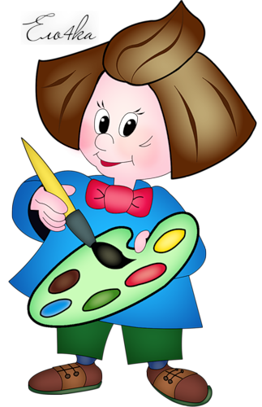

Find the character:

Slide 6
Food (unit 6 ex. 25)

Slide 7
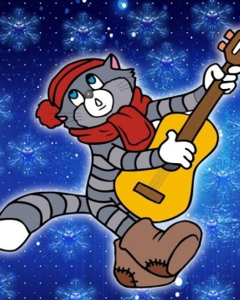
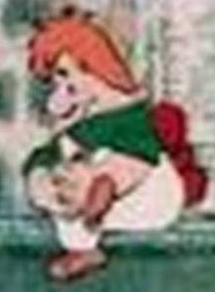

Make up the shopping list for:

Slide 8
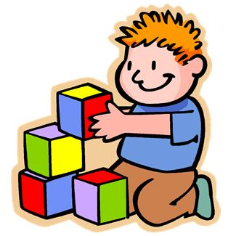
Let’s play!
Put on your…

Slide 9

Fill in the words SOME, ANY, NO
1 some
2 some
3 any
4 no
5 any

Slide 10
Dialogue “Shopping for food”
(Unit 6 ex. 24)

Slide 11

Did we
review the words “Clothes” and “Food”?
describe people?
review the rule of using SOME, ANY, NO?
make up the dialogues “Shopping for food”?

Slide 12


Did you have any mistakes or difficulties?
YES
NO
  Good luck!
Excellent!

Slide 13
H/t: ex 1, 2 p 83

