Slide 1
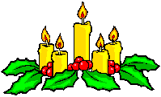
Christmas
Рождество

Slide 2
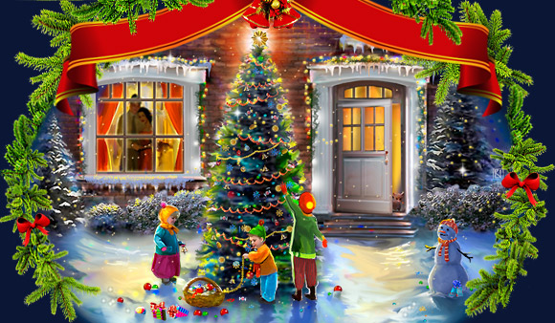
Какой русский царь повелел отмечать
на Руси новый год первого января?
Пётр I
Notes:
Welcome to Power Jeopardy
© Don Link, Indian Creek School, 2004
You can easily customize this template to create your own Jeopardy game. Simply follow the step-by-step instructions that appear on Slides 1-3.

Slide 3
Когда празднуется
католическое Рождество?
25 декабря
Notes:
Welcome to Power Jeopardy
© Don Link, Indian Creek School, 2004
You can easily customize this template to create your own Jeopardy game. Simply follow the step-by-step instructions that appear on Slides 1-3.

Slide 4
Кого в разных странах
называют такими именами:
Юлеманден (Дания),
Сегацу-сан (Япония),
Дун Че Лао Рен (Китай),
Папай Ноэль (Панама),
Карбобо (Узбекистан).
Деда Мороза
Notes:
Welcome to Power Jeopardy
© Don Link, Indian Creek School, 2004
You can easily customize this template to create your own Jeopardy game. Simply follow the step-by-step instructions that appear on Slides 1-3.

Slide 5
В какой стране зародился
обычай ставить на
рождество ёлку?
А) в Германии
Б) в России
С) в США
В Германии
Notes:
Welcome to Power Jeopardy
© Don Link, Indian Creek School, 2004
You can easily customize this template to create your own Jeopardy game. Simply follow the step-by-step instructions that appear on Slides 1-3.

Slide 6
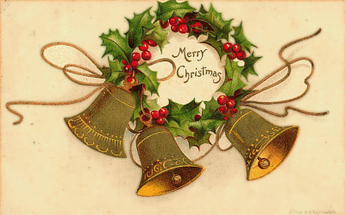
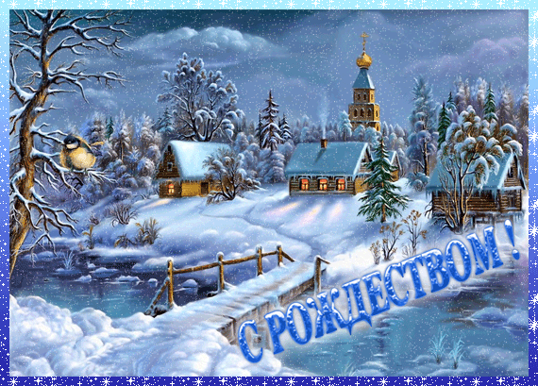
Почему католики и православные
празднуют Рождество в разные дни?

Slide 7
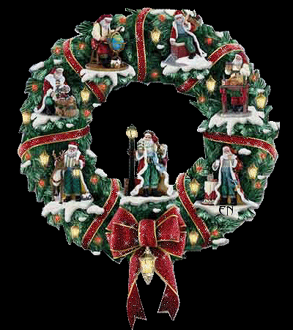
Как называется в Германии время
подготовки к Рождеству?
Advent
Notes:
Welcome to Power Jeopardy
© Don Link, Indian Creek School, 2004
You can easily customize this template to create your own Jeopardy game. Simply follow the step-by-step instructions that appear on Slides 1-3.

Slide 8
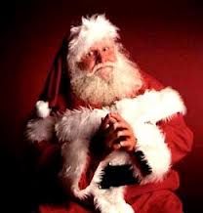
Куда бросает подарки французский
Дед Мороз –Пер Ноэль?
В трубу
Notes:
Slide 3-Question/Answer (Cat1, $100)
This slide is the first Question/Answer slide. It corresponds to Category 1 for $100. Once you have followed the instructions on Slide 2 to replace category name placeholders with your actual categories, the text “Cat1” on this slide will be replaced with your 1st category name.
When you click on Category 1 for $100 on the main slide, this slide opens automatically, with the Question appearing at the top. (Note: On TV Jeopardy, the contestant is actually shown an
answer and is asked to offer a related question. Since this concept is sometimes difficult to understand and implement, this PowerPoint version shows a question followed by the corresponding answer.)
One way to play the game in class is to set up three teams. For each round, have one person from each team stand up as contestants. Have one pick the category and dollar value; click on that box and then ready the question that appears. Call on the first contestant that raises his or her hand for the answer. If they are correct, their team gets corresponding points or dollars (e.g., 1 point for each $100). If the first contestant misses the question or does not answer quickly enough, his or her team loses the corresponding points. Then, offer the question to the remaining two contestants in order of their raised hands. After the question has been answered correctly, or after all three contestants miss it, or after no contestant wants to try, return to the main slide by clicking on the yellow arrow. The current contestants then sit down, and the game moves to the next round.
Note that this Jeopardy game does not have a Double Jeopardy question.
To tailor this slide, follow these instructions:
You are now ready to put in your questions and answers, but you might want to go ahead and save this file first, using Save As and giving it a new name—one that makes sense for this particular Jeopardy game (e.g., Fractions Jeopardy).
If your Question is short, simply double click on the word “Question” and type in your specific question (e.g., “50% of 150” or “Capitol of France”). If the text you enter will not fit on one line, there’s room for two lines at this font size. If you need more room, reduce the font size by triple clicking on the text and using the Font Size selector in the toolbar. In some cases, your question may need a drawn figure or graphic. You can use PowerPoint features to draw the figure you need or to insert graphics. A few examples are show below.
Double click on the word “Answer” and type in your answer in the same way.
Do the same steps to tailor the remaining Question/Answer slides, remembering to make questions of higher dollar value more difficult. Also remember to save your work.
Example Questions:

Slide 9
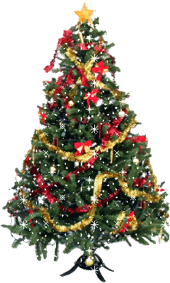
3.Откуда лондонцы получают
рождественскую ёлку?
А) из Норвегии
Б) из России
В) из Финляндии
Из Норвегии
Notes:
Welcome to Power Jeopardy
© Don Link, Indian Creek School, 2004
You can easily customize this template to create your own Jeopardy game. Simply follow the step-by-step instructions that appear on Slides 1-3.

Slide 10
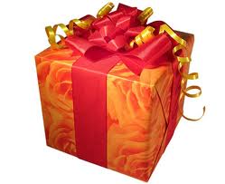
Что такое «Вохing Day»?
Почему он так назывется?
Следующий день после Рождества,
когда открывают подарки
Notes:
Welcome to Power Jeopardy
© Don Link, Indian Creek School, 2004
You can easily customize this template to create your own Jeopardy game. Simply follow the step-by-step instructions that appear on Slides 1-3.

Slide 11
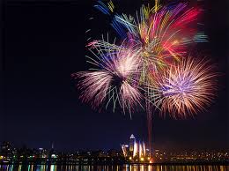
В день какого святого немцы
отмечают Новый год?
А) в день Святого Николая
Б) в день Святого Мартина
В) в день Святого
Сильвестра
в день Святого Сильвестра
Notes:
Welcome to Power Jeopardy
© Don Link, Indian Creek School, 2004
You can easily customize this template to create your own Jeopardy game. Simply follow the step-by-step instructions that appear on Slides 1-3.

Slide 12
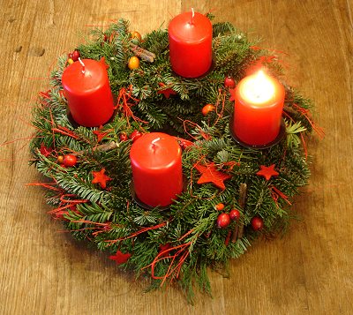
Почему в немецком рождественском
венке 4 свечи?
Они символизируют 4 воскресенья
до Рождества
Notes:
Welcome to Power Jeopardy
© Don Link, Indian Creek School, 2004
You can easily customize this template to create your own Jeopardy game. Simply follow the step-by-step instructions that appear on Slides 1-3.

Slide 13
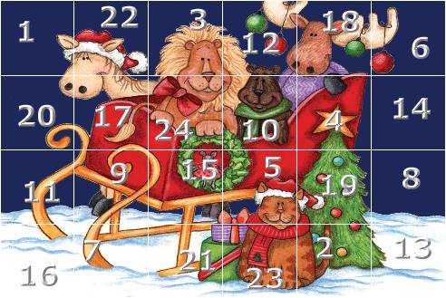
Сколько окошек в
рождественском
календаре?
24
Notes:
Welcome to Power Jeopardy
© Don Link, Indian Creek School, 2004
You can easily customize this template to create your own Jeopardy game. Simply follow the step-by-step instructions that appear on Slides 1-3.

Slide 14
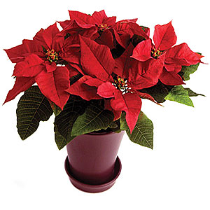
Какое растение является символом
Рождества во многих странах?
пуансеттия
Notes:
Welcome to Power Jeopardy
© Don Link, Indian Creek School, 2004
You can easily customize this template to create your own Jeopardy game. Simply follow the step-by-step instructions that appear on Slides 1-3.

