Slide 1
CONFLICT RESOLUTION CENTRE

Slide 2
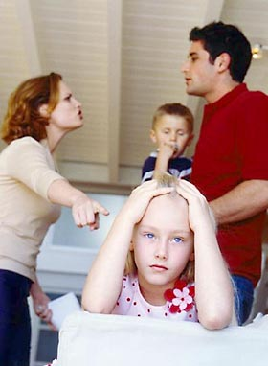

Slide 3
between parents
conflict

Slide 4
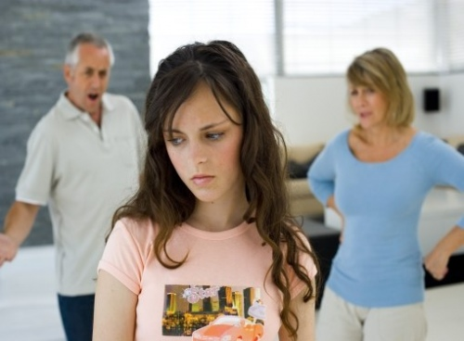
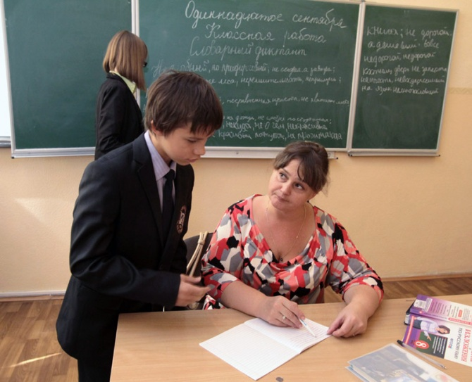
What kinds of conflicts can we see in everyday life?

Slide 5
Negative aspects:
to quarrel with
to argue
to hurt
to shout
to cry
to lie
Positive aspects:
to trust
to respect
to support
to be fond of
to care for
to rely on

Slide 6
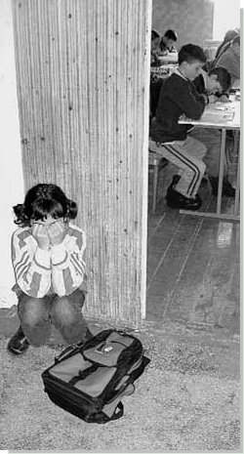
Discuss about it

Slide 7
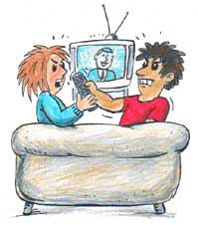
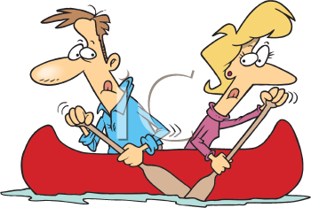
How to resolve conflicts?

Slide 8
Cooperate and work for 1-2 minutes.
We should … We should not …
observe other people’s rights
ask for advice from someone who is older than you
listen attentively to other people
be optimistic
be confident and relaxed
tell people what makes you unhappy
bully people
criticize differences
ignore someone’s opinion
trouble people
punish unfairly
quarrel with people

Slide 9
Crossword
1 All people have to __________ the rights of other people.
2 Students of our class ___________ conflicts peacefully.
3 Conflicts between states can __________ to war.
4 People all over the world must _________conflicts between states.
5 Children have the _________ for education.
6 If we resolve a conflict __________, we will have better relations.
7 A peaceful ___________ of a conflict is important.
8 If people don’t listen to each other they may have bad _______.

Slide 10
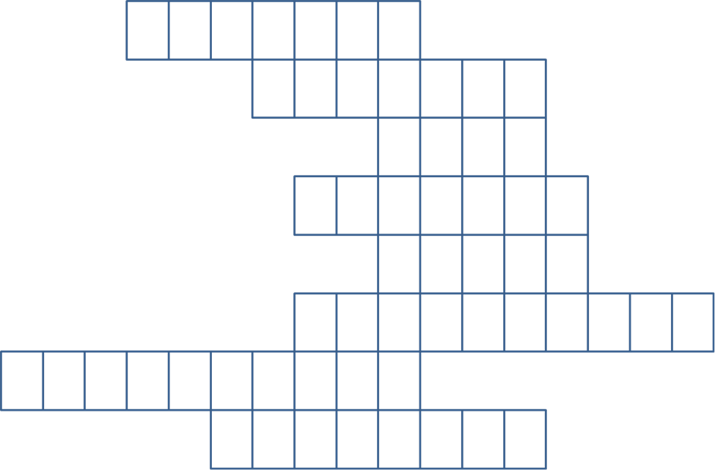
1
2
3
4
5
6
7
8

Slide 11
To conclude

Slide 12
THANK YOU FOR YOUR TIME AND COOPERATION.

