Slide 1
The Wood Of Flowers
By James Stephens

Slide 2
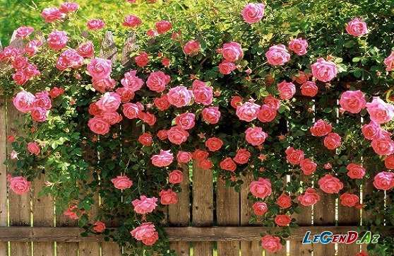
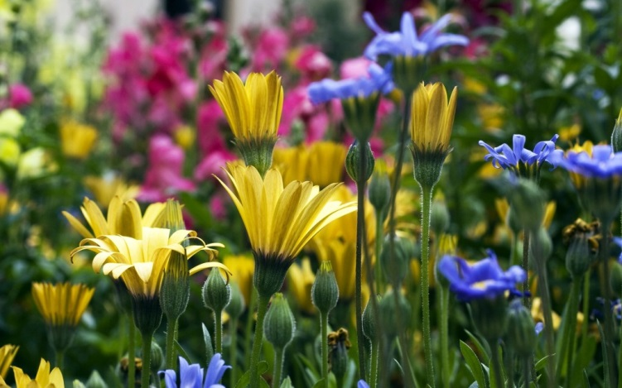
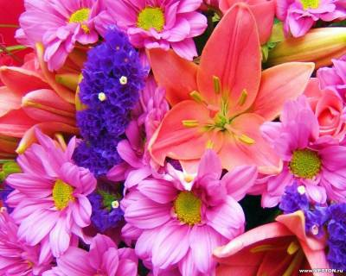
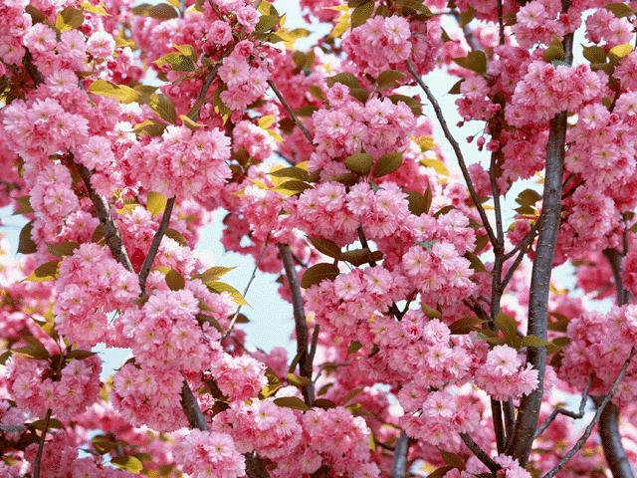
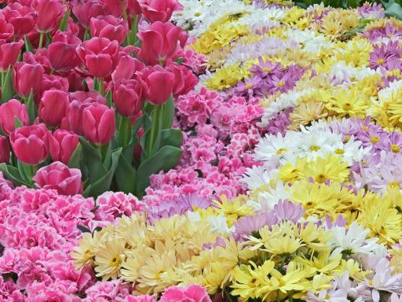
I went to the wood of flowers,
(No one was with me)
I was there alone for hours –
I was happy as could be
In the wood of flowers.
There was grass on the ground,
There were buds on the tree,
And the wind had a sound
Of such gaiety,
That I was as happy
As happy could be
In the wood of flowers.

