Slide 1
Guess the animal
The Author: Lukinykh Anastasia
6 «А»

Slide 2
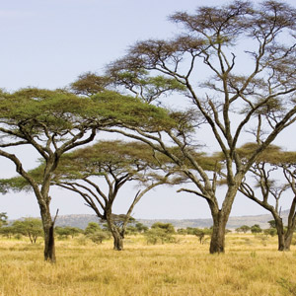
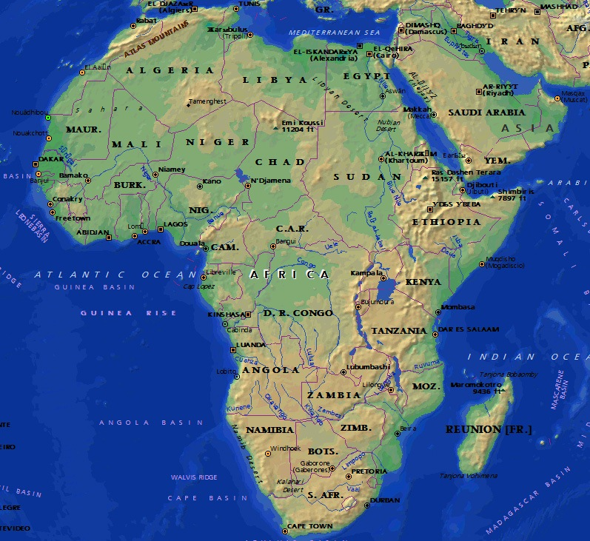
Where do I live?
Safari Africa

Slide 3
he knows how to climb trees
!!!

Slide 4
Who am I?
?
!
?
?
!
!
?
!

Slide 5
tips

Slide 6
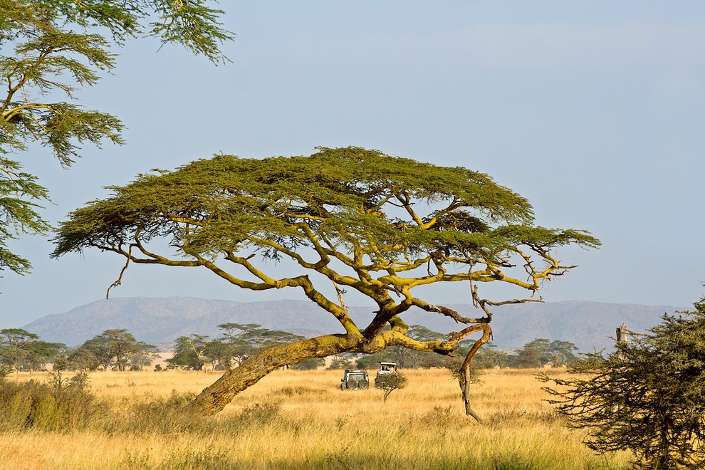
What do I eat?
I eat only leaves

Slide 7
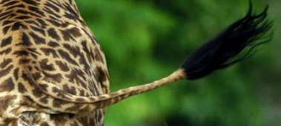
What parts of body do I have?
I have a tail and horns

Slide 8
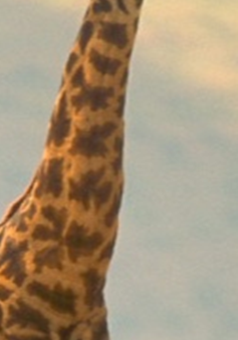
I have a long neck

Slide 9
Who am I?
?
!
?
?
!
!
?
!

Slide 10
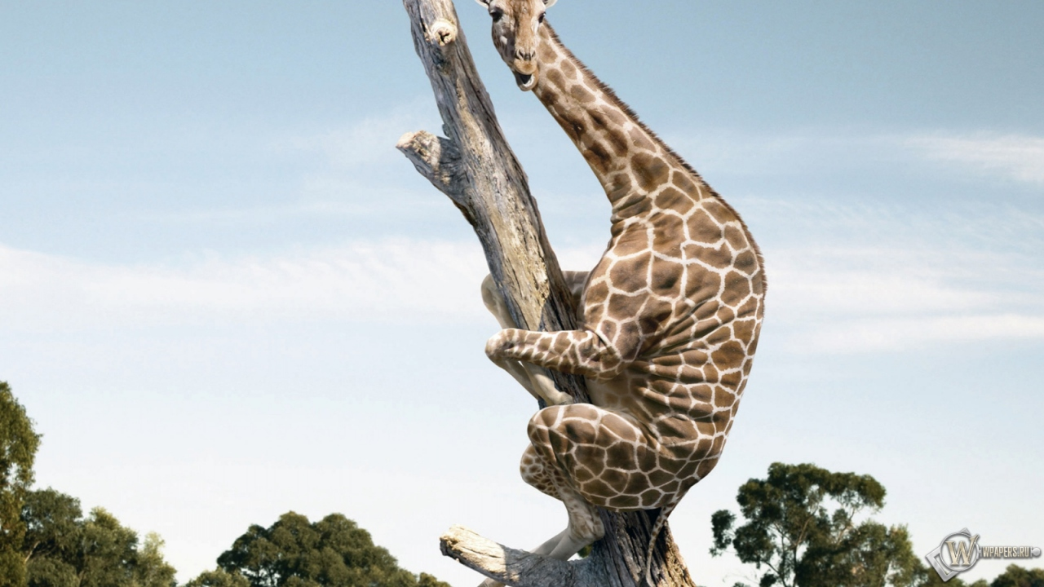
I am a giraffe!!!

Slide 11
The second animal

Slide 12
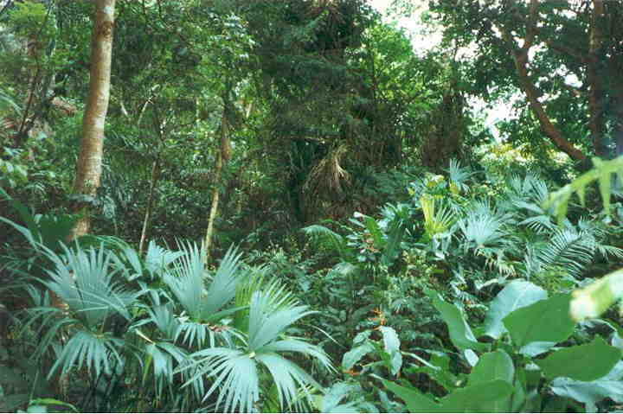
where do I live?
I live in the tropical forests of America

Slide 13
where do I live? I was born here

Slide 14
What do I eat?
I eat bananas and berries

Slide 15
my parts of body
I have a big, beautiful beak

Slide 16
Who am I?
?
!
?
?
!
!
?
!

Slide 17
I am a TOUCAN!!!

