Slide 1
a pilot He usually wears a dark blue suit
with gold buttons, a blue shirt,
a blue tie, a blue cap and black
shoes.

Slide 2
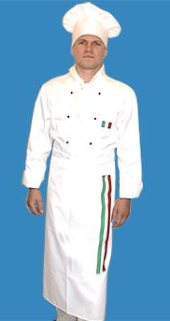
a cook
He usually wears a white shirt,
white trousers and a white cook cap

Slide 3
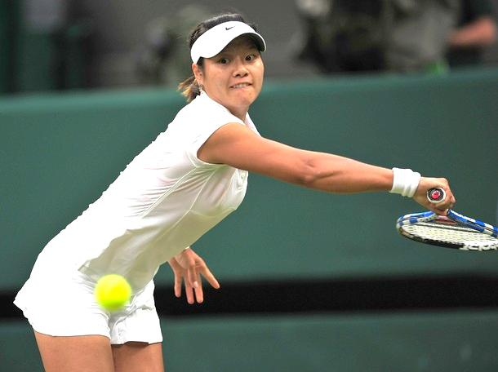
a tennis player
She usually wears a white T-shirt,
a short white skirt or white shorts,
a white cap , white socks and
white (Reebok/ Adidas)trainers.

Slide 4
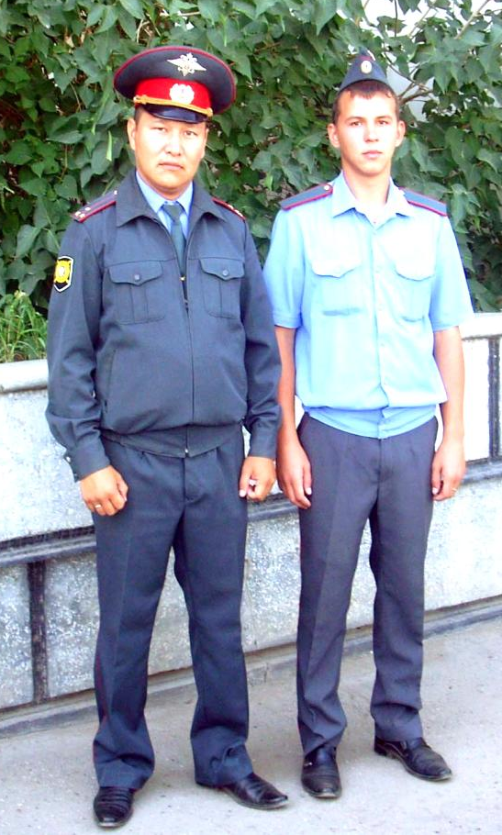
а policeman
He usually wears a dark blue suit
a blue shirt, a blue tie, a blue cap
and black shoes/ boots.

Slide 5
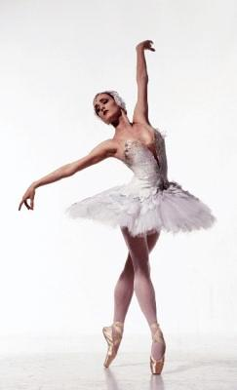
а ballet dancer
She usually wears a ballet
skirt / dress , ballet shoes- pointe.

