Slide 1
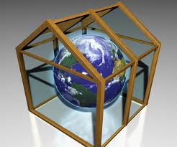
The
GREENHOUSE
EFFECT
There are a lot of problems at the beginning of the new century. People suffer air, water and land pollution.
People have produced a lot of carbon dioxide (CO2). It doesn't allow the heat to escape back. The atmosphere becomes warmer. It is called the "greenhouse effect".

Slide 2
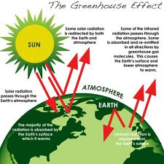
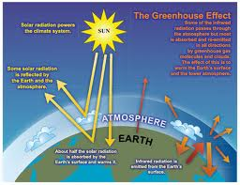
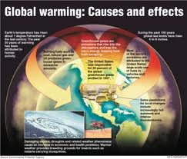
What is the Greenhouse Effect?
The atmosphere is a blanket of gases around the Earth. Now because of pollution, there are more and more gases in the atmosphere. This means that the Earth is getting hotter.

Slide 3
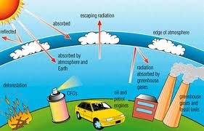
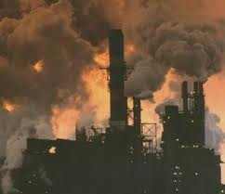
Why is it happening?
Pollution sends 4 main 'greenhouse gases' into the atmosphere. These are:
1) Carbon dioxide (CO2) 2) Methane
3) CFCs (Chloro-fluoro-carbons) 4)Nitrous Oxide

Slide 4
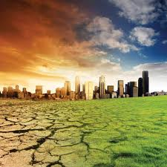
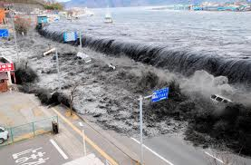
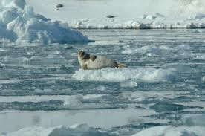
What will it do?
This will change the weather everywhere.The ice at the North and South Poles will start to melt. And the level of the sea will rise. It will cause serious floods in many countries. Then there's the problem of food.

Slide 5
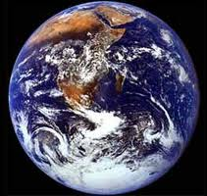
How can we stop it?
We can't stop the Greenhouse Effect, but we can slow it down. There are several ways to do this:
Conserve Fossil Fuels
Conserve Rainforests
Use Natural Energy
Ban CFCs

