Slide 1
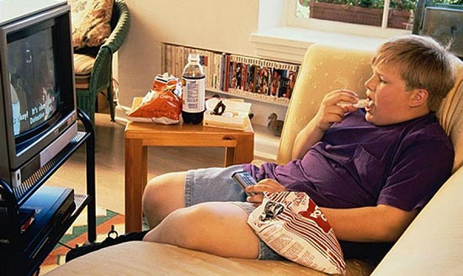
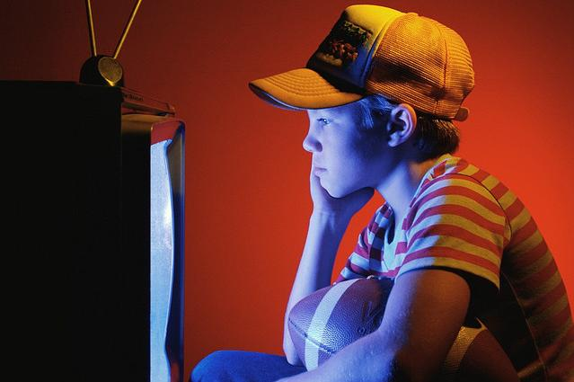
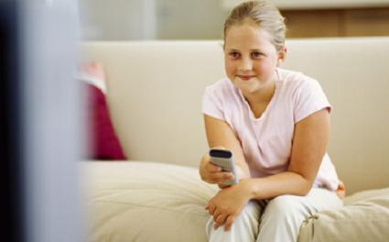
Are you a TV Addict?

Slide 2
A TV Quiz
How much time/ to spend/ in front of TV?
What/ the first thing to do/ when to come home?
If/ to have free time/ today/ what/ to do?
Imagine/ TV/ not to work? what/ to do?
If/ there /to be nothing good on/ what/ to do?
How/ to spend perfect evening?
How/ TV/ to influence ones’ lives?

Slide 3
The questions of the quiz
How much time do you spend in front of a TV?
What is the first thing you do when you get home?
If you have free time today what would you do?
Imagine your TV is not working for a week, what would you do?
There is nothing good on, what would you do?
How would you spend your perfect evening?
How does TV influence our lives?

Slide 4
The right answers
A
B
A
A
B
B
B
The score: 9

Slide 5
Are you a TV Addict?
 | 1 | 2 | 3 | 4 | 5 | 6 | 7 | Score
1. DASHA D.
2. DASHA S.
3. SASHA B.
4. VANYA S.
5. SASHA R.
6. ALESYA S.
A (1 POINT)
B (2 POINTS)
C (3 POINTS)

Slide 6
Are the pupils of the 8 B TV Addicts?

Slide 7
Thank you!

