Slide 1
Притяжательные местоимения
* Они отвечают на вопрос whose? - чей?-чья?чьё? и выражают принадлежность какому-либо лицу
* Они показывают на отношения (родство) между людьми:
He is my grandpa.
Мой, моя – my
Tвоё- your
Её - her
Его- his
Для неодушевленных лиц
Его, ее, их – its.

Slide 2
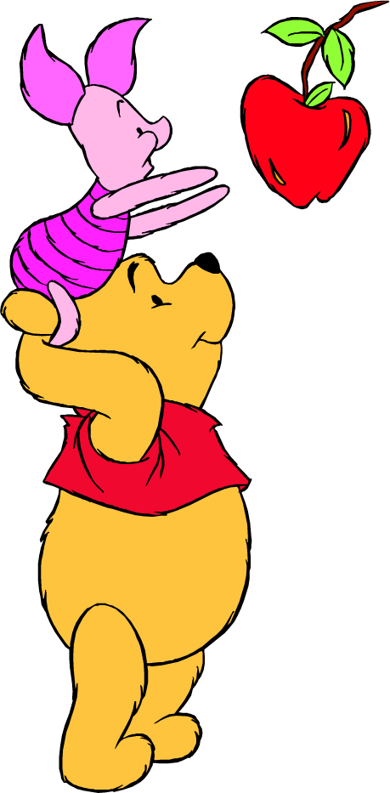
Let’s sing a song

Slide 3
Open your books at page 28
my/ her
his/her
your/my
Your/Their

Slide 4
What does Maya say about her family members?
This is my …

Slide 5
Open your workbooks at page 15
Read and circle:
her / his
its / their
her / their your /my
Our/ Its
Kelly Don
Sue Frank
Jill
Lin
Vicky
Pam

Slide 6
Check your work, please.
2. His name is Don.
3.Their names are Sue and Frank.
4. Is her name Jill or Pam?
5. Are your names Lin and Vicky?
6.Its name isn t Bubbles.

Slide 7
TEST
1
2
3

Slide 8
Check your work, please.
1 | B
2 | C
3 | A

Slide 9
HOMEWORK
Модуль 2. LESSON 3 а . EX.4, P.29 textbook
P.28 выучить грамматическую таблицу «Местоимения»

