Slide 1
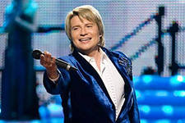
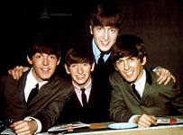
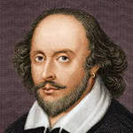
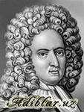
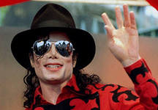
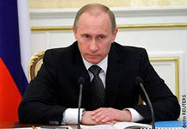
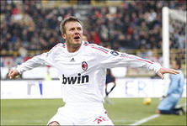
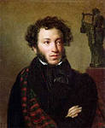
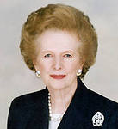
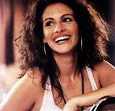
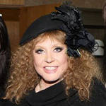
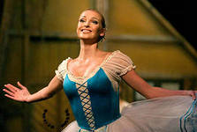
Baskov
The Beatles
W.Shakespeare
D.Defoe
M.Jackson
V.Putin
D. Beckham
A.Pushkin
M.Thatcher
J.Roberts
A.Pugacheva
A.Volochkova

Slide 2
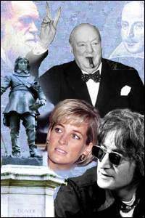
FAMOUS PEOPLE
ЛИСТВЕНСКАЯ ОШ
Урок английского языка
в 5 классе по теме:
Подготовила:
учитель английского языка
Галагуцкая Наталья Васильевна

Slide 3
Four furious friends fought for the phone.

Slide 4
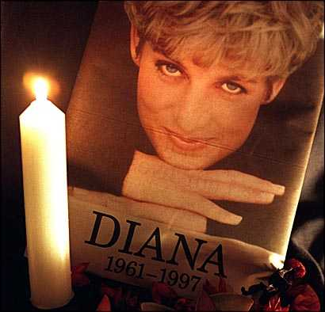

Slide 5
PRINCESS DIANA
Diana was born on July 1, 1961 in Norfolk, England. Diana had two older sisters, Sarah and Jane, and a younger brother, Charles.
Diana attended private boarding schools. she was good at sports, and won trophies for her swimming.
Diana and Prince Charles married on July 29, 1981 in St. Paul’s Cathedral in London.

Slide 6
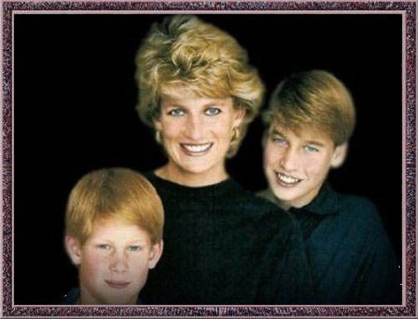
They had two children, William and Harry, but soon they became unhappy together.

Slide 7
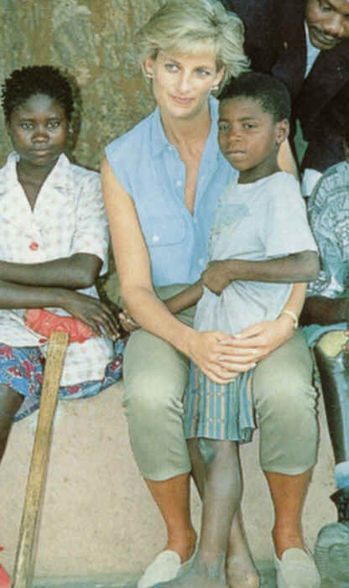
Diana liked pop music, romantic novels and charity work. In 1996 Charles and Diana were no longer husband and wife.

Slide 8
Diana put all of her energy into her two sons and her charity work.
In 1997 she was tragically killed in a car crash in Paris.

Slide 9
Diana’s facts
FULL NAME______________________
IS FROM_________________________
DATE OF BIRTH____________________
FAMILY__________________________
HOBBIES_________________________
SHE COULD_______________________

Slide 10
The Possessive Case of Nouns Притяжательный падеж существительных
‘s- для ед. числа
The dog’s box-коробка собаки
‘- для множ. числа
The cats’ basket-корзина кошек

Slide 11
Choose the right answer
Кошка Элисон
Alison’s cat b. the cat’s Alison
2.собака Тома
a.the dog’s Tom b. Tom’s dog
3. попугай мальчиков
a.the parrots boys b.the boys’ parrot
4.черепаха девочек
a.the girls’ tortoise b. the tortoise’s girls
5.велосипед ученика
a.the pupil’s bicycle b.the bicycle’s pupils

Slide 12
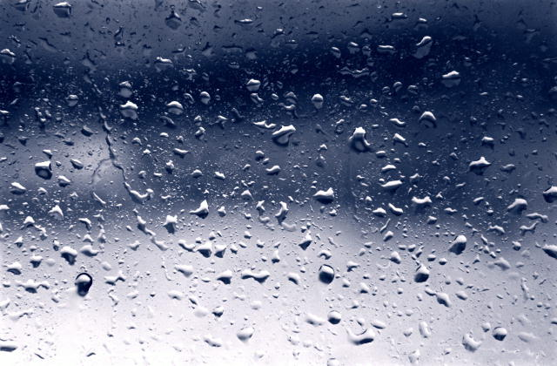
Write down your home task:
Study the information about Shakira and
fill in the card with facts about her
( EX .1 p.60)

Slide 13
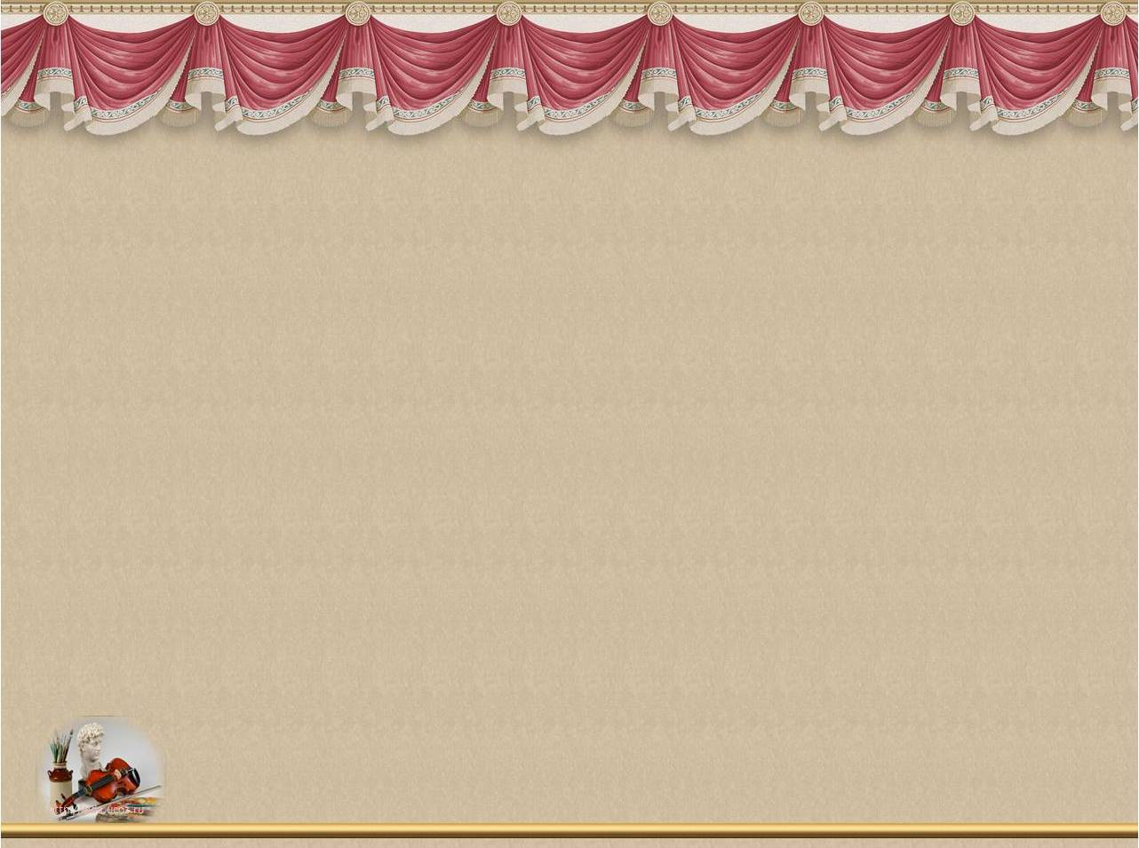
THANKS
FOR YOUR
GOOD JOB!

