Slide 1
English Tea
Труфякова Т.В.

Slide 2
English tea is a mixture of several black teas, usually taken during breakfast. English tea is currently one of the most popular varieties of tea in England.

Slide 3
English tea is also marketed as English Breakfast Tea.
English tea usually involves a mixture of several black teas mainly from Indian and Sri Lanka, although Chinese black tea is also used. Some teas used in English tea include Assam tea, Nilgiri tea and Keemun tea.

Slide 4
The term comes from the popularity of tea drinking in England, which began in full swing during the 19th century.
English tea has a full-bodied taste, with floral undertones. When blended with milk, English tea has a taste reminiscent of freshly toasted bread with honey.

Slide 5
The strength of English tea also makes it ideal as a morning wake-up drink. The mixture of black teas in English tea gives the tea a stimulating quality.

Slide 6
History of English tea
Drinking English tea during breakfast is a common ritual in England. It was invented in the 19th century in Scotland by a tea master named Drysdale, who created a blend of several black teas and marketed it as "Breakfast Tea".

Slide 7
Tea at the time was highly popular in England and soon the name was changed to English tea. The toasted bread with honey taste helped give English tea its connotations as a breakfast tea.
During the 19th century, the English had two meals - breakfast and dinner. It was common for people to take afternoon tea in between, which was a light lunch. With tea already associated with a time, it was not difficult for English tea to become associated with mornings.

Slide 8
English tea became highly popular in England, and taking English tea as part of breakfast has become an English tradition.
Amongst the mixture of teas in English tea is Keemun tea, a Chinese black tea. It is said by some tea authorities that Keemun tea blended with milk creates the famously homely taste.

Slide 9
Teas in Britain
Tea is the British and Irish national drink. Teas in Britain are drunk daily, often many cups a day, but where did this love of teas in Britain come from?

Slide 10
History of Teas in Britain and Ireland
Tea was first brought to Britain in the early 17th century by the East India Company. It was an expensive product and one only for the rich and often kept under lock and key. Catherine of Braganza, wife of Charles II introduced the ritual of drinking teas to the English Royal Court and the habit was soon adopted by the aristocracy.

Slide 11
The first tea shop for ladies was opened by Thomas Twining in 1717 and slowly tea shops began to appear throughout England making the drinking of teas available to everyone. The British further developed their love of teas during the years of the British Empire in India.

Slide 12
One Per Person and One for the Pot - Making the Perfect Cup of Tea.
Everyone has an opinion on how to make a ‘proper’ cup of tea. The first ingredient must be leaf teas. Not tea bags and certainly not powder. Only black tea is considered real for a cup of tea in Britain. Black tea is the dried and fermented leaves of the tea plant, Camellia sinensis.

Slide 13
Step by Step Instructions to the Perfect Cup of Tea
Fill a kettle with fresh water and bring to the boil.
Warm the teapot with a little of the boiled water, swirl it around the pot and discard.
Place 1 tsp of fresh, leaf tea per person plus one for the pot.
Top up the teapot with the boiling water (do not allow the water to go off-the-boil or it will not be hot enough to brew the tea).
Leave to infuse for 3 – 4 minutes, no longer or it will develop a ‘stewed’ flavor.
Pour the tea through a tea-strainer directly into clean – preferably – china teacups.

Slide 14
Milk in First or Teas in First?
Debate continues about whether to put milk in the cup before pouring or after. Originally milk was always added before the tea to prevent the hot teas from cracking the fine bone china cups. Tea experts agree with this tradition but also state to pour milk into hot tea after it is poured alters the flavor of the tea.

Slide 15
The Right Teapot
The right teapot for the perfect cuppa is a matter if personal preference either metal (all early teapots were solid silver, ornate vessels) or china. A metal teapot will keep the tea hotter for longer but some feel that china keeps a finer flavor, with no tainting from the metal.

Slide 16
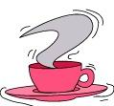
There are some occasions when you must not refuse a cup of tea, otherwise you are judged an exotic and barbarous bird without any hope of ever being able to take your place in civilized society.

Slide 17
If you are invited to an English home, at five o'clock in the morning you get a cup of tea. It is either brought in by a heartily smiling hostess or an almost malevolently silent maid. When you are disturbed in your sweetest morning sleep you must not say: "Madam, I think you are a cruel, spiteful and malig­nant person who deserves to be shot". On the contrary, you have to declare with your best five o'clock smile: "Thank you so much. I do adore a cup of early morning tea, especially early in the morning". If they leave you alone with the liquid, you may pour it down the washbasin.

Slide 18
Then you have tea for break­fast; then you have tea at eleven o'clock in the morning; then after lunch; then you have tea for tea; then for supper; and again at eleven o'clock at night.

Slide 19
You must not refuse any additional cups of tea under the following circumstances: if it is hot; if it is cold; if you are tired; if anybody thinks that you might be tired; if you are nerv­ous; if you are gay; before you go out; if you have just returned home; if you feel like it; if you do not feel like it; if you have had no tea for some time; if you have just had a cup...

Slide 20
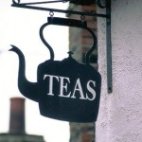
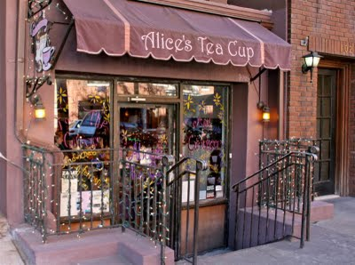

Slide 21
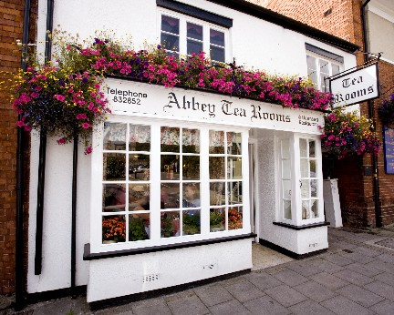
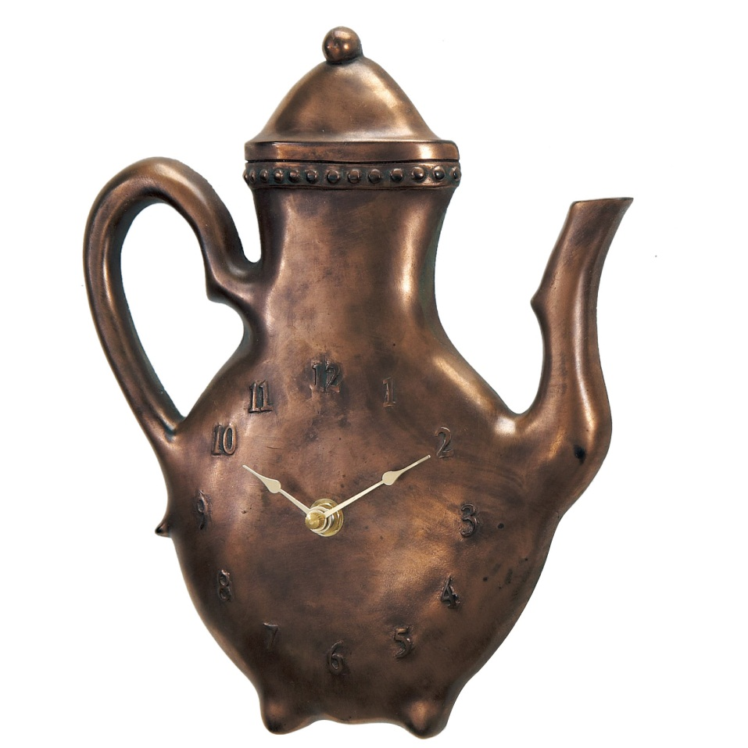
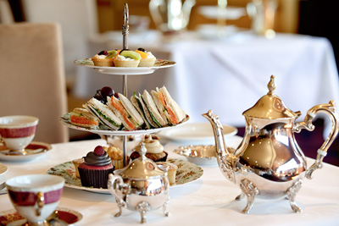

Slide 22
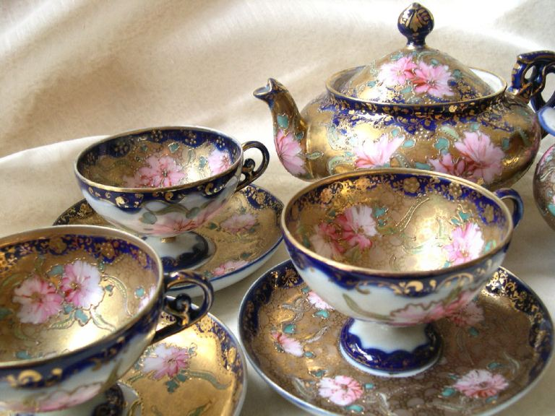
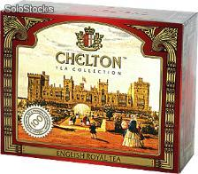
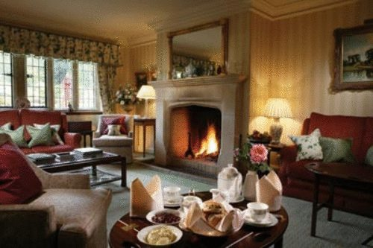

Slide 23
