Slide 1
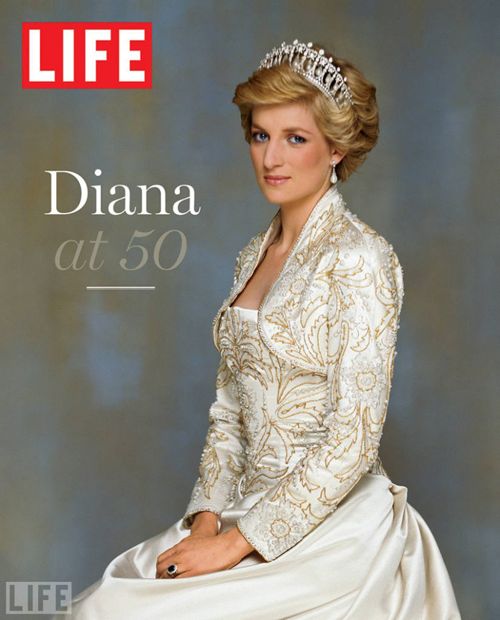
Diana, Princess of Wales

Slide 2
the most famous woman of the XX century

