Slide 1
Mikhail Gorbachev
RUSSIAN POLITIC

Slide 2
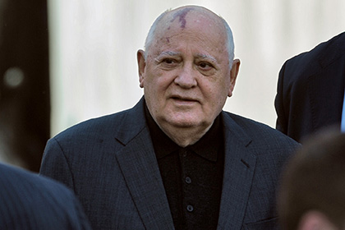
Gorbachev Mikhail Sergeevich-soviet and Russian state and public figure, Secretary general of CК of КPSS in 1985-1991гг.,initiator of alteration resulting in considerable changes in life of country and world

Slide 3
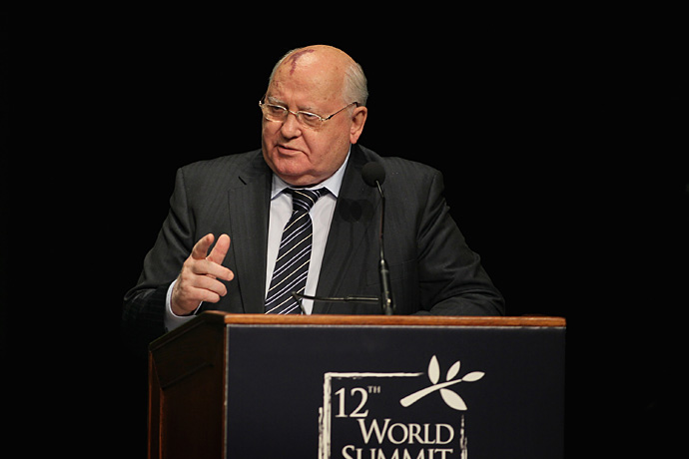
In 1985 on March Plenum of CК of KPSS Gorbachev was officially select the Secretary general of CК of КPSS. Gorbachev also occupied and other higher posts in State: since 1989 Chairman of Presidium of Supreme Soviet of the USSR, And From a 1990 President of the USSR.

Slide 4
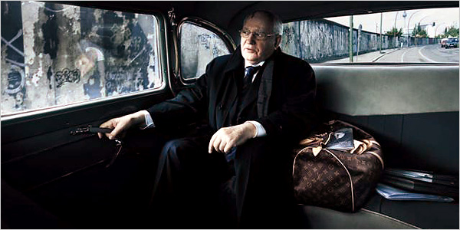
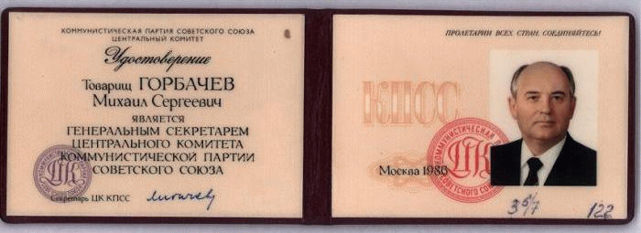
Originally reforms brought back to life economic life. Commodities appeared on counters, but at the end of 1988 scarcity of goods was sharply intensifyed. A production in a number of industries began to fall

Slide 5
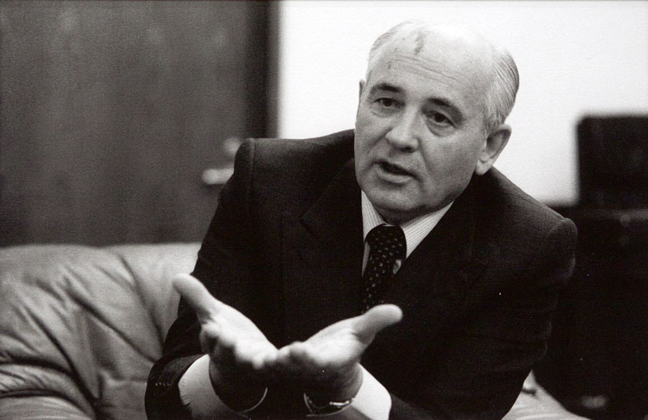
Related to the name of Gorbachev the foreign policy of the "new thinking" assisted the native change of all international climate (stopping of "cold war" and war is in Afghanistan)

Slide 6
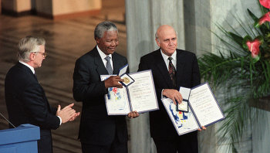
Nobel Peace Prize of 1990 became an award to Gorbachev for his contribution to easing of international tension

Slide 7
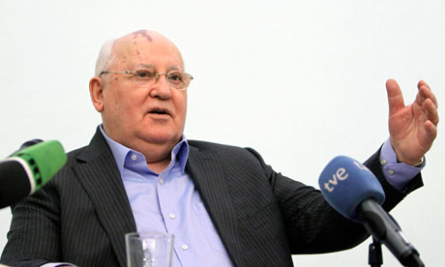
The domestic policy, first of all chaotic economic reforms, led at deepening of crisis in all spheres of society and a consequence, to sharp decrease in a standard of living for what blamed, first of all, Gorbachev

Slide 8
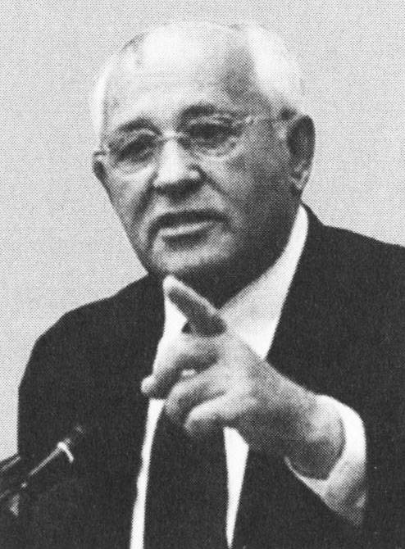
At Gorbachev the bloody international conflicts broke out (in Nagorno-Karabakh, in Sumgait and Baku, etc. regions). Gorbachev's reaction was, as a rule, запоздалой.он followed the tastes of events not in a state to affect them

Slide 9
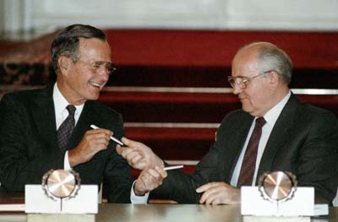
In December, 1991 after signing of the Belavezha Accords about elimination of the USSR Gorbachev gave to resignation from the presidency of the USSR

Slide 10
