Slide 1
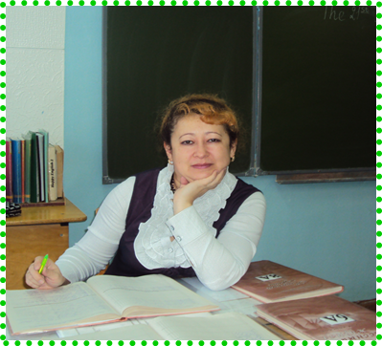
The Solar System
Муниципальное бюджетное общеобразовательное
учреждение средняя общеобразовательная школа № 4
(МБОУ СОШ № 4 г. Советский)
628242, Ханты-Мансийский автономный округ - Югра
г. Советский, ул. Советская 10 « а» т. 3-33-58
Учитель английского языка
Турсунова .М.С.
г. Советский

Slide 2
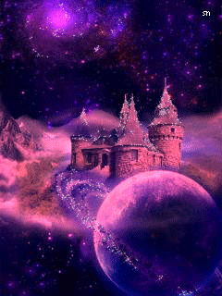
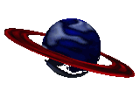
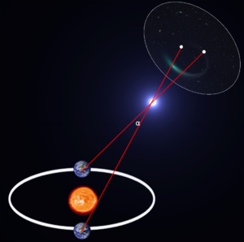
Note:
The Galaxy -the large group of stars which our Sun and its planets belong to.
A galaxy – one of the large groups of stars that make up the universe
The universe is all space and everything that exists in it.

Slide 3

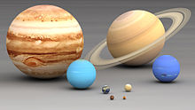
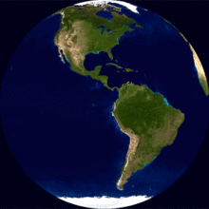
The Earth
The Earth moves round the Sun.
Earth ́ — the third planet from the Sun. The fifth by the size among all planets of Solar system. It is also the largest on diameter, weight and density among planets of terrestrial group

Slide 4


The Sun
The Sun — the only star of Solar system, a sun. Round the Sun other objects of this system address: planets and their satellites, dwarfish planets and their satellites, asteroids, meteorites, comets and space dust

Slide 5

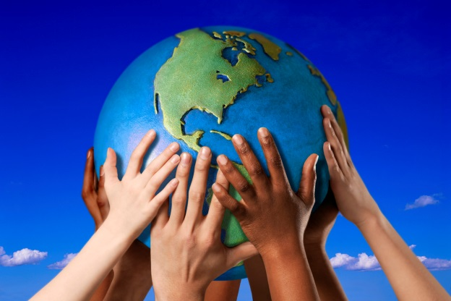

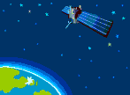
Look at the space picture. Match the pictures and the following words: galaxy,the Earth, the Sun,planet, the Moon, star, astronaut.
the Moon
the Sun
the Earth
star
planet
galaxy
astronaut.

Slide 6
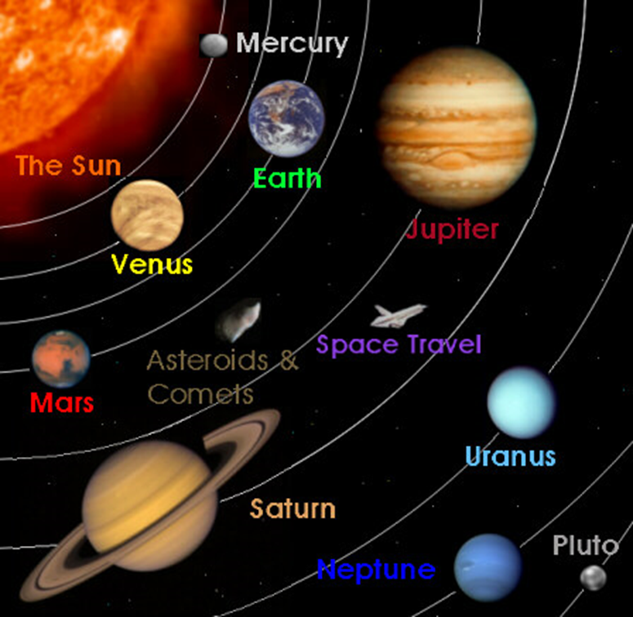
Look at the picture and name the main planets of the Solar System

