Slide 1
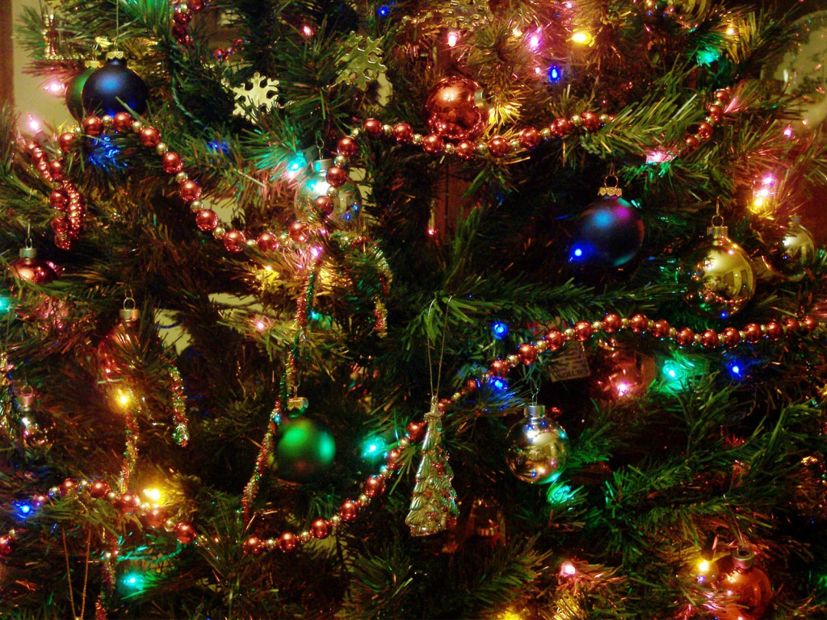
The English people celebrate Christmas on the twenty fifth of December.

Slide 2
They decorate houses.

Slide 3
They decorate the room with a Christmas tree.

Slide 4
Parents give presents to children.

Slide 5
People give presents to each other (друг другу).

Slide 6
Children sing Christmas songs.

Slide 7
We wish you a merry Christmas! We wish you a merry Christmas! We wish you a merry Christmas! And a Happy New Year!
Let’s sing together!

Slide 8
Children write letters (письма) to Santa Claus.

