Slide 1
King Arthur
Sofya Zalivanskaya Form 8A Gymnasium №1

Slide 2
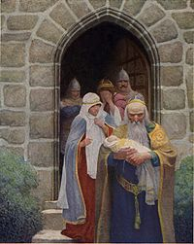
King Uther and Merlin
Once there was a king in Britain called King Uther. He loved the beautiful princess Igraine, and he wanted to marry her, but she did not love him. There was a magician named Merlin, who lived in that country. One day Merlin came to King Uther. He said that he would help him but King Uther would have to give his son to him. King Uther agreed.

Slide 3
King Uther Calls Great Men
Soon after that, King Uther became very ill and he was going to die. He asked Merlin to call great men. King Uther wanted his son to become king after him. But all the knights and great men wanted to make themselves king. Merlin showed a sword in the stone, and said that the man who could take it out of the stone would be King of Britain.

Slide 4
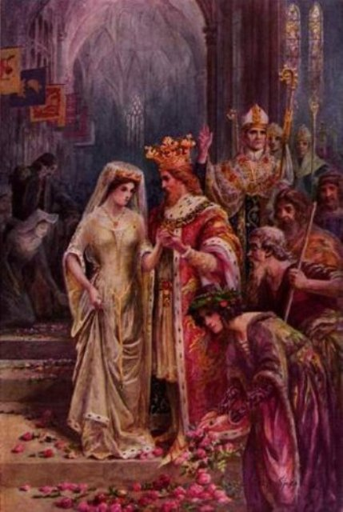
Arthur Becomes King
Only Arthur could take it out of the stone . So Arthur became king. He married the most beautiful lady in England, Princess Guinevere, and she became his queen. Then Merlin made a large round table for King Arthur’s knights in Camelot. There were150 places. Each knight had his name written in his place.

Slide 5
The Sword Excalibur
When some time passed, King Arthur broke his sword in a fight. Merlin said he’d help him to get a bet­ter sword. As Arthur stood by the lake he saw an arm with a sword in its hand come up out of the water. "It is the sword Excalibur. It's a magic sword." "No man can kill the man who has this sword," said Merlin. Arthur took the sword.

Slide 6
Morgan le Fay
Morgan le Fay was a queen, with a castle in the country of Gorres.
She could do magic for bad things. King Arthur did not know that Morgan le Fay hated him. She wanted King Arthur to die. On his way home he left Excalibur with Queen Morgan le Fay at her castle and stayed there because he was very tired.

Slide 7
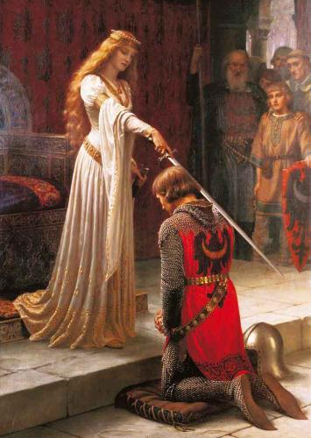
Queen Morgan le Fay sent some knights to kill King Arthur. The fight began. He could not hurt the other knights with his sword, because the sword was not Excalibur! It was a sword from Morgan le Fay’s magic.
It looked the same as Excalibur, but it was different. When the other knight hit Arthur with his sword, it hurt him. He hit the knight on the helmet with his broken sword — so hard that the knight fell down and his sword fell from his hand. Arthur quickly took the knight's sword. It was Excalibur!

Slide 8
The Grail
King Arthur and all his knights sat down at the Round Table.
Suddenly they heard a loud noise. Then there was a great white light.
They looked up and saw a gold cup above the table.
Sir Galahad said, ’That is the Grail’
Some knights also left Camelot to look for the Grail. At last they found the Grail. The Grail: A gold cup. Jesus used it before he died.

Slide 9
King Arthur Dies
When Arthur was away, the evil knight Sir Mordred told Queen Guinevere that King Arthur was dead. He wanted to take Queen away. Sir Mordred and his men saw King Arthur. They began to fight. They fought all day.

Slide 10
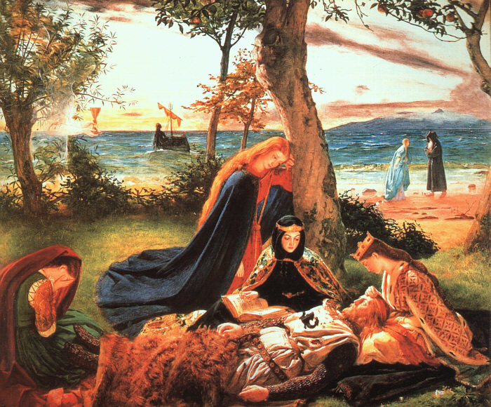
King Arthur saw that his knights were dead. Then Arthur ran to Mordred and killed him. Mordred fell, but he wounded King Arthur with his sword. Arthur said that he was dying and asked his knight to throw Excalibur into the water. His knight put King Arthur on the boat and the ladies stood round him.

Slide 11
King Arthur
Sofya Zalivanskaya Form 8A Gymnasium №1

