Slide 1
Открытый урок
по теме:
«English Holidays»
Цыганок М.Р.
МБОУ СОШ №24
Орёл 2014

Slide 2
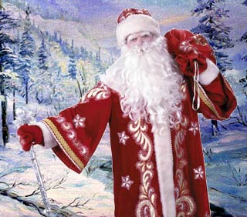
New Year’s day (January, 1)
There are a number of holidays, which are celebrated in Great Britain every year. One of them is, of course, New Year's Day on 1 January. It is not so popular in England as in our country, but it is rather popular in Scotland. On that day people usually visit their friends and there is a lot of dancing and eating. In Scotland people bring a piece of coal for good luck in the New Year.

Slide 3
St. Valentine’s Day (February, 24)
The next holiday of the year is St. Valentine's Day. It is on 14 February. People buy or make Valentine cards and send them to the people they love.

Slide 4
Mother’s Day (March)
In March there is Mother's Day. It is always the fourth Sunday of Lent. Mothering Sunday is a time when children pay respect to their Mothers. All the children, little or adult ones, come to their mothers on that day to express their love and gratitude.

Slide 5
Easter (April)
In April there is Easter. At Easter children eat chocolate Easter eggs. Sometimes parents hide them in the house or in the garden and children have to look for them.

Slide 6
Father’s day (June)
In June there is Father's Day. This festival is celebrated on the third Sunday of June and therefore the date of the holiday is never fixed. On Father's Day children give or send their fathers and grandfathers cards and presents.

Slide 7
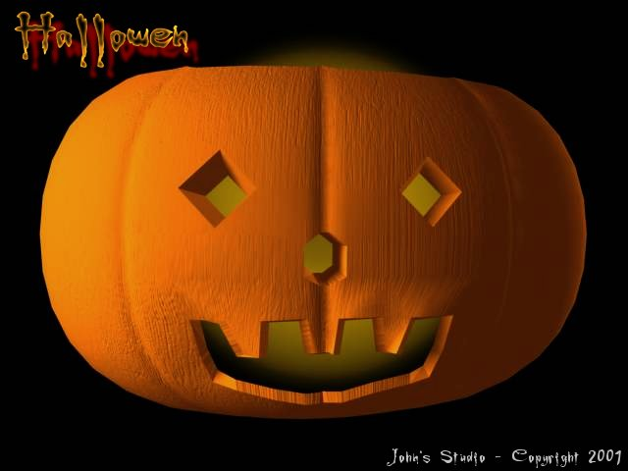
Halloween (October, 31)
On 31 October there is a Halloween. They say ghosts and witches come out on Halloween. People make lanterns out of pumpkins. Some people have Halloween parties and dress as witches and ghosts.

Slide 8
GIFT-RECEIVING:
Thank you very much.
I’m so grateful to you…
I’m happy to have it.
Thanks a lot.

Slide 9
GIFT-GIVING:
You are welcome.
Don’t mention it.
I was happy to do it.
It was my pleasure.

