Slide 1
Mikhail
Yuryevich
Lermontov

Slide 2
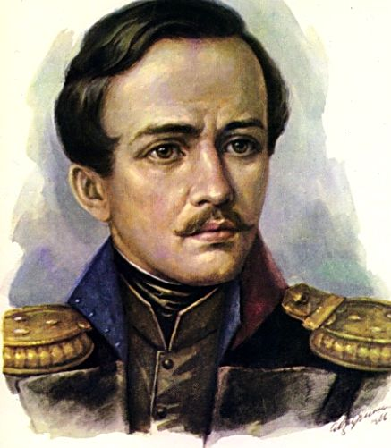
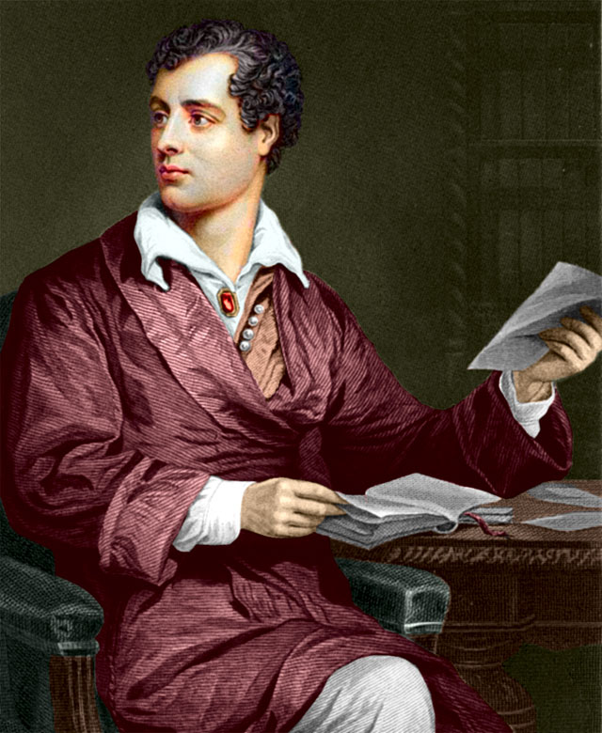
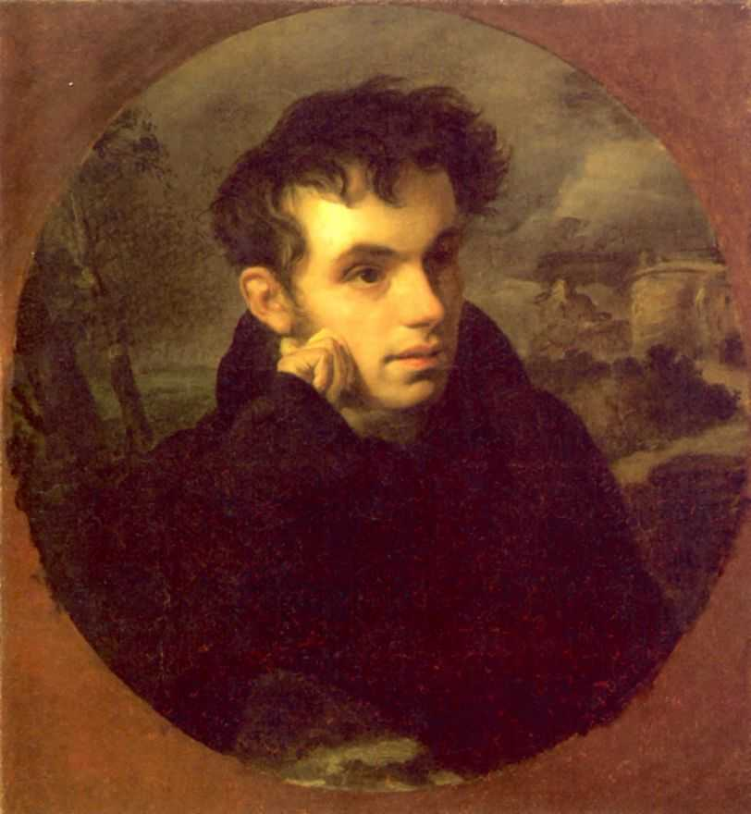
Match the names with the pictures
1
a) Zhukovskyi
2
b) Lermontov
3
c) Byron

Slide 3
Lermontov is one of the most famous Russian
poets
scientists
artists

Slide 4
Lermontov is one of the most famous Russian
poets

Slide 5
Lermontov was born in
Moscow
Tarkhany
Pyatigorsk

Slide 6
Lermontov was born in
Moscow

Slide 7
Lermontov was born in
1814
1418
1841

Slide 8
Lermontov was born in
1814

Slide 9
As Lermontov’s mother died when he was only 3 … took care of him.
his father
his grandmother
his uncle

Slide 10
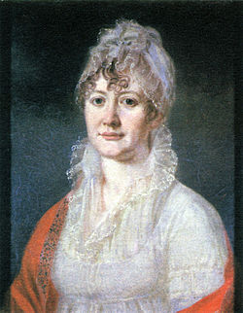
As Lermontov’s mother died when he was only 3 his grandmother took care of him.

Slide 11
Lermontov entered Moscow University in
1830
1827
1832

Slide 12
Lermontov entered the Moscow University in
1830

Slide 13
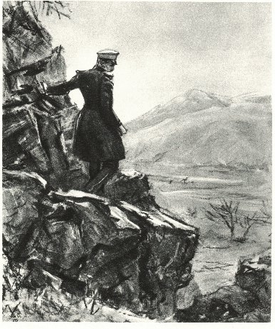
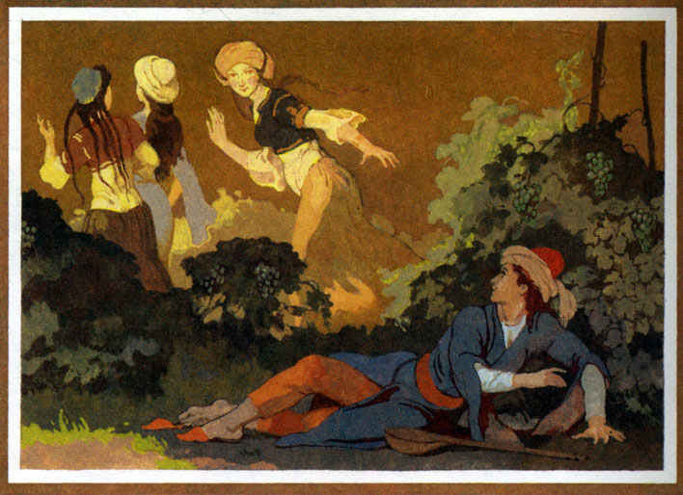
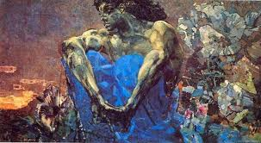
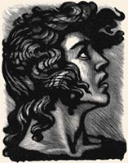
Try to match the book and the illustration
1
3
a) THE DEMON
b) MTSYRI
c) ASHYK-KERIB
2
d) A HERO OF OUR TIME
4

Slide 14
This poem made him famous.
Mtzyri
Death of a Poet
The Demon

Slide 15
This poem made him famous.
Death of a Poet

Slide 16
Try to guess the poem
A lonely sail is flashing white Amdist the blue mist of the sea!... What does it seek in foreign lands? What did it leave behind at home?..

Slide 17
Try to guess the poem
A lonely sail is flashing white Белеет парус одинокий
Amdist the blue mist of the sea!... В тумане моря голубом.
What does it seek in foreign lands?
-Что ищет он в стране далекой?
What did it leave behind at home?..
Что кинул он в краю родном?
Sail
«Парус»

Slide 18
Lermontov gave the name of his main hero after the river
Lena
Pechora
Onega

Slide 19
Lermontov gave the name of his main hero after the river
Lena
Pechora
Onega

Slide 20
Lermontov died during a duel with a fellow officer
Dantes
Barant
Martynov

Slide 21
Lermontov died during a duel with a fellow officer
Martynov

Slide 22
He is buried in
Moscow
Pyatigorsk
Tarkhany

Slide 23
He is buried in
Tarkhany.

Slide 24
Michail Yuryevich Lermontov
M.Y.Lermontov was born in Moscow in 1814. His mother died when he was only 3 years old, so his grandmother took care of a little grandson. He spent his childhood in Tarkhany. In 1830 Lermontov entered Moscow University but didn’t graduated it. He entered the Guard School in St. Petersburg. He began writing in his childhood but became famous after Pushkin’s death when he wrote his poem “Death of a Poet”. In 1830 Lermontov was sent to the Caucasus. It made a great influence on his creativity. One of the most famous books is “A Hero of our Time”. The main character of this book is Pechorin. They say that Pechorin is Lermontov himself. We know many Lermontov’s books, such as “Mtsyri”, “The Demon”, “Ashyk-Kerib” and of course his poems “Sail”, “Borodino”, “The Prophet” (Prorok) and others. Lermontov was a very creative person. He played the piano and violin, knew many languages and was a great artist. Unfortunately he was killed on a duel with a fellow officer Martynov when he was only 27. Lermontov is buried in Tarkhany.

Slide 25
Fill in the Gaps
M.Y.Lermontov was born in ……….. in ……….. His mother died when he was only …….. years old, so his …………… took care of a little …………….. He spent his childhood in ……………. In 1830 Lermontov entered ………………………… but didn’t graduated it. He entered the Guard School in ……………... He began writing in his ……………. but became famous after ………………… when he wrote his poem “Death of a Poet”. In 1830 Lermontov was sent to the ……………….. It made a great influence on his …………………. One of the most famous books is “ …………….”. The main character of this book is …………... They say that Pechorin is ……………..himself. We know many Lermontov’s books, such as “…………..”, “…………..”, “Ashyk-Kerib” and of course his poems “Sail”, “…………..”, “The Prophet” (Prorok) and others. Lermontov was a very …………. person. He played the …………… and violin, knew many ………….. and was a great ……….. Unfortunately he was killed on a ……….. with a fellow officer ………. when he was only ……... Lermontov is buried in ……………….

Slide 26
Fill in the Gaps
M.Y.Lermontov was born in ……….. in ……….. His ……………. died when he was only …….. years old, so his …………… took care of a little …………….. He spent his …………….. in ……………. In ……………..Lermontov entered ………………………… but didn’t graduated it. He entered ……………………… in ……………... He began writing in his ……………. but became ………………after ………………… when he wrote his poem “……………………”. In ………… Lermontov was sent to the ……………….. It had a great influence on his …………………. One of the most …………… books is “ …………….”. The main ………………… of this book is …………... They say that ……………….. is ……………..himself. We know many Lermontov’s books, such as “…………..”, “…………..”, “………………………….” and of course his poems “……………”, “…………..”, “………………” (Prorok) and others. Lermontov was a very …………. person. He played the …………… and ……………., knew many ………….. and was a great ……….. Unfortunately he was killed on a ……….. with a fellow officer ………. when he was only ……... Lermontov is ……….. in ……………….

