Slide 1
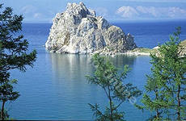

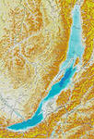
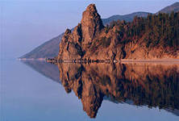
Baikal

Slide 2
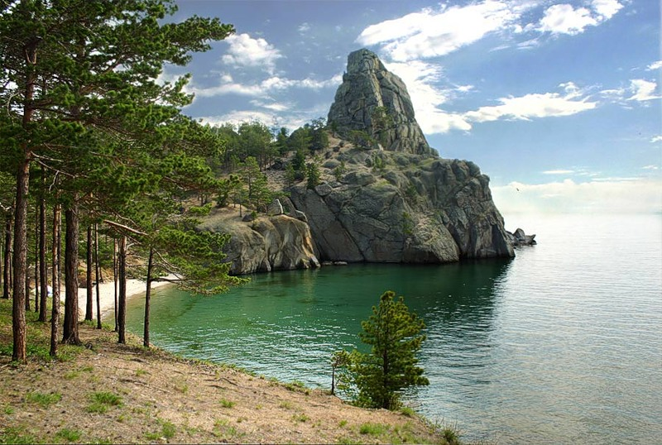
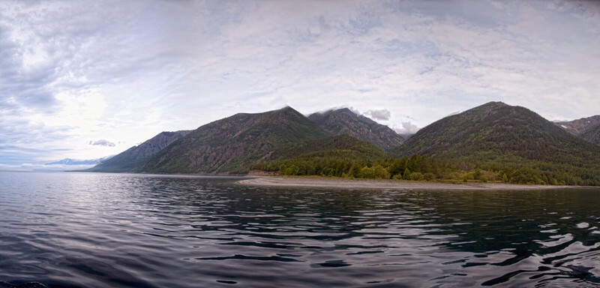
Baikal is the largest lake in Eurasia(636km long and almost 80km wide). and it is the deepest lake in the world.

Slide 3

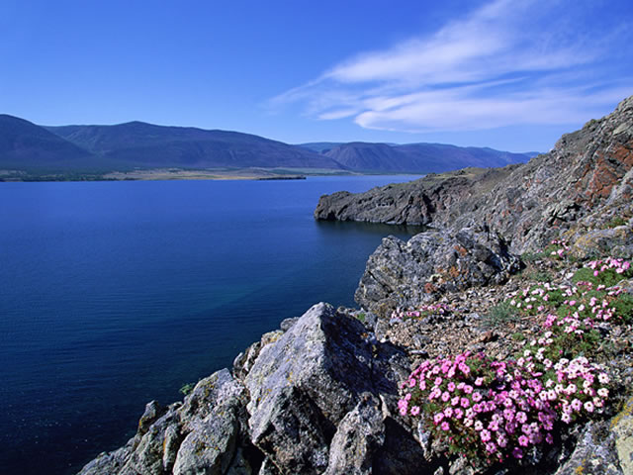
Baikal is situated in a very beautiful place, surrounded by forests and the Barguzin Mountains.

Slide 4
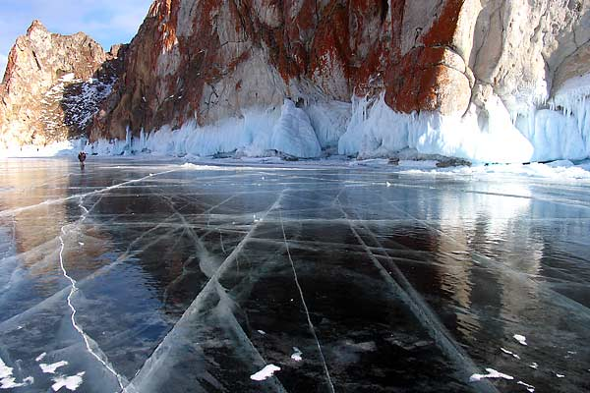
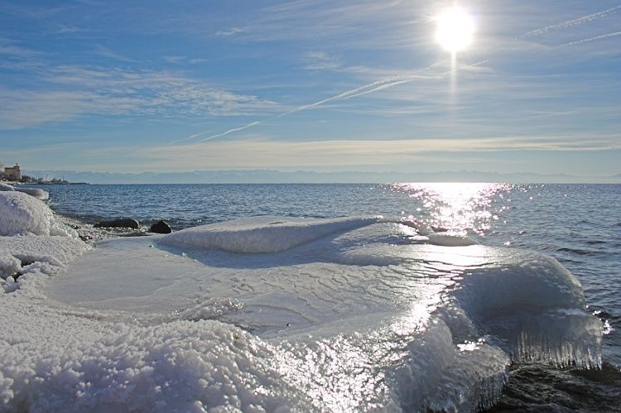
In the winter Baikal freezes over, with ice so thick that you can go sleighing on the lake.

Slide 5
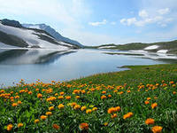
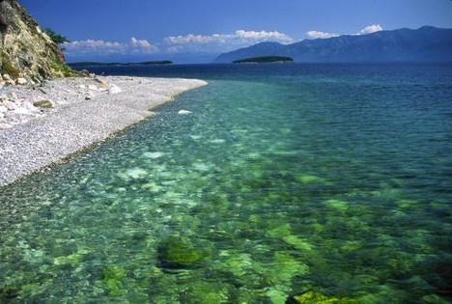
In the summer, its crystal blue waters are transparent to a depth of forty metres, and there are many seasonal wildflowers by the side of the lake.

Slide 6
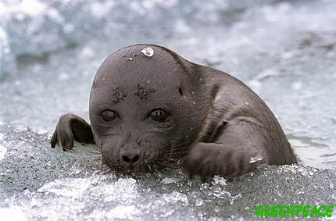
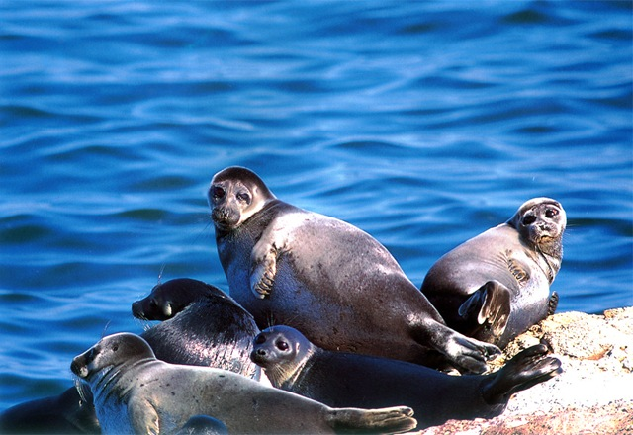
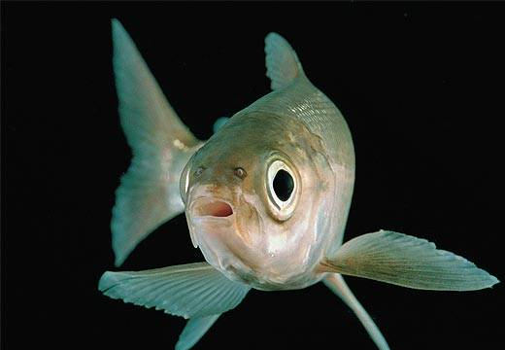
The lake region is home to a great variety of plants and animals, most of which – like nerpas and the omul salmon – are found nowhere else in the world.

Slide 7
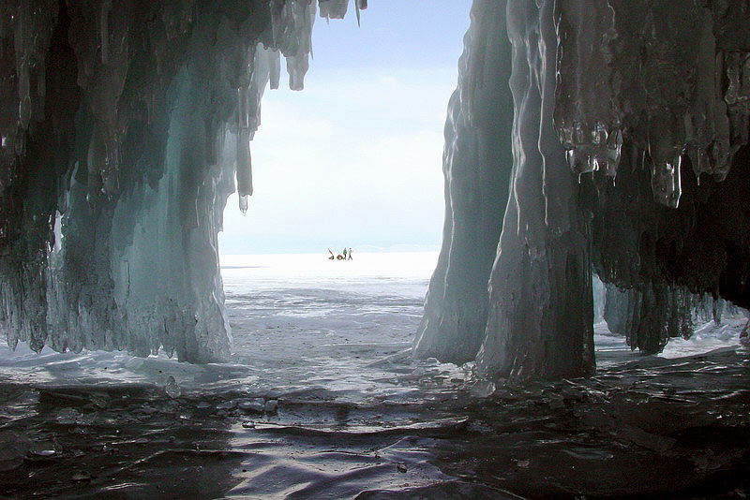
.
Lake Baikal long ago became famous for the purity of its water.

Slide 8
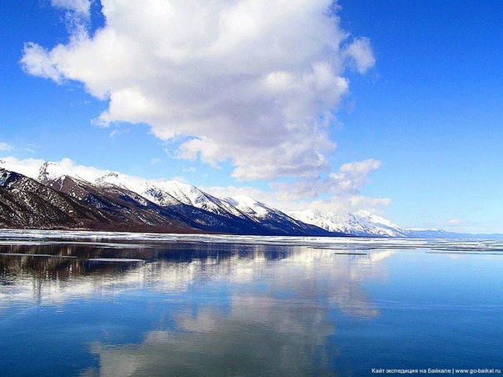
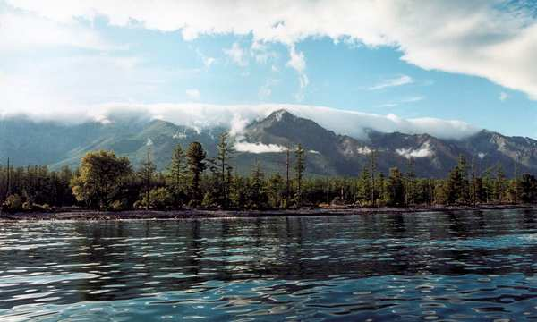
Lake Baikal and the entire surrounding area have become a national park , and today Baikal is a naturalist’s paradise and idyllic holiday area.

Slide 9
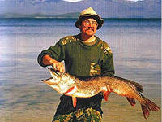
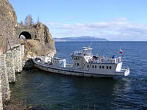
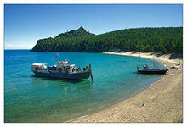
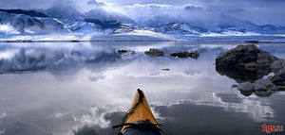

Boat tours during the warm months and hiking in the forest, along the streams and waterfalls of Baikal’s parks, are very popular.

Slide 10
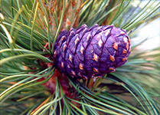
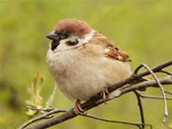

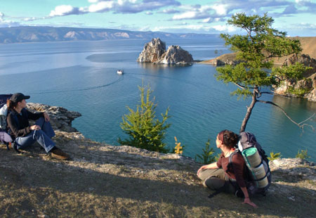
With fine beaches, excellent hiking, birdwatching, and pleasure boating, Baikal is one of the most attractive tourist areas in Asia.

