Slide 1
Our pets

Slide 2
1 step - monitoring
- What pets do you know?
- Have you got a pet?
- What pet have you got?
- Do you like your pets?

Slide 3
Have you got a pet?

Slide 4
What pet have you got?

Slide 5
Do you like your pets?

Slide 6
2 step – scientific information
Cats are very popular in Russia. They are the most popular pets in our class too.
Cats descended from African wild cat and became domestic animals thousands years ago. They have got 4 legs, 2 small or large ears, a short nose, blue, green or grey eyes. They can be long-haired or short-haired. Cats can mew. They are very clever. Cats are very independent and can defend themselves. They love their homes, but not their owners. During a day cats like to sleep, but they like to hunt at night. Cats like to eat fish, cream and to drink milk and water. There are many breeds of cats: long-haired cats (Persian cat), short-haired cats (British cat), Turkish Angora, etc.

Slide 7
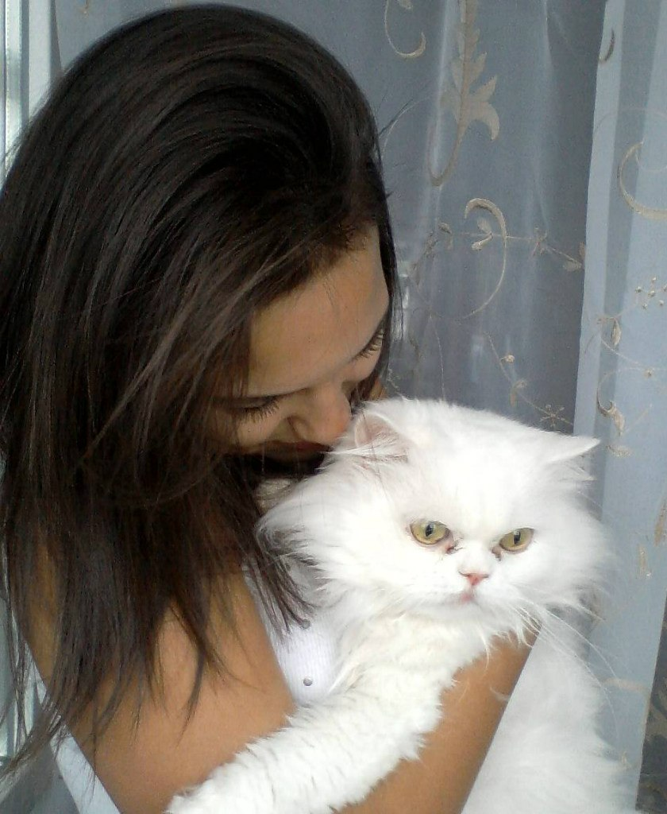
Essays
My name is Nastya. And I have got a pet. It's a cat. His name is Kusia. He is two. He's got big orange eyes, black ears, a long tail and a short neck. He's grey, orange, white, brown and black. My cat is very beautiful and clever. When he was a little kitten he jumped very high, but he didn 't run fast. He was a nice, and fluffy, and funny kitten. He loved playing with my toys and me. Now he's a big cat. Every summer we take our cat to the country. There he hunts mice, birds and lizards. All the nights he spends outdoors. My cat is not very kind, but everybody is fond of her beauty and intellect. Kusia likes to sit at the window-sill and look аt the flying pigeons and other birds. I love Kusia very much.

Slide 8
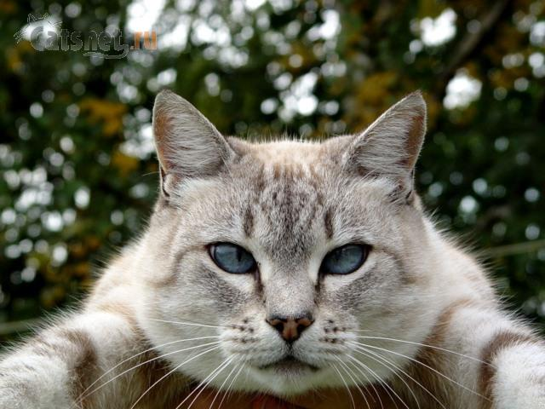
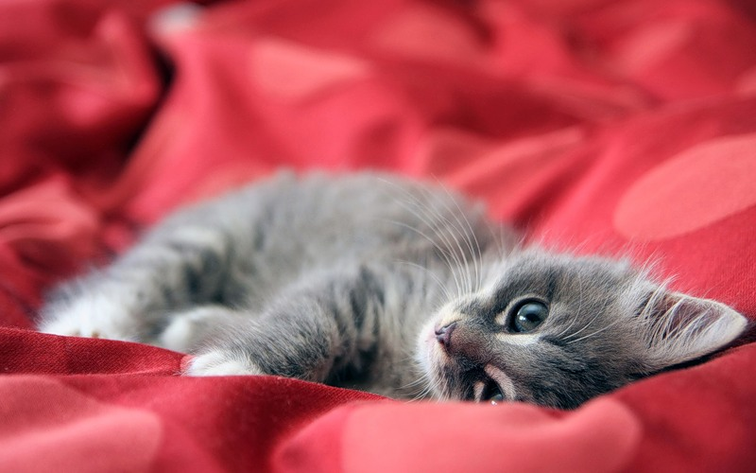
Limericks
There is a cat.
He is very nice and fat.
He is very good
He likes some food,
My cat is very clever and red.
There once was a cat named Pat,
Who didn't know where he was at,
He looked up and down,
And then turned around,
Ran into a wall and went splat!!!

Slide 9
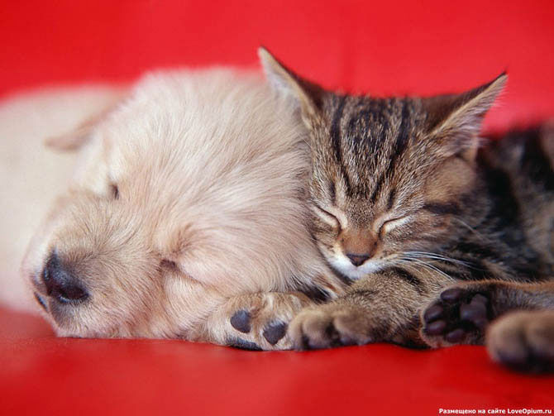
Proverbs
1”When the cat is away the mice will play”( “Без кота мышам раздолье”)
2. “All cats are grey in the night”( “Все кошки ночью серые”)
3. “А cat may look at a king”. (“Смотреть ни на кого не возбраняeтся”)
Riddles:
1. Why does a cat wag its tail? ( because it wants to do it)
2. What is it that looks like a cat, eats like a cat, walks like a cat, but still it is not a cat.(a kitten)

Slide 10
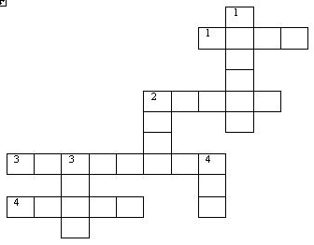
Crosswords
Down Across
1. A young cat (kitten). 1. Cats like to eat it (fish)
2. Cats like to do it at night (hunt). 2. Cats like their … (homes).
3. Cats like to drink it (milk) 3.Cats are … animals (domestic).
4. A domestic animal (cat) 4. Cats like to do it during a day (sleep).

Slide 11
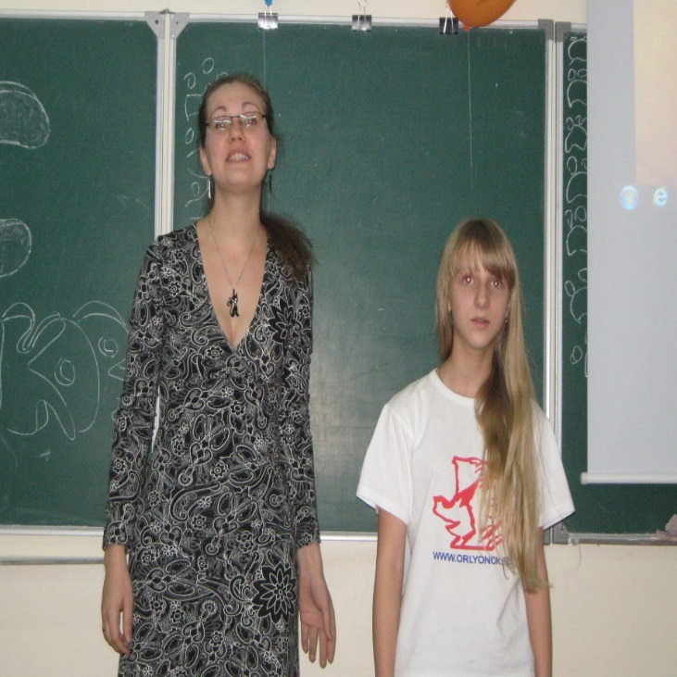
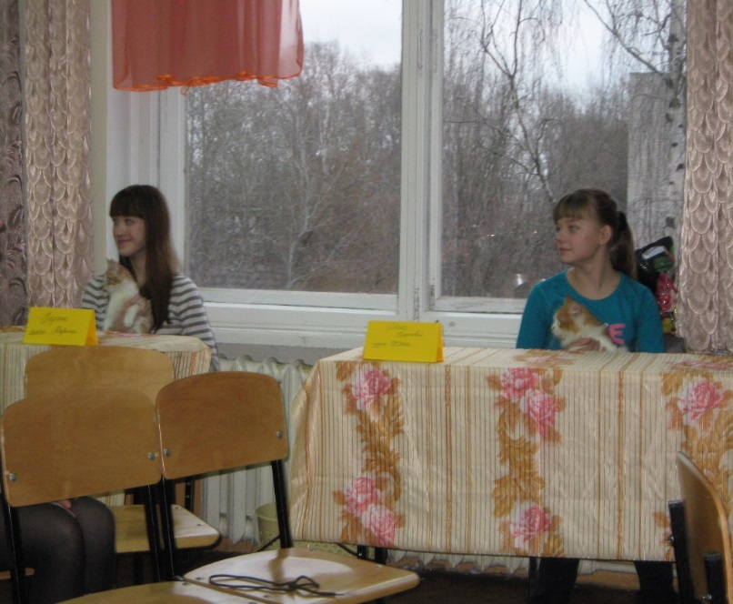
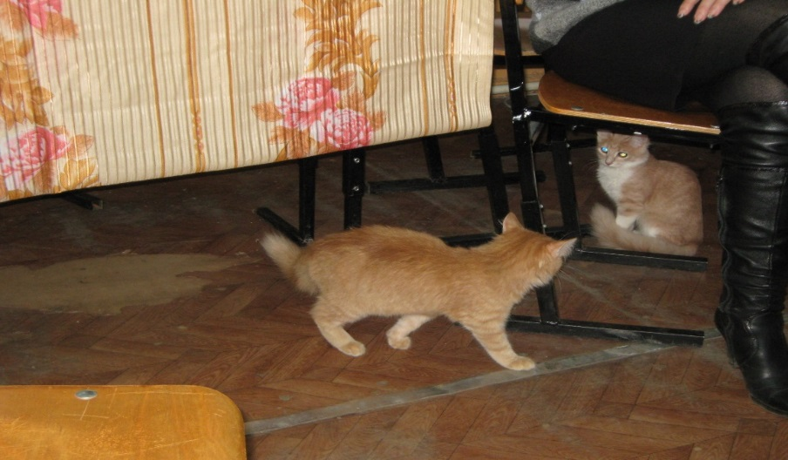

Slide 12
Love your pets, care about them and never throw them away! We are responsible for these pets, whom we tamed!!!

Slide 13
Thank you for attention!

