Slide 1
Writing Skills Greetings cards

Slide 3
Hi Matthew,
Happy birthday! Cheers for inviting me to your party next week! I’ll definitely come! Can’t wait to see you all!
Love,
Paul

Slide 4
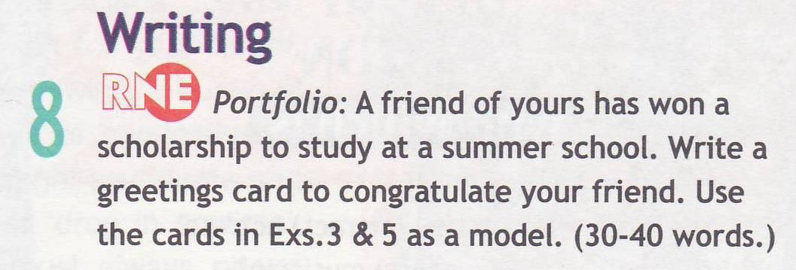

Slide 5
Dear Kira,
Congratulations on winning the summer school scholarship! I’m sure you’ll enjoy studying and living in London. Best of luck with everything!
Love,
Sarah

Slide 6
A friend of yours has bought a new car. Write a greetings card to congratulate your friend. Write 30-40 words.
A friend of yours has a new job. Write a greetings card to congratulate your friend. Write 30-40 words.
A friend of yours is in hospital. Write a card to your friend. Write 30-40 words.

