Slide 1
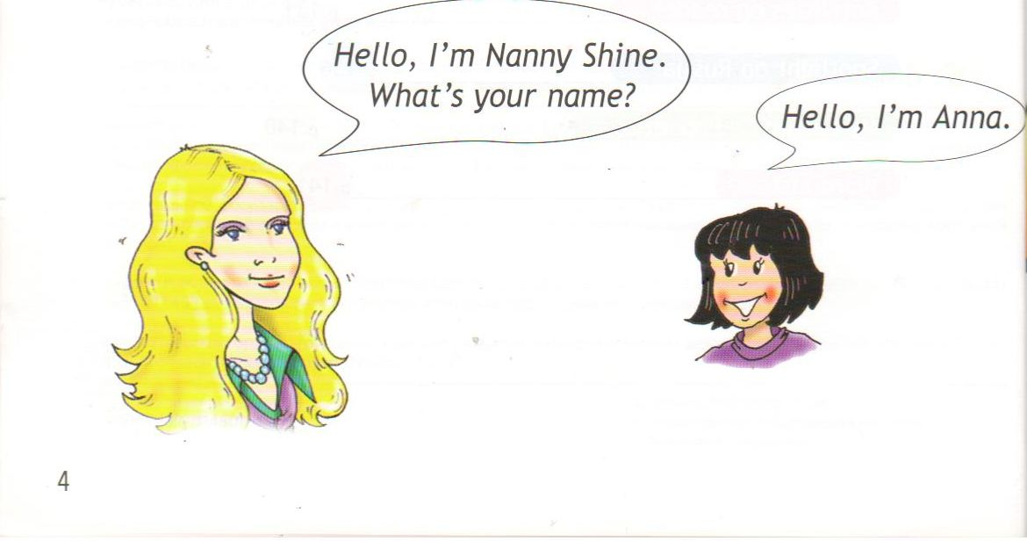
Hello. Nice to meet you

Slide 3
Look at the questions and find the answers in the text
1. What is the girl s name?
2. How old is she?
3. When was she born?
4. How large is her family?
5. Does she have brothers or sisters?
6. What are her father and mother?
7. What is her favourite subject at the college?
8.What music does she like to listen to?

Slide 4
Read the numerals
6 | 15 | 47
12 | 28 | 63
10 | 19 | 36
38 | 52 | 87
25 | 8 | 17
43 | 59 | 86

Slide 5
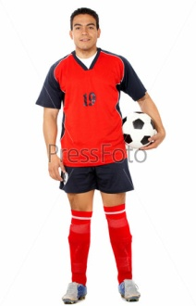
Look and match the pictures with the descriptions
a) b) c)
A few words about myself. I am Ann. I am 16. I am a student. I am rather slim. My hair is dark and long. I have brown eyes. I am a happy and an optimistic person. I like watching films, reading detective stories. When I have free time I usually go to the cinema or read.
Let me introduce myself. My name is Nick. I am 17. I am at 11-th grade. I have an elder brother and a younger sister. My mum is 40, she works for newspaper. My dad is 44, he is an engineer. I go in for sports. I play football and take part in different sports competitions.
Hello. I am Julia. I was born on the 22-nd of May. I am slim with curly blond hair. I am very kind and cheerful at all times. I like to listen to music. I prefer classical music and can play the piano. My favourite composer is Tchaikovsky.

