Slide 1
“
Research work in
Senior School
26.11.2014
Dubrovskaya I.V.

Slide 2
“
Why?
«And will you succeed?
Yes indeed, yes indeed! Ninety-eight and three-quarters percent guaranteed! » Dr. Seuss
Modern Society
School
Life Skills

Slide 3
What ?
Research

Slide 4
What kind of?
set a problem
Research
investigate
present

Slide 5
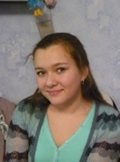
Who?

Slide 6
How?
an interrogative form of the theme
public speech
reading for the gist
written reports
group work
brainstorming
feedback
search for information

Slide 7
What for?

