Slide 1
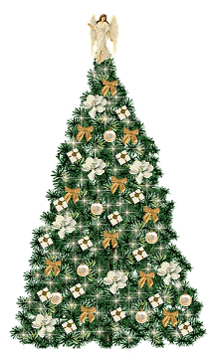

Slide 3
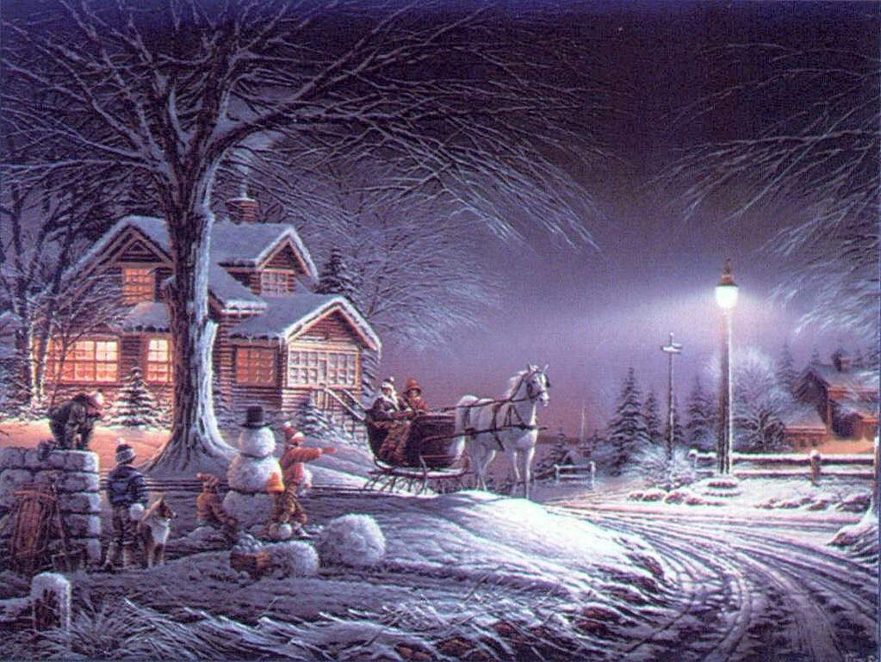

Slide 5
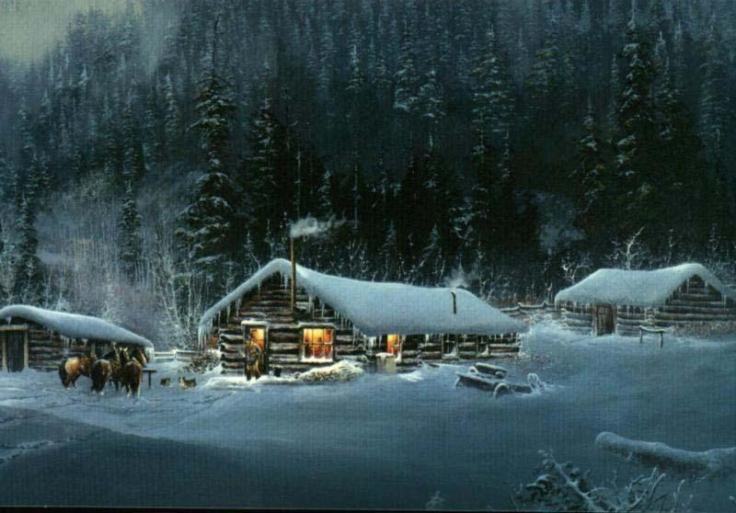
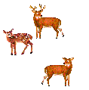

Slide 8
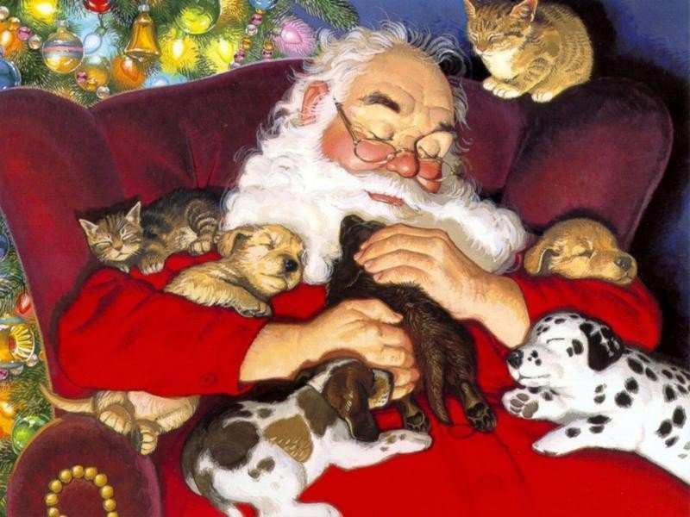

Slide 9
MERRY CHRISTMAS!
HAPPY NEW YEAR 2011!
HAPPY NEW YEAR 2010!

