Slide 1
1. Книгопечатная продукция
Creating a cabinet of English at a modern level in accordance with the requirements for technical and content filling the federal component of the state standard of general education require large capital investments.

Slide 2
Interior Design

Slide 3
Practice shows that learning a foreign language in a specialized study, students learn better in all aspects of the subject. They demonstrate a high level of all types of speech activity, they have increased the interest and motivation to master the language, since it is possible to introduce into the pedagogical process modern teaching aids, information and communication and computer technology, use of Internet resources.

Slide 4
Cabinet equipped with English language training furniture, office withstand rigorous design in bright colors of walls and furniture, to create a comfortable climate and psychological comfort. There are themed stands, the UK and U.S. maps, videos, training kits, grammar tables, themed paintings, supplementary literature for home reading, electronic manuals and encyclopedias on multimedia carriers, dictionaries, creative works of students.

Slide 5
is one of the most important components of foreign language study.
Desks should be comfortable for students.
School board should be spacious and to have magnetic surface.
All books and training manuals must be stored in special cupboards or bookshelves.
In the study have to be a few plants to create a pleasant atmosphere.

Slide 6
Each office should have basic standards for foreign language education.
Literature for home reading.
Additional manuals that can help in learning.
Aids to prepare for the exam in English language.
Dictionaries (English-Russian, Russian-English, linguistic and regional studies: U.S., UK)

Slide 7
Alphabet.
Grammar tables (for 5-9 grades).
Maps of English speaking countries.
Flags.
Photos of attractions and historical sites.
Thematic Pictures.

Slide 8
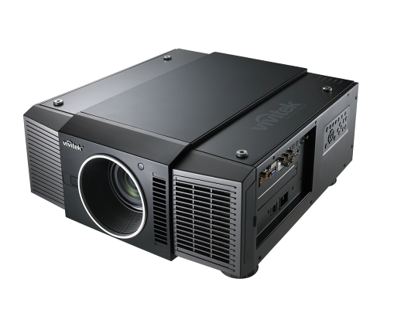
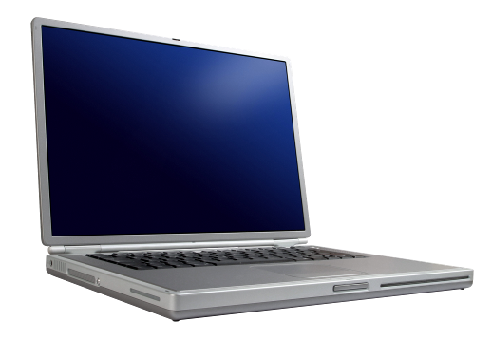
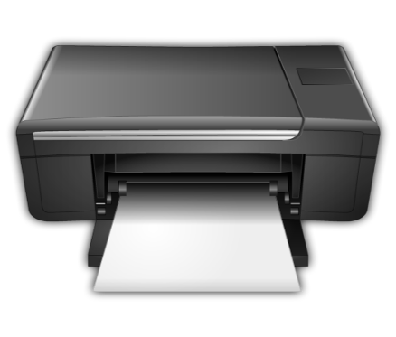
For successful learning a foreign language needs cabinet equipped with modern technical devices. Each study is recommended to have:
Computer or a laptop
Projector
Magnitofon for playing old records that are not supported by the computer.
Printer

