Slide 1
Schools of my parents
Schools of my mum:
School №17(Feodosia, Crimea)
School №13(Feodosia, Crimea)
School №35(Vorcuta)
School of my dad:
School №51(Leningrad)

Slide 2
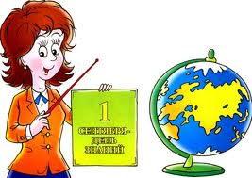
First teachers
Father’s first teacher:
Valentina Aleksandrovna
Mother’s first teacher:
Serafhima Gennadievna

Slide 3
Favorite teachers of my parents
Father’s favorite teacher:
Shumilova Zenoida Iliinichna(math teacher; form-master)
Mother’s favorite teacher:
Lyudmila Aleksandrovna (Russian language,
literature teacher)

Slide 4
Favorite subject
Father’s favorite subject:
Physics(Sofia Ivanovna)
Mother’s favorite subject:
History

Slide 5
Unloved subject
Father unloved subject:
Russian language(Lidia Ivanovna)
Mother unloved subject:
Physics(Vladimir Ivanovich). It is the only four in the school certificate!

Slide 6
If they liked to go to school
Father-YES
Mother-YES

Slide 7
If they liked doing homework
Father-No
Mother-YES

Slide 8
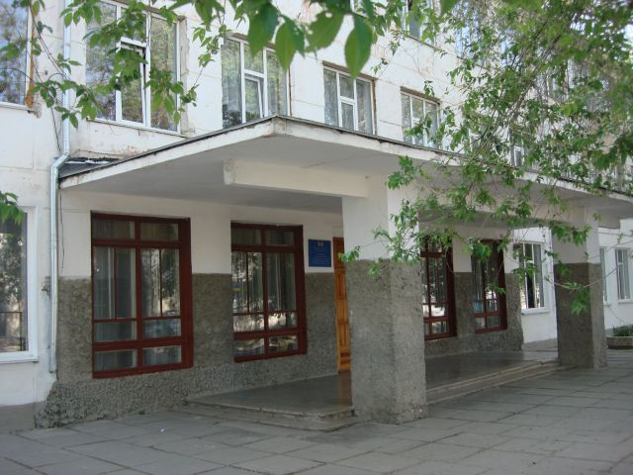
Фотографии школ
Father’s school
Mother’s school

Slide 9
Thanks for attention!

