Slide 1
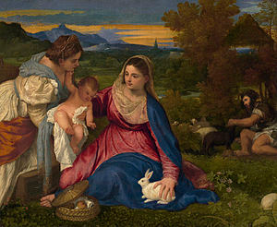
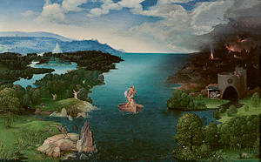
Landscape painting
The word "landscape" entered the modern English language as landskip (variously spelt). Landscape painting, also known as landscape art, describes natural scenery such as mountains, valleys, trees, rivers, and forests. It developed at European art in the 17 centure. Sky is almost always included in the view, and weather is often an element of the composition. Joachim Patinir (1480-1524) He was a Flemish Northern Renaissance history and landscape painter who pioneered the "world landscape" type of view.
Titian, La Vierge au Lapin à la Loupe (The Virgin of the Rabbit), 1530, Louvre, Paris. Idealized Italianate landscape background.
Joachim Patinir (1480-1524), Landscape with Charon Crossing the Styx, 1515-1524, oil on wood, Prado.

Slide 2
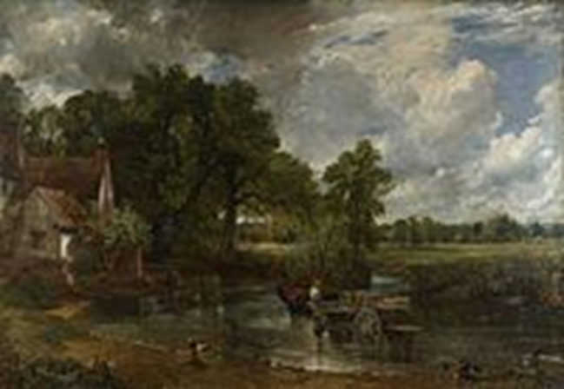
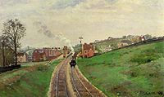
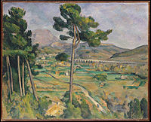
History
Camille Pissarro, Lordship Lane Station, c. 1870. Impressionism
John Constable, 1821, The Hay Wain. Early Romanticism
Paul Cézanne, Mont Sainte-Victoire, 1882-1885, Metropolitan Museum of Art. Post-Impressionism
Ivan Aivazovsky, 1863, The Caucasus. Late Romanticism

Slide 3
History
The earliest forms of art around the world be called landscape.The mountains, trees or other natural features are included. The earliest "pure landscapes" with no human figures.
Both the Roman and Chinese traditions typically show grand panoramas of imaginary landscapes, generally backed with mountains – in China often with waterfalls and in Rome often including sea, lakes or rivers.

Slide 4
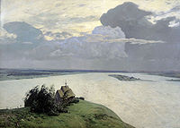
Isaac Levitan and Ivan Shishkin opened the beauty of our earth for us. Landscape is a poetry and a musical painting.
Ivan Shishkin, Rain in an Oak Forest, 1891, Russian Landscape painter
Isaac Levitan, Above Eternal Peace, 1894

Slide 5
Western tradition. Medieval.
During the 14th century Giotto di Bondone and his followers began to study nature in their work, introducing elements of the landscape as the background setting for the action of the figures in their paintings.
Artists were often solving the problem by showing a landscape background from over the top of a parapet or window or reproducing effects of light.

Slide 6
Renaissance
Landscape backgrounds for various types of painting became increasingly prominent and skilful during the century.
The Italian development of graphical perspective was now known all over Europe, which allowed large and complex views to be painted very effectively.

Slide 7
17th and 18th centuries
The popularity of exotic landscape scenes can be seen in the success of the painter, who spent the rest of his life painting Brazilian landscapes.
The Romantic movement pure landscapes became more common.
Painted landscape watercolours developed.

Slide 8
19th and 20th centuries
The Romantic movement intensified the existing interest in landscape art, and remote and wild landscapes, which had been one recurring element in earlier landscape art, now became more prominent.
In the 19th century, as other nations bigan to develop national schools of painting.

Slide 9
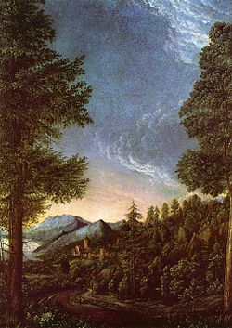
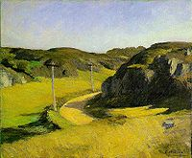
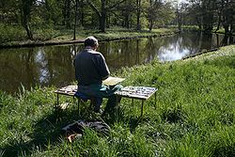
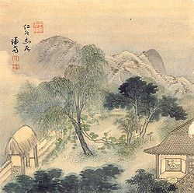
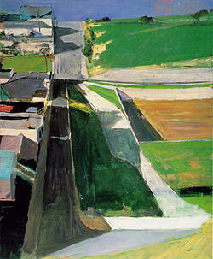
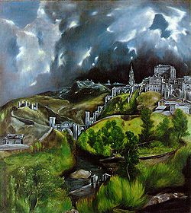
Landcape painting

