Slide 1
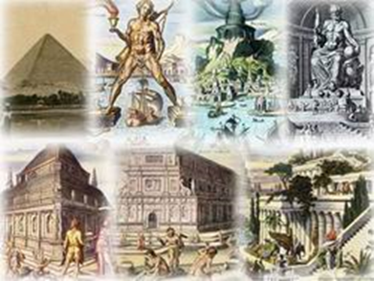
“Seven Wonders of the world” Presentation on Art
Выполнен Комендантовой Н.Г.
Учителем по английскому языку высшей квалификационной категории

Slide 2
Seven wonders of the world - this is the most famous monuments of ancient sculpture and architecture in the world. They are described by ancient historians and travelers, including the "father of history" Herodotus in his "History” Questions about the seven wonders of the world are very common in quizzes and crosswords, but not everyone remembers all seven facilities. Try to refresh the information and remember all the 7 wonders, as well as look at each of the wonders in more detail.

Slide 3
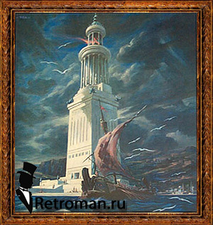
Lighthouse of Alexandria

Slide 4
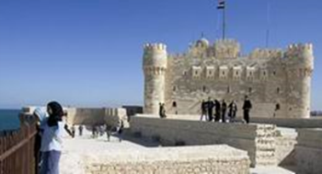
In Alexandria - Egypt's new capital, founded in 332-331 BC Alexander the Great had built the majestic palace, parks and gardens. It houses the tomb of Alexander the Great, Museion - establishment of the temple of the Muses, where they lived, scientists and poets, the famous Library of Alexandria, which holds nearly 500,000 scrolls. In Alexandria lived famous mathematicians (Euclid), scientists, doctors, astronomers. It was a major cultural center of the time. There's also a safe approach for the courts to the city was built by the architect Sostrata Lighthouse of Alexandria (c. 280 BC).Huge three-storey tower was 120 m on the eastern shore of. Pharos. On the wall of the lighthouse was carved inscription: "Sostratus son Deksifana of Knidos, dedicated to the god-saviors for sailors."Rectangular in plan first floor, built of large limestone slabs (length of each wall - 30.5 m) was oriented to the cardinal. Second floor - an octagonal tower, lined with marble slabs - was oriented toward the eight major winds. This part of the lighthouse decorated bronze statues, some of which were weather vanes pointing in the direction of the wind. Third floor-lantern was round, ended with a dome on which stood a bronze statue of Poseidon (Zeus), a height of about 7 m dome rests on the granite columns. There was a fire beacon whose light amplified by reflecting it in the system metal concave mirrors, and was visible from afar. Fuel for the fire brought up saddled donkeys on a screw, shallow stairs. Lighthouse also served as a fortress, where there was a large garrison, observatory to detect the enemy, in an underground tank was part of the drinking water in case of siege.

