Slide 1
КВН по английскому языку

Slide 2
Hello! My name is Jason!
I am glad to see you. Today we are playing KVN. I think you don`t know English language. There are 12 tasks. I wish you success!

Slide 3
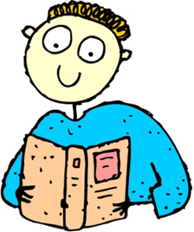
I think you have forgotten English alphabet.
My first task is writing words in alphabetical order:

Slide 4
Let`s check:
1) apple 9) ice 17) queen
2) bed 10) jam 18) right
3) chocolate 11) kiss 19) send
4) dear 12) last 20) table
5) end 13) mother 21) union
6) flower 14) name 22) vase
7) garden 15) orange 23) work
8) holiday 16) present 24) xylophone
25) you
26) zoo

Slide 5
My second task is finding of missing letter

Slide 6
B D K Y

Slide 7
Children I am sure you know alphabet but I think you don`t know sounds.
3 ЗАДАНИЕ
Aa [di
:
]
Ff [waɪ]
Mm [ju:]
Qq [eɪ]
Gg [bi
:
]
Dd [em]
Yy [ef]
Jj [dӡi
:
]
Bb [kju
:
]
Uu [d
ӡ
eɪ]

Slide 8
Let`s check:
Aa [di
:
]
Ff [waɪ]
Mm [ju
:
]
Qq [eɪ]
Gg [bi
:
]
Dd [em]
Yy [ef]
Jj [dӡi:
]
Bb [kju
:
]
Uu [dӡeɪ]

Slide 9
Now, children,
say antonyms:
sister old yes black short father hello small up white bad goodbye girl can good hello no new long brother big mother can’t down no boy short

Slide 10
black – white long – short
yes – no father - mother
up – down no – yes
hello – goodbye happy – sad
small – big can – can’t
good – bad girl – boy
new – old sister – brother

Slide 11
The next task is
to paint the picture

Slide 12
Let`s check:

Slide 13
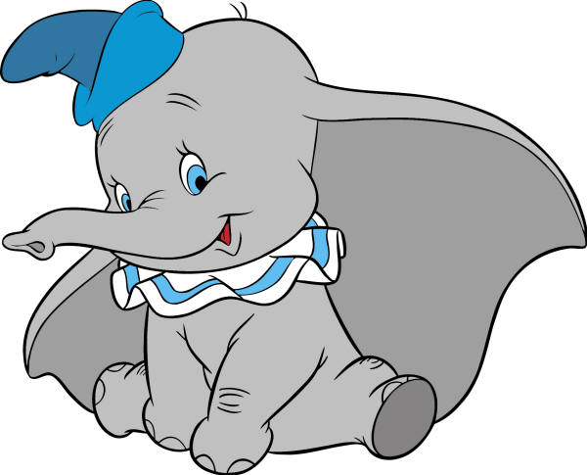
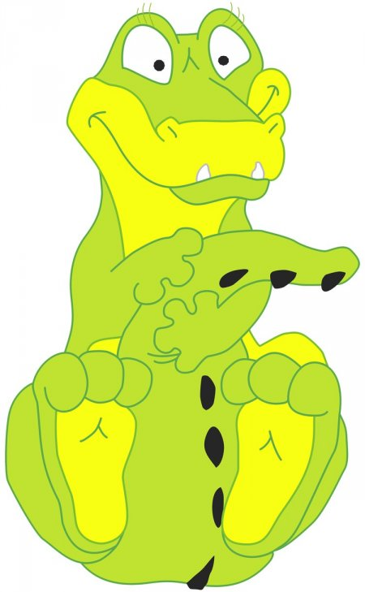
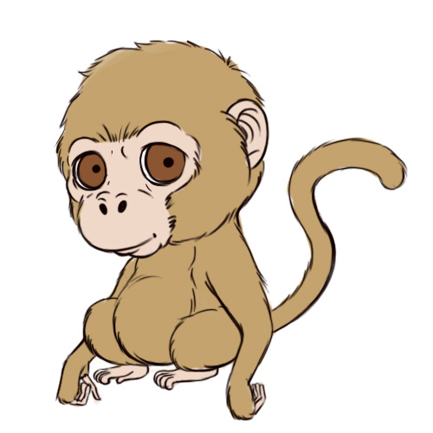

Slide 14
I like labyrinths. The next task is writing a phrase.
N
S
V
I
T
I
H
K
S

Slide 15
This is KVN

Slide 16
We can`t manage without verbs. My next task is finding verbs:

Slide 17
RUN WASH SING
SIT GO WRITE
EAT DO READ
PLAY

Slide 18
Now make sentences:

Slide 19
I usually watch TV on Sunday.
She always plays the piano at home.
We often cleans his teeth in the morning.
He doesn`t read fairy-tales to my sister.
It`s time to go to bed.
He likes jam, cakes, sweets.

Slide 20
Now you have to find 9 animals in the crosswords:
e | s | g | s | a | a | s | c | a | t
r | m | i | a | p | i | g | s | s | r
h | o | r | s | e | d | e | s | c | d
u | u | a | a | d | g | l | i | o | n
o | s | f | t | i | g | e | r | c | d
o | e | f | r | o | g | p | y | k | s
y | h | e | n | o | o | h | r | u | r
w | f | i | s | h | g | a | y | i | z
d | o | g | q | m | o | n | k | e | y
c | f | e | e | u | y | t | h | m | n

Slide 21
e | s | g | s | a | a | s | c | a | t
r | m | i | a | p | i | g | s | s | r
h | o | r | s | e | d | e | s | c | d
u | u | a | a | d | g | l | i | o | n
o | s | f | t | i | g | e | r | c | d
o | e | f | r | o | g | p | y | k | s
y | h | e | n | o | o | h | r | u | r
w | f | i | s | h | g | a | y | i | z
d | o | g | q | m | o | n | k | e | y
c | f | e | e | u | y | t | h | m | n

Slide 22
I want to know how well you Know the Present Continuous Tense.
Run, sleep, eat, get up, I am, wash, go, he is, dance, sing, read, they are, write, we are, she is, do, sit.
Например: He is sleeping. (Он спит)

Slide 23
I am washing.
He is sleeping.
They are dancing.
She is running.
We are writing.
I am going.

Slide 24
Dear children, now I see that you know English very well. You are good pupils.
Thank you for your hard work.
See you again.
Good Bye.

Slide 25
Good for you!

