Slide 1
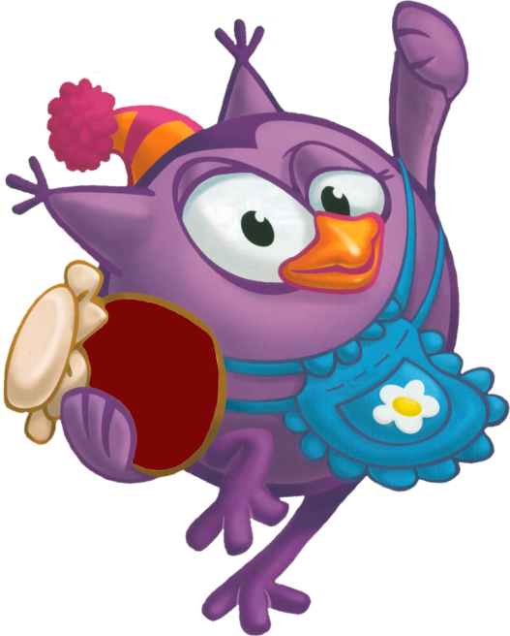
Good morning, dear boys and girls! Good morning, good morning! Good morning to you! Good morning, dear children!

Slide 2
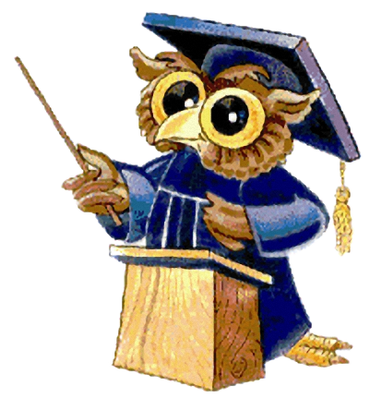
1. He is the father of your father. 2. She is the sister of your father. 3. She is the mother of your sister. 4. She is the daughter of your mother. 5. He is the brother of your mother. 6. American “father”.

Slide 3
g r a n d f a t h e r
a u n t
m o t h e r
s i s t e r
u n c l e
d a d d y

Slide 4
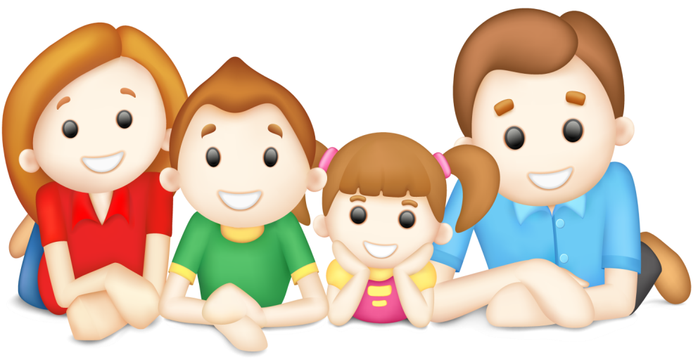
«Family»

Slide 5
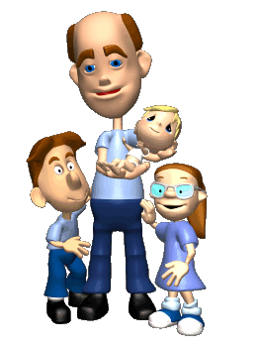
[f] family, fine, father, grandfather; [m] mother, grandmother; [a:] father, grandfather; [Λ] mother, grandmother, brother; [ı] family, sister;

Slide 6
-Have you got a family? -Yes, I have. -Have you got a mother/a father/a sister/a brother/grandparents? -Yes, I have got a mother/a father.

Slide 7
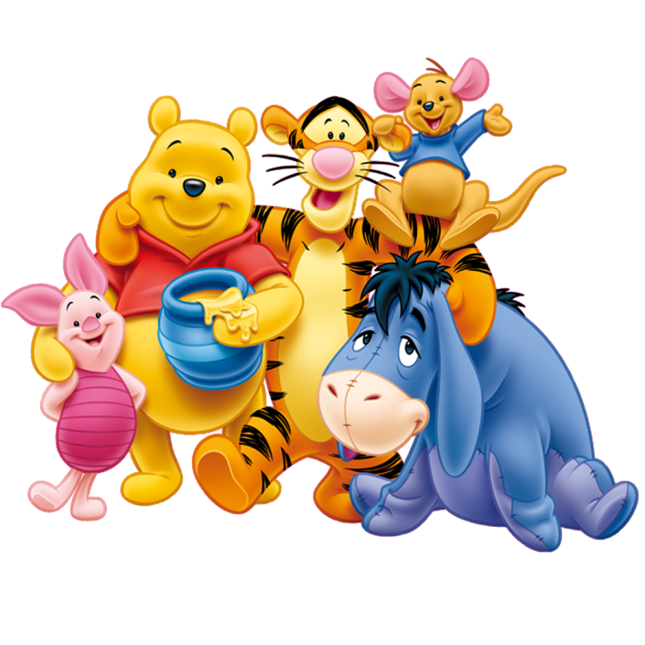
Sister, brother, car, mother; Father, mother, son, aunt; Parents, brother, friends, uncle; Grandmother, grandfather, sister, mother.

Slide 8
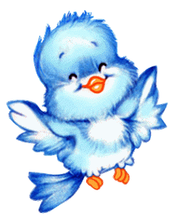
Sister, brother, car, mother; Father, mother, son, aunt; Parents, brother, friends, uncle; Grandmother, grandfather, sister, mother.
Very well!

Slide 9
A Letter Dear friend, This is Mary. She is my friend. She is twelve. This is her little brother Jack and her sister Jane. Peter and Helen are the children’s parents. Their mother, Helen, is thirty-five years old. And their father, Peter, is thirty-eight years old. Mary and Jane are daughters and Jack is their son. Mary’s mother has a sister, Judy. She’s the children’s aunt. Mary’s father has a brother. His name is Robert and he is Mary’s uncle. Love, your Kate

Slide 10
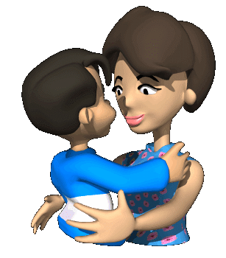
Family I have a father, I have a mother, I have a sister, I have a brother, Father, mother, Sister, brother Hand in hand With one another.

Slide 11
My Mother Who said «Good night» When I was a child? My Mother. Who dressed my dolls in clothers so gay And showed me often how to play? My Mother. Who ran to help me when I fell? My Mother. Who sits at my head when I am in bed? My mother.

Slide 12
Home work: Your homework is to draw your family.

Slide 13
I hope that we always will be great friends.
And everyone must have your own family.

