Slide 1
Презентация
к уроку по теме
”Health and Body Care”
5 класс
УМК Верещагина И.Н.
Афанасьева О.В.
Учитель Хардыкайнен И.А.

Slide 2
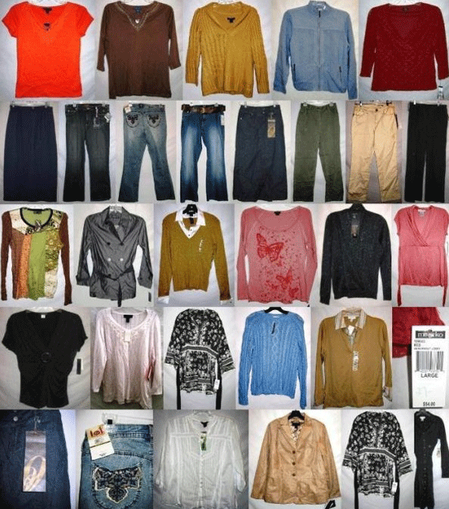
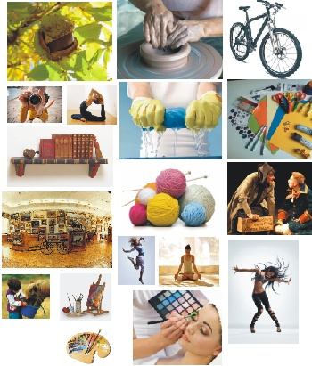
Say Compliments!!!
Clothes
Hobbies

Slide 3
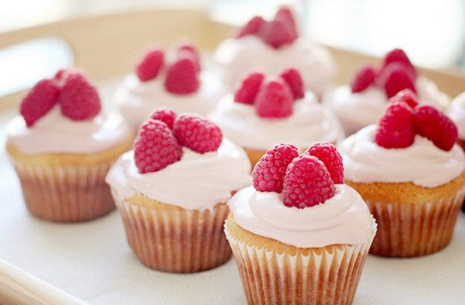
People, Tastes

Slide 4
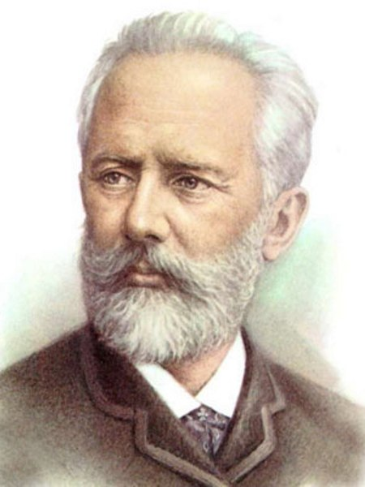
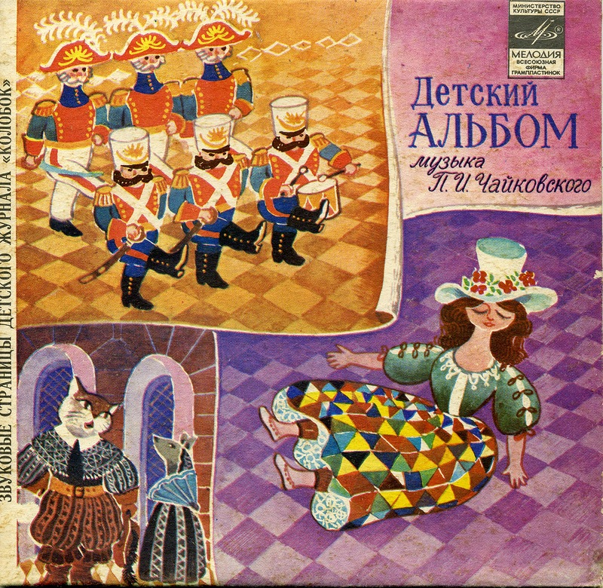
Who is this man? (The child`s album. The doll is ill.)
What is the topic of our lesson?

Slide 5
Health and Body care

Slide 6
What parts of the body do you know?

Slide 7
3.Make up good expressions: pain, temperature, pressure, medicine, bad, pulse, A
blood, pain
_____________ cough
______________pressure
To take blood_____________
To have a__________________
To take __________________
To feel the _______________
To feel some _____________
To take__________________

Slide 8
Check up
3.Make up good expressions: pain, temperature, pressure, medicine, bad, pulse, blood, pain
A bad cough
Blood pressure
To take blood_pressure
To have a pain
To take temperature
To feel the pulse
To feel some pain
To take medicine

Slide 9
Think of the Definition
A chest
A lung
A cough
To cough
Regular
Regularly means
Touch,
Immediately
To hurt
A pain
Silly

Slide 10
Make up sentences
A chest is the upper front part of the body
A lung is one of the two organs of breathing in the chest
To cough means to force air from the lungs with a sudden sound.
Regular means usual, unchanging
Regularly means in the regular manner.
Touch means to put a hand or other part of the body on something.
Immediately means at once.
Silly means foolish

Slide 11
Is healthy food good for our health?

Slide 12
Quiz.
1. What is good to eat when we are ill? 2. What can happen to the people when they are ill?
3. What do people usually do when they are ill?
What does the doctor usually do when he/she visits the patient?

Slide 13
Describe the picture (You are a doctor)

Slide 14
Describe the picture
(You are ill)

Slide 15
R e f l e c t i o n
Tasks | + - ?
Dialogues
Definition
Parts of the body
Song
Quiz
Picture

Slide 16
How to fill in the table on reflection
If you are sure in your knowledge put +;
If you are not sure put ?;
If you don`t know put -.

Slide 17
Thanks a lot!!! Well Done!!!

